Slide 1
Attack of the evil mine craft
By Andrew

Slide 2
One day a chican was walking around the castle when he saw a weird green thing by the bushes .
.does he check it out
.or does he stay away for action from it

Slide 3
You walk by it look at it and then it turns red and blows with fire the warrior died

Slide 4
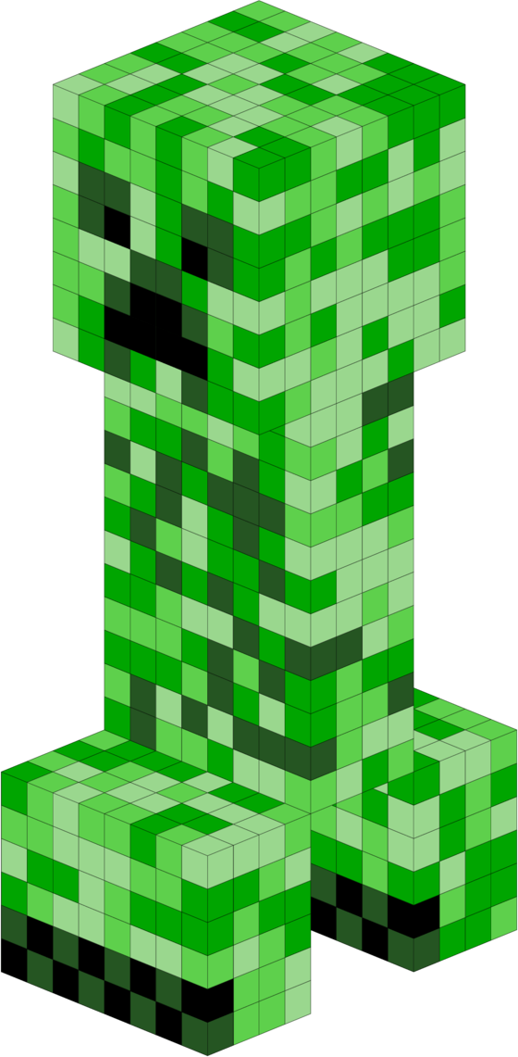
It starts walking then it blows up you run with a spear and kill it

Slide 5
Then more of them start coming straight at the warrior
. RUN
Go straight at them attack

Slide 6
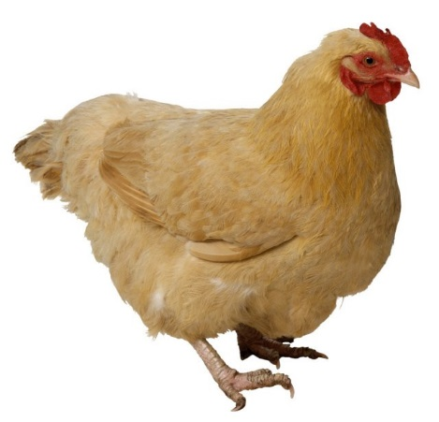
He runs straight away from them then he runs into a big spider you eat it and run you get a jet and fly away .

Slide 7
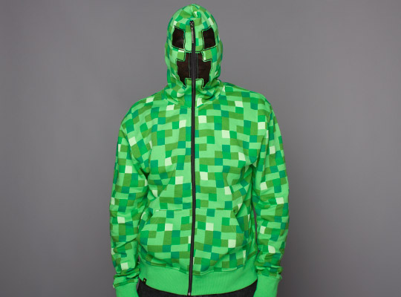
You run at them you kicked one at the other one it blew up them but behind him was one more it jumped on his head and blew him up you died

