Slide 1
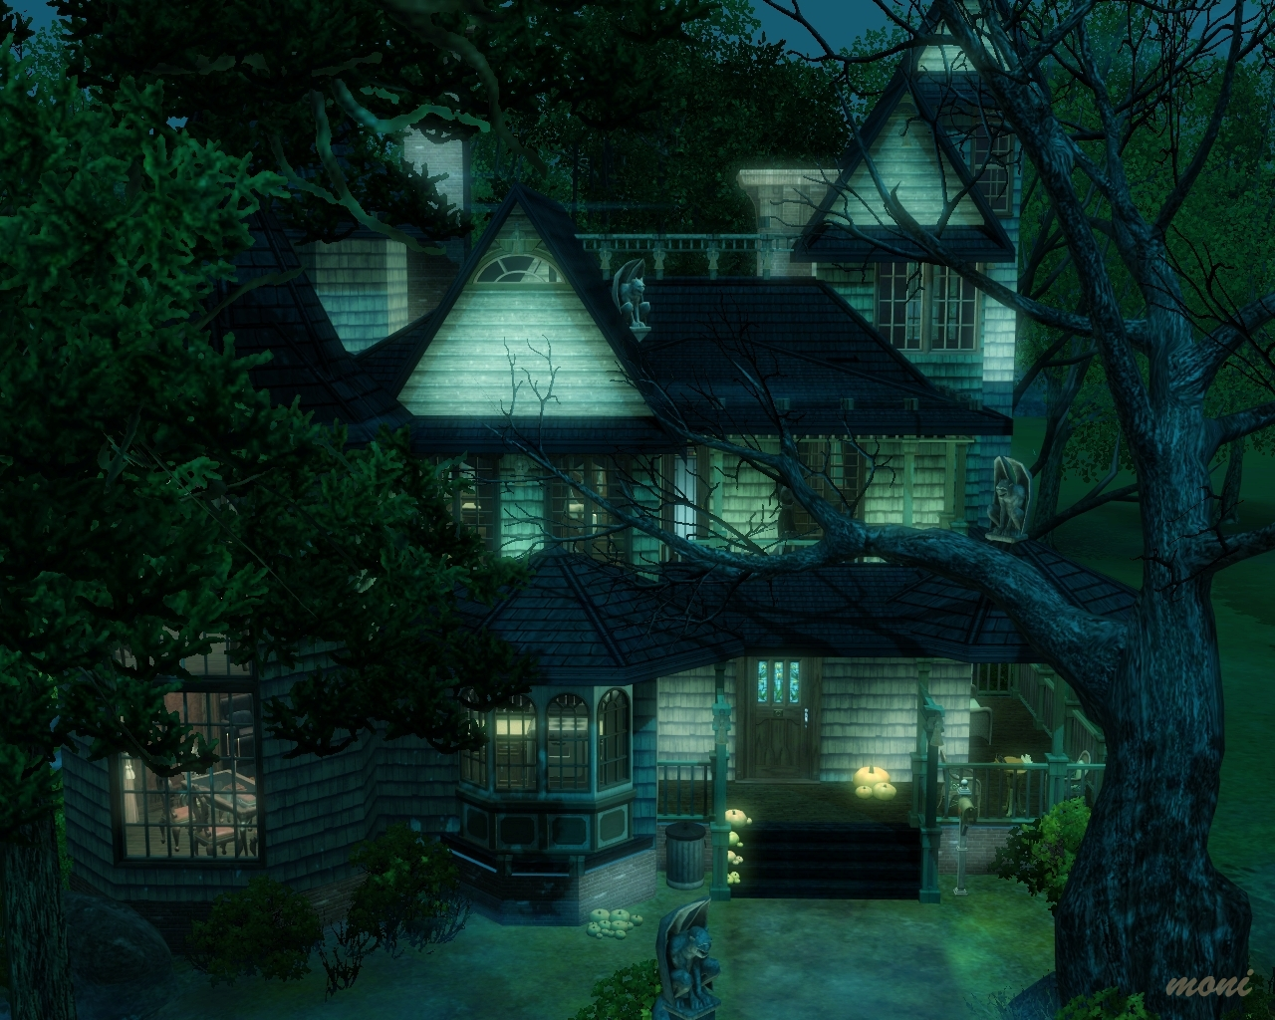
The Witches House
By Angelika

Slide 2
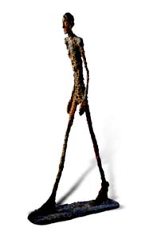
Moving Statues
I've been looking all over an this exit! WHER IS IT! Ugh. Its too dark
You hear foot steps.
1 Flip the light switch on.
2 run away.

Slide 3
Game Over
You got lost in the darkness. You were never heard of again. Soon cops arrived but they found no traces.
Restart

Slide 4
Familiar Face
You turn on a light and see a statue of a familiar person you met before.
That’s weird..
It gave you the creeps. You keep walking on.

Slide 5
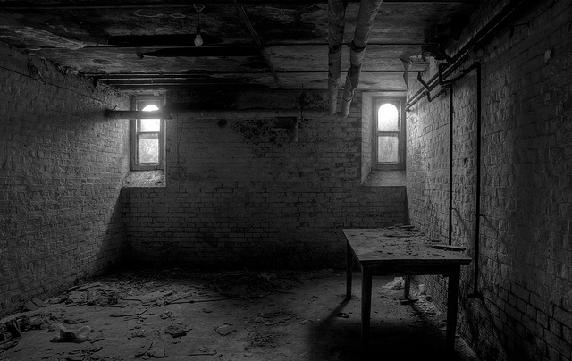
Dangers in the Basement
You hear the footsteps getting closer.
1.Hide in the locker
2.Grab an flashlight

Slide 6
Game Over
A creature was crawling on the floor and looking at you the lights suddenly turned off.
The last thing you heard was.. “Give it back please” Restart

Slide 7
RETURN
You grab the flashlight and use it. You flickered it on something but you didn’t know what. You see the exit.
1.Exit the house and run
2.Exit the house quietly

Slide 8
Fake End
You escaped! Fake end!

Slide 9
Real End
You heard a sound behind you. You looked back and saw the creature.” you cant have it back”. You chose to give it to me”. ”It’s mine now”.

