Slide 1
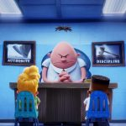
Captain Under Pants
By:Zakaria

Slide 2
Day Number One!!!
One In the

