Slide 1
Star Wars
By Ashbaal

Slide 2
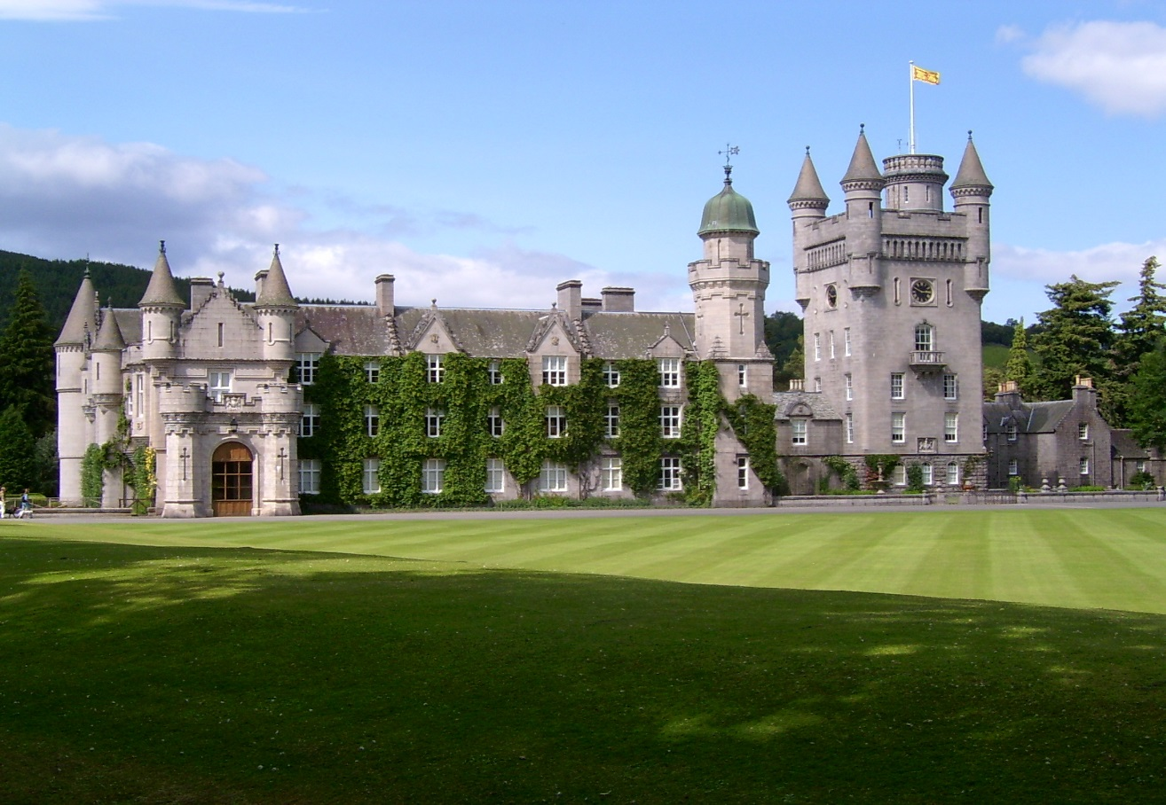
Our Story Begins…
One day our hero wakes up found in a mystery's castle in on a mountains called “The Jedi’s Castle”. What do you do?
Choice 1:run and hide
Choice 2:escape

Slide 3
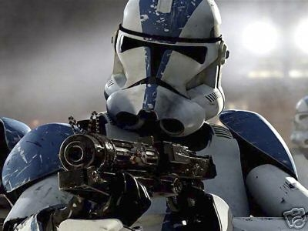
Choice 1
You run and hide and you get caught by a flame trooper
What do you do?
Choice 1:run out the window
Choice 2:hide

Slide 4
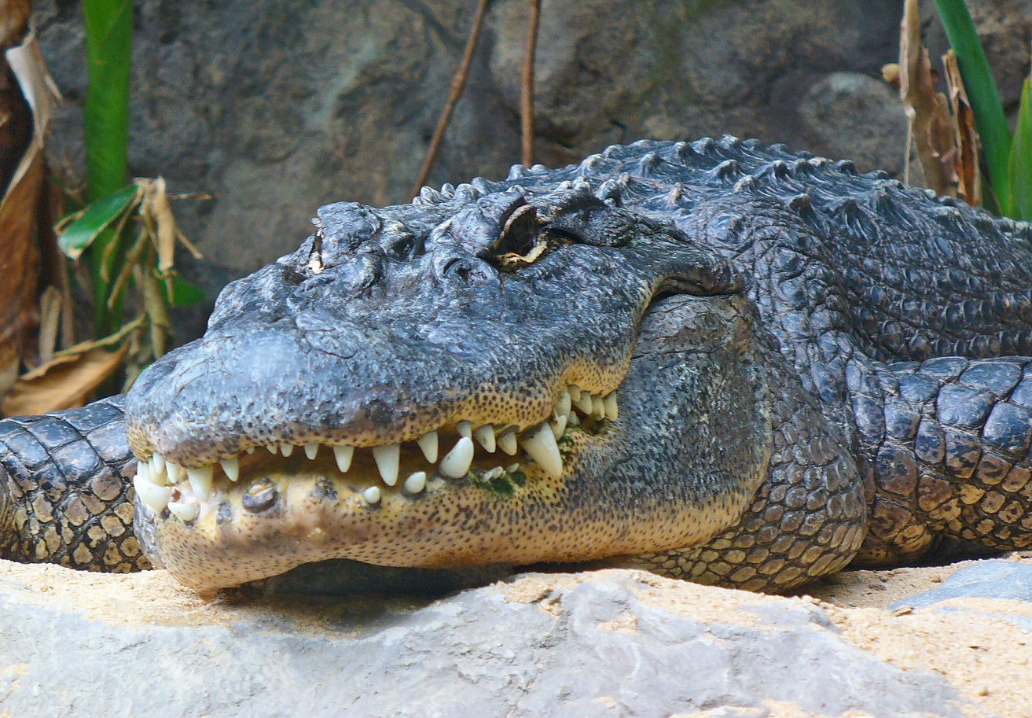
Choice 2
You escape the castle and you get eaten by an alligator
You lose!

Slide 5
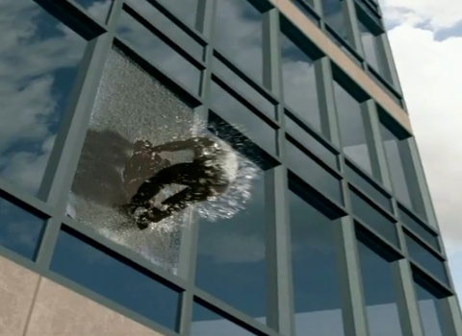
Run out the window
You runout the window and you escape
You win!

Slide 6
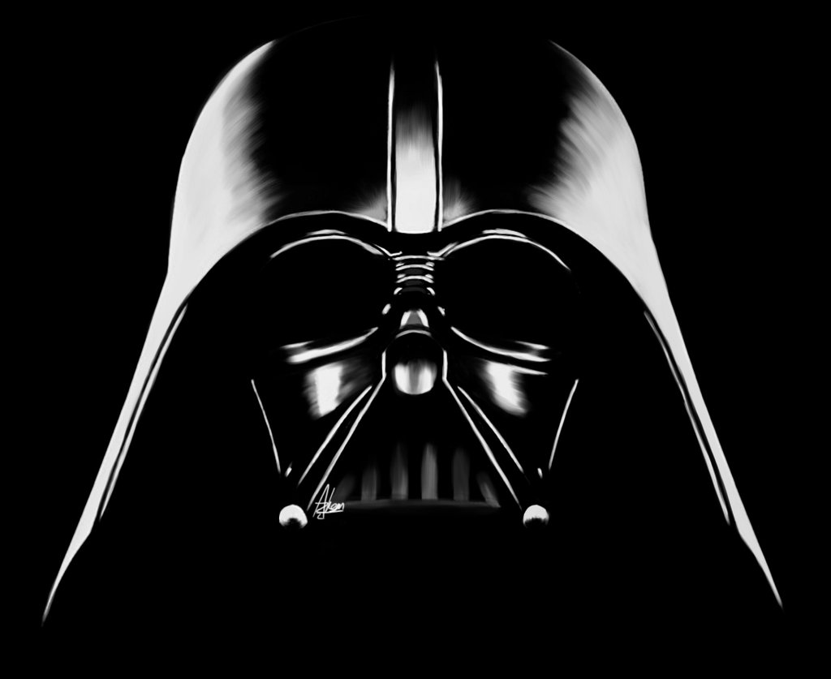
Hide
You hide and darth Vader caught you and stabs you with a light saber
You lose!

