Slide 1
An great advencuture story
By ayan.S

Slide 2

Story 1
Once upon a time in a land of flore a place of magic and wisards . Its called fairy tail.

Slide 3
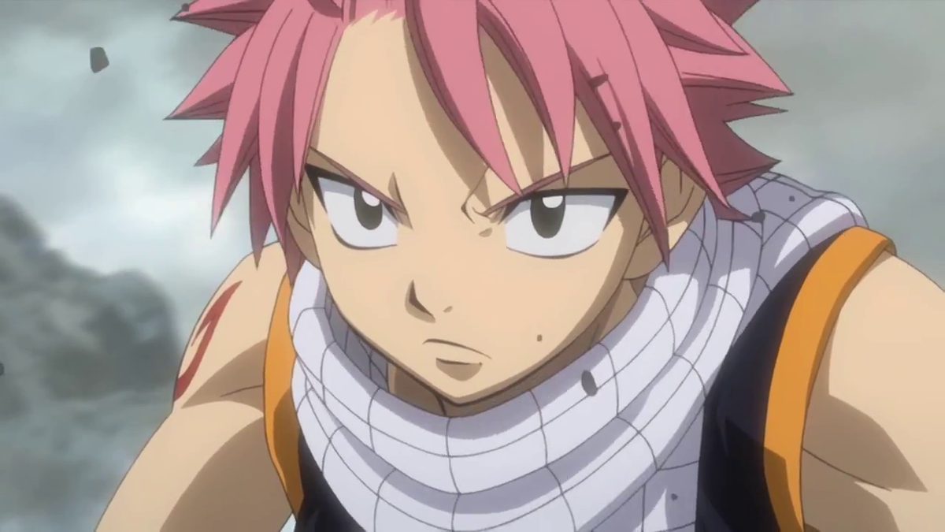
Story 2
As solomander and his friend cat . Well I don’t know his name. Were walking to fairy tail … they found this guy that was trying to inpress the other girls by

Slide 4
story

