Slide 1
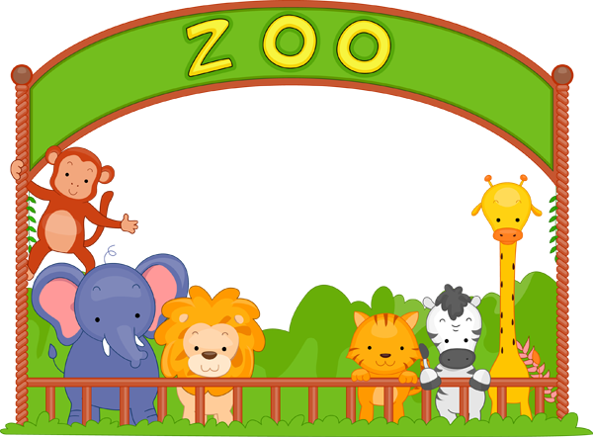
An Animal
By Ayan A

Slide 2
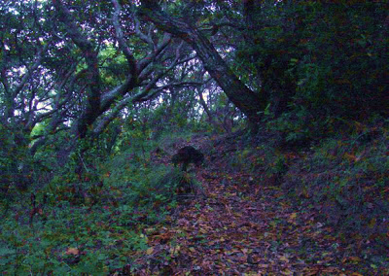
The noise
One day a girl heard a weird noise that did not sound familiar
Then…

Slide 3
Then the animal noise started coming closer and closer after it got so close the animal started to sound like a cow and a wolf howling at the same time.
The girl kinda saw the animal’s eye it was blue it looked like it was mad.
She saw all of the animal now not just the eye the animals face was a face that you can never imagine.

Slide 4
The animal got close and specked like a human then it was just a cow and a wolf standing together.
They both started running all of a sudden…

Slide 5
But then it wasn’t the animals talking it was…
A dragon!
Do you run away?
Or Fight back!

Slide 6
You win the dragon couldn’t find the girl!

Slide 7
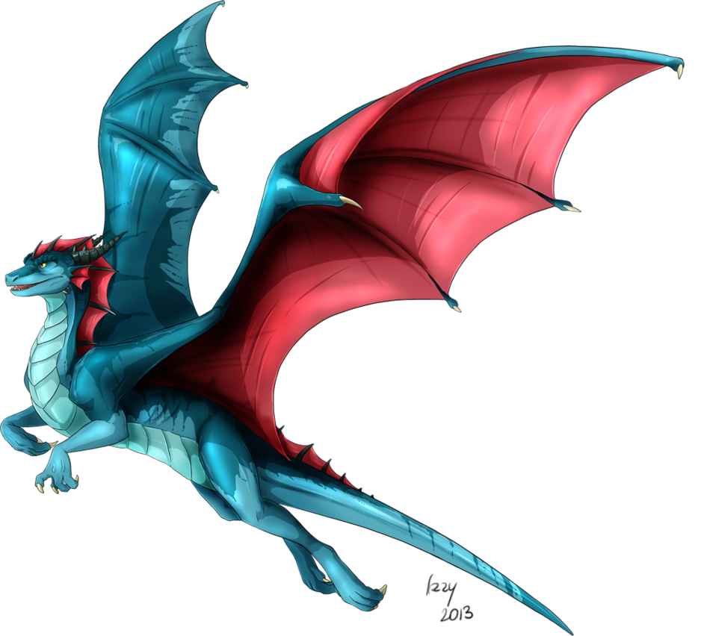
You lose The dragon found the girl and took her as a prisoner at his world

