Slide 1
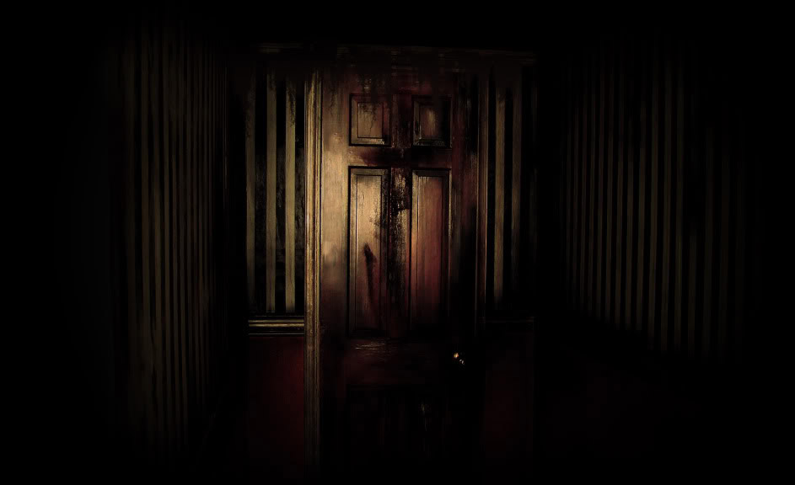
THE DOOR….
BY AYAN S

Slide 2
PATH 1
AS WENDY WAS SLEPPING SHE HEARD A CREEK FROM THE DOOR. . Would she go and open the door . Back to sleep

Slide 3
PATH 2
WHEN SHE WENT TO SLEEP SHE HEARD A SCREAM FOR THE DOOR .THEN SHE LOOKED SHE SAW this * would she run out of the house * OR KILL THE KILLER CLOWN

Slide 4
Run out of the house
As she was running out of the house she saw a creepy shadow from the trees since there was no one at the house she ran to her friends house she was hearing footsteps following her what would she do ? . She keep walking or . Or kill it

Slide 5
Keep walking
When she knocked the door at her friends house there was no one in there ?

Slide 6
Kill the killer clown
When she killed it and ran away what should she do ? Go back to her house stay there

Slide 7
PATH 3
WHEN SHE KILLED THE KILLER CLOWN … IT CAME BACK THE NEXT DAY WAS SHE WAS WALKING HOME AS USALLY SHE HEARD A EVIL LAUGH . WOULD SHE GO AND SEE IT . WOULD SHE KEEP WALKING

Slide 8
Would see go and see it

