Slide 1
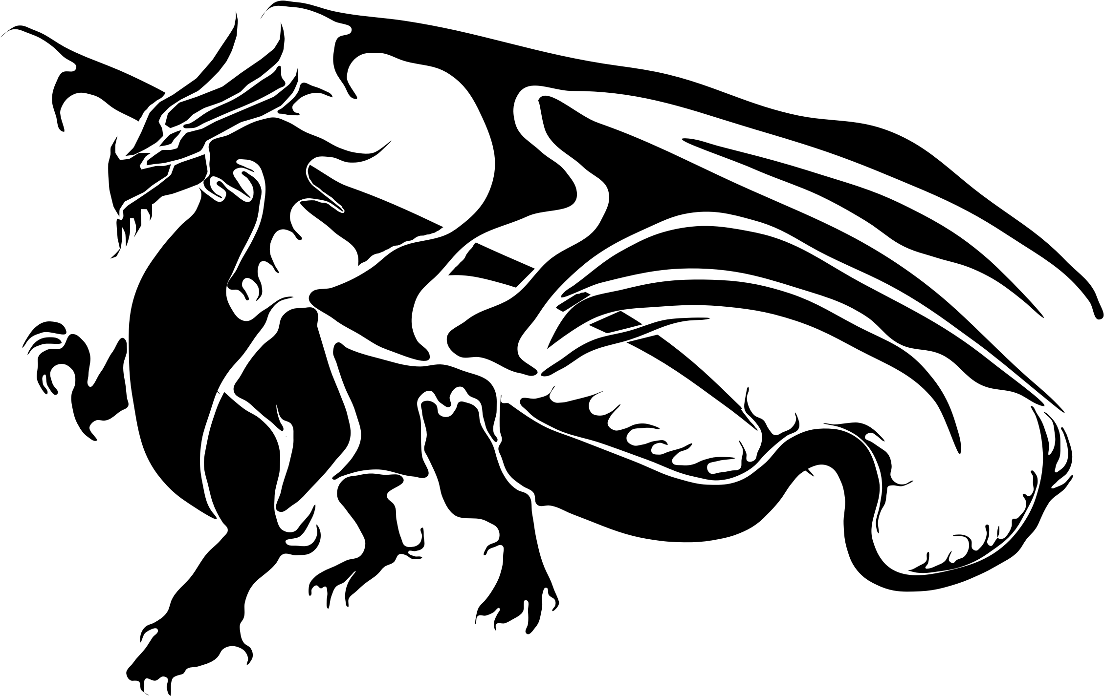
The Dragon slayer

Slide 2
Once upon a time
Once upon a time there was a dragon slayer who slayed many dragons but then………

Slide 3
You see a ginormous dragon
Call backup
Fight it of alone

Slide 5
You have a chance to ride it
Ride it
Get of

