Slide 1
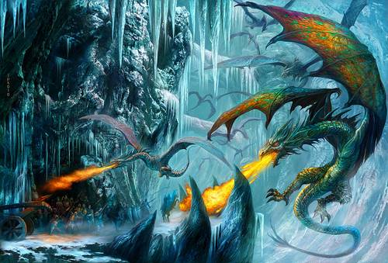
Battling the witch
Written by Hailey Taylor

Slide 2
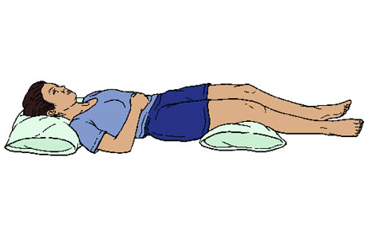
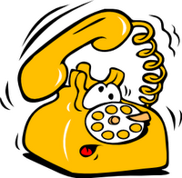
introduction
You wake up .it is midnight! your phone starts ringing like crazy.

Slide 3
what should you do?
You have two options.
1.answer your phone.
2.sleep through it.

Slide 4
answer your phone.
You answer your phone your boss says’ you are late!’ you say I didn’t no we had to be there at 1:00!
you rush to get your clothes on.
You get to your car. all of a sudden someone breaks the window!
You DIE!!
Try again

Slide 5
Sleep through it.
You wake up it is 7:00.
You throw some cloths on .
When you take one step out of your house…
All of a sudden you feel very hot.

Slide 6
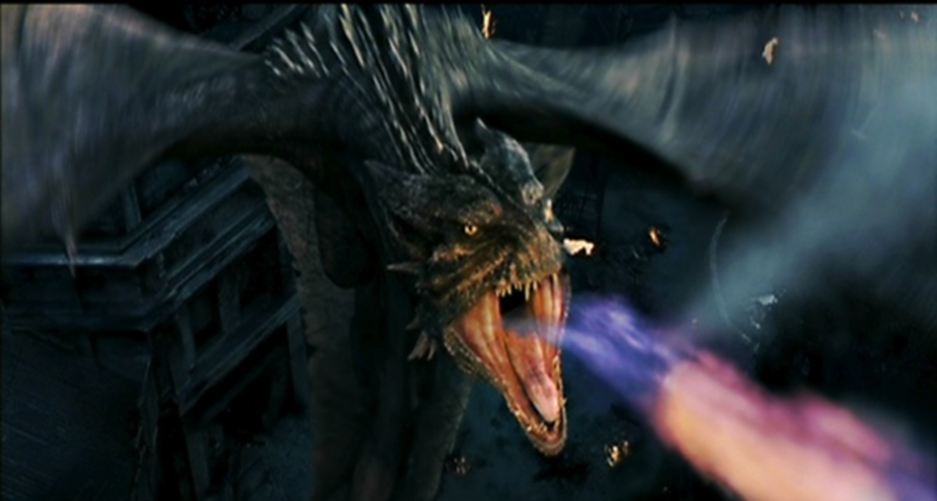
Catching on fire
You look up you see thousands of dragons in the sky.
You look down you are on fire!
Somehow a person was driving by and had a fire extinguisher with them.
They get out of their car and spray you out.

Slide 7
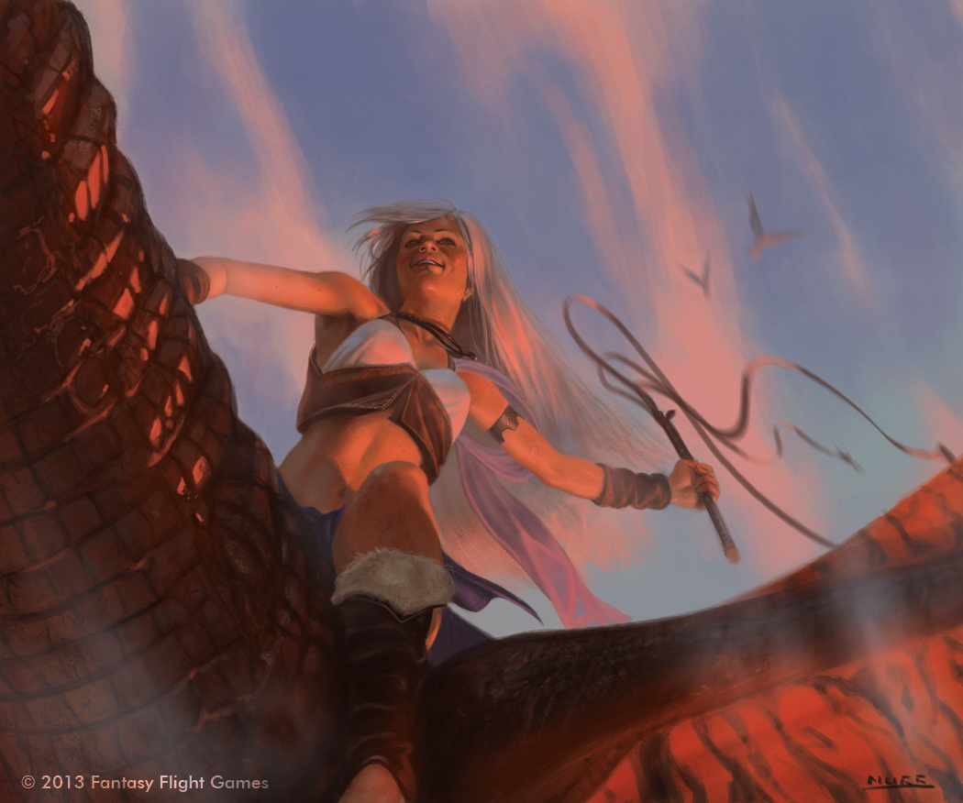
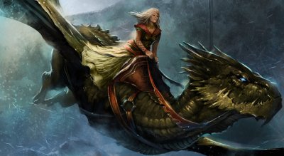
The time of your life!
You whistle all of a sudden a dragons appear out of nowhere!
You climb on to the dragon you fly off towards the sun.

Slide 8
flying
You fly to the fire mountains where you found all the fire dragons waiting for you.
You say follow me I think I know where the witch is.

Slide 9
Meet the witch
You fly towards where you think the witch is.
Sure enough you see the witch.
She cackles and says “oh really! I will get you very soon.’’

Slide 10
!
Lots of dragons
The witch shouts “dragons go get those things right now!’’
You charge towards the wicked witch and you start shooting arrows at the evil witch who is giving orders to her dragons all of a sudden dragons are swarming around you.

Slide 11
What to do?
The witch is coming at you.
You want to get away and quick.
What should you do?
Fly over the dragons
Stay put

Slide 12
fly over the dragons
You fly over the dragons and they come after you. Suddenly they start surrounding you. You start doing twisty turns.
What should you do?
The dragons are calling other dragons.
Keep doing twisty turns
charge

Slide 13
stay put
You stay put and the witch comes and gets you.
She tortures you .
YOU DIED!!!!!!!!!!!!!!!!!!!!!!!!!!!!!!!!!!!!!!!

Slide 14
keep doing twisty turns
You keep on doing twisty turns. Unfortunately dragons were everywhere. They blow fire at you and you DIEEEEEEEEEEEEEEEEEEEEEEEEEEEEEEEEEEEEEEEEEEEEEEEEEEEEEEEEEEEEEEEEEEEEEEEEEEEEEEEEEEEEEEEEEEEEEEEEEEEEEEEEEEE!!!!!!!
Try again

Slide 15
charge
You charge and strike at the witch. She yells at you “I will get you I promise!!”

Slide 16
slay the witch
You use your arrow and aim it at the witch’s heart, she yells just as you slay her.

Slide 17
victory
You and your dragons do a hooray dance.
You win!!!!!!!!!!!!!!!!!!!!!!!!!!!!!!!!!!!!!!!!!!!!!!!!!!!!!

