Slide 1
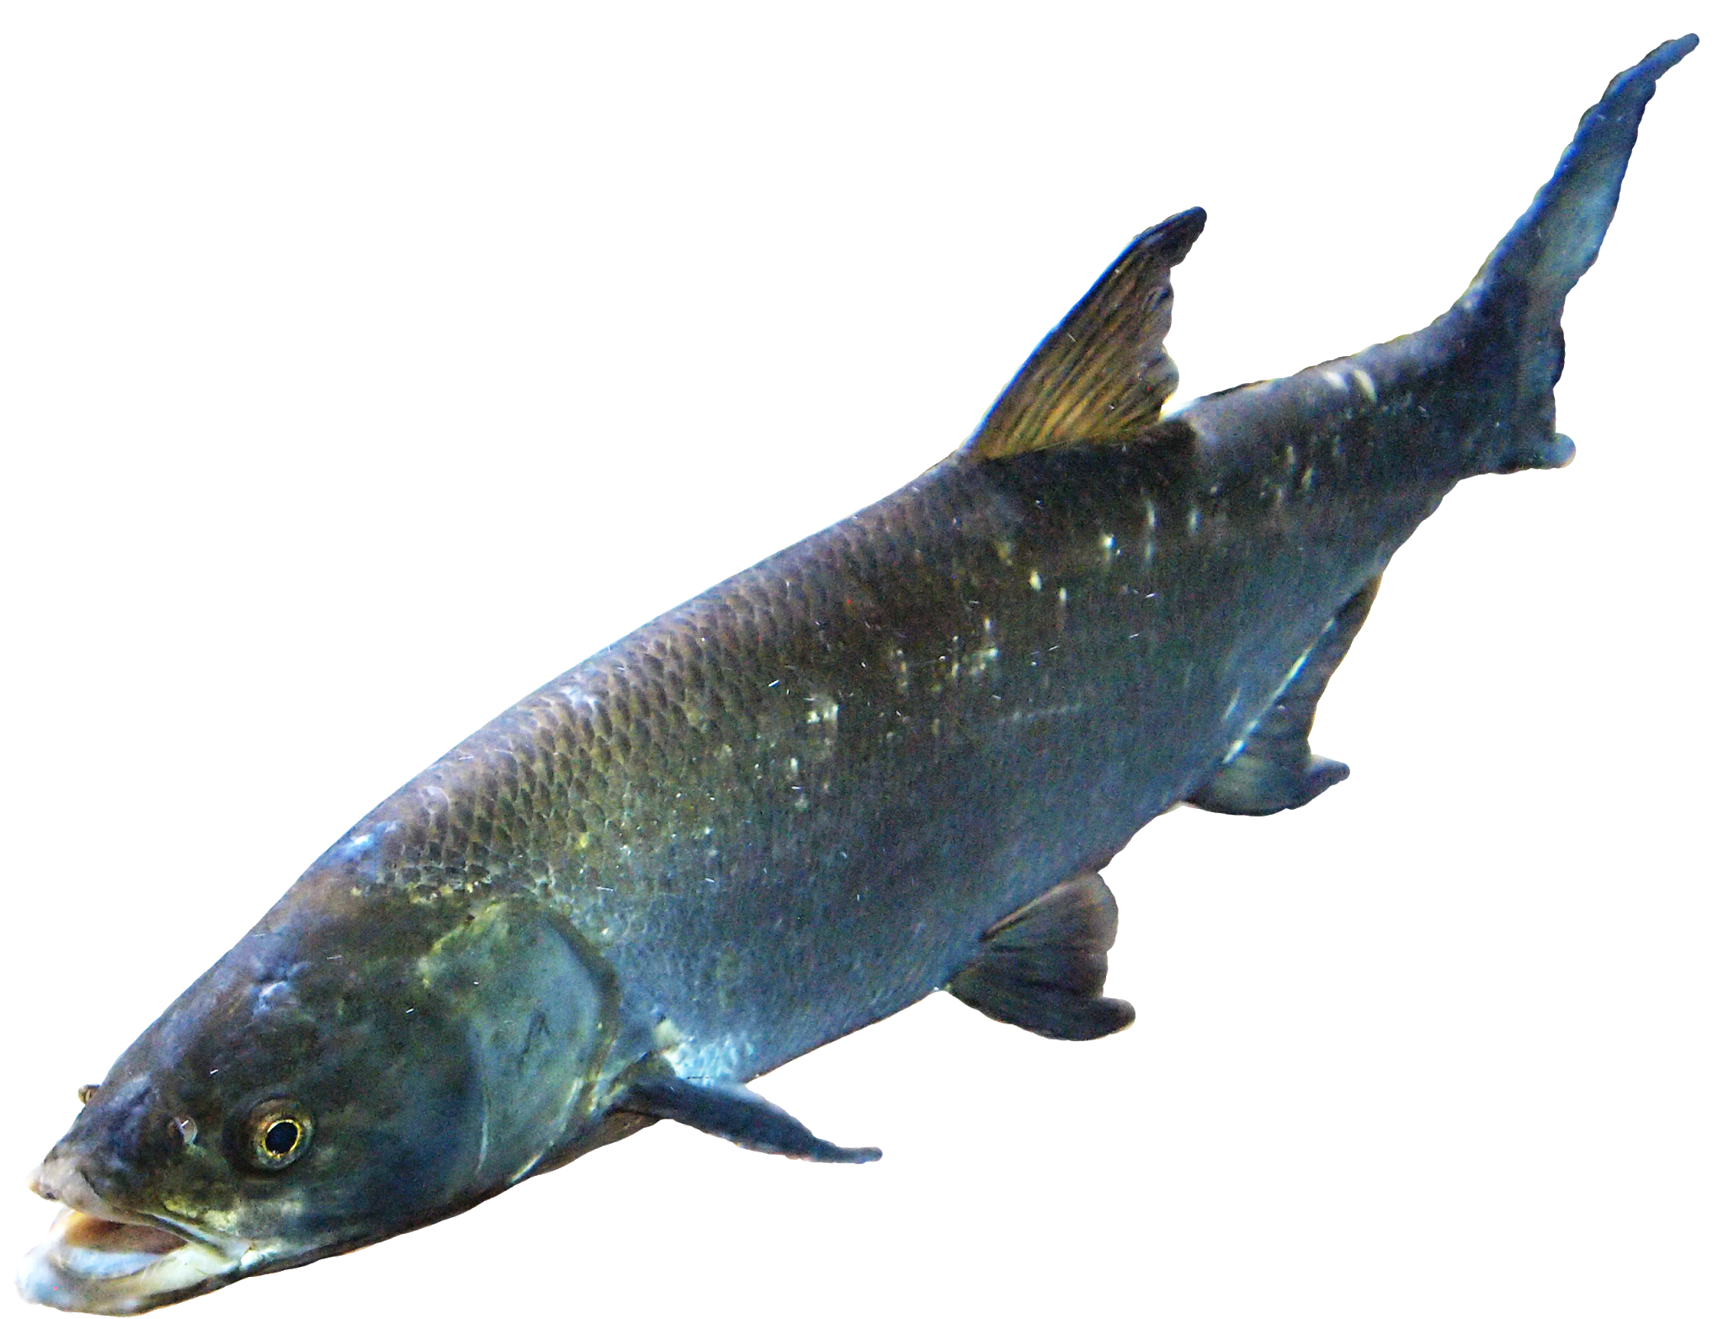
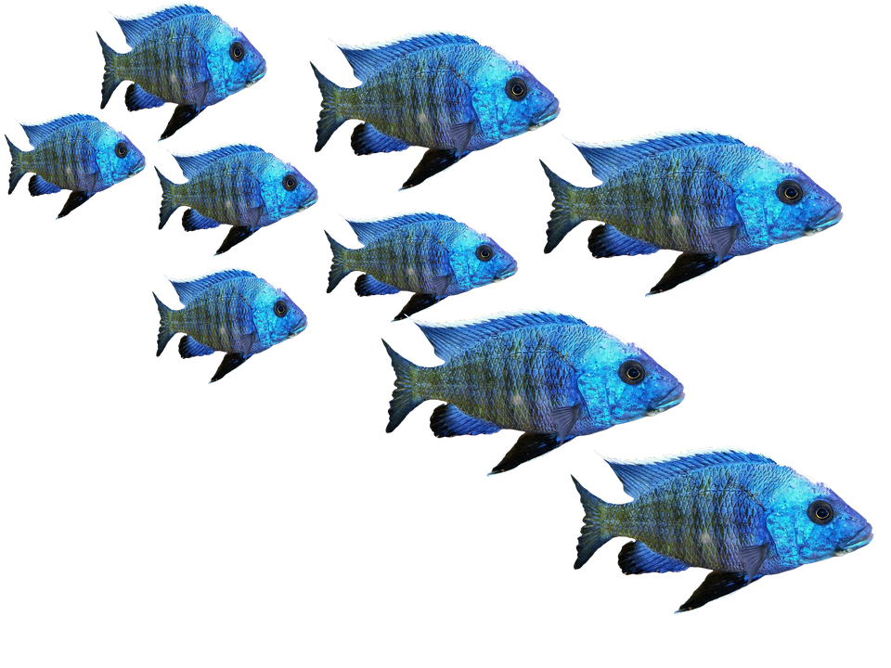
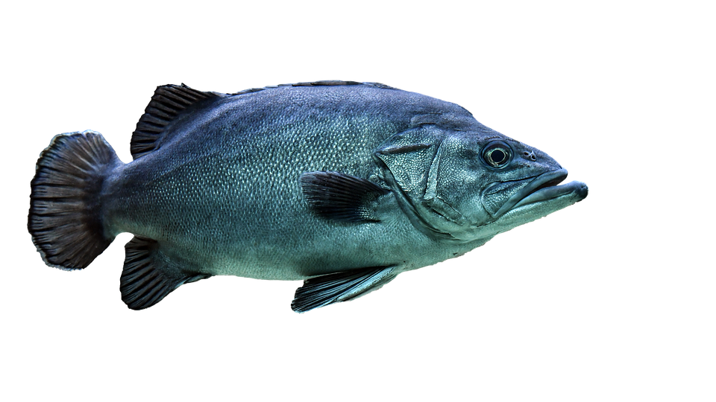
Underwater adventure
By cady r.

Slide 2
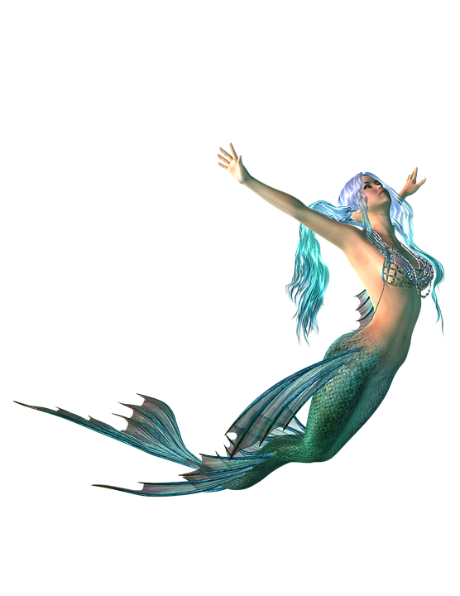
This is the start of a great adventure!
You realize that you feel different. The last thing you remembered was… oh no! An horrible ghost girl cursed you because you were rude to her. You have become a mermaid. Do you….
Explore your new world
Find food

Slide 3
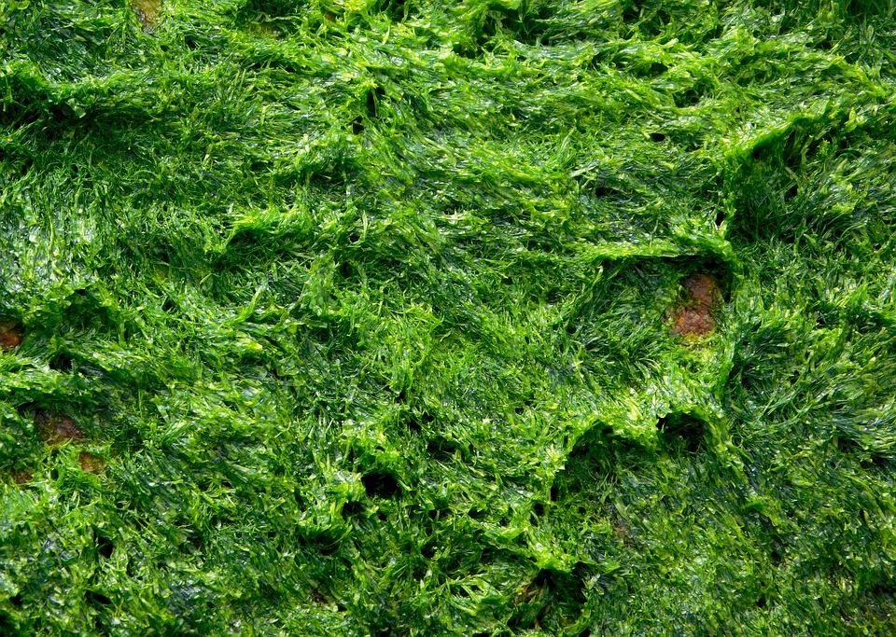
Find food
You slowly swim to a large patch of algae.”chomp!” eww! It's all squishy and wet and nothing like the seaweed chips you enjoy. Suddenly, an adorable hammerhead shark swims up to and flips over for tummy rubs. Do you:
Give it the desired tummy rubs
Swim away

Slide 4
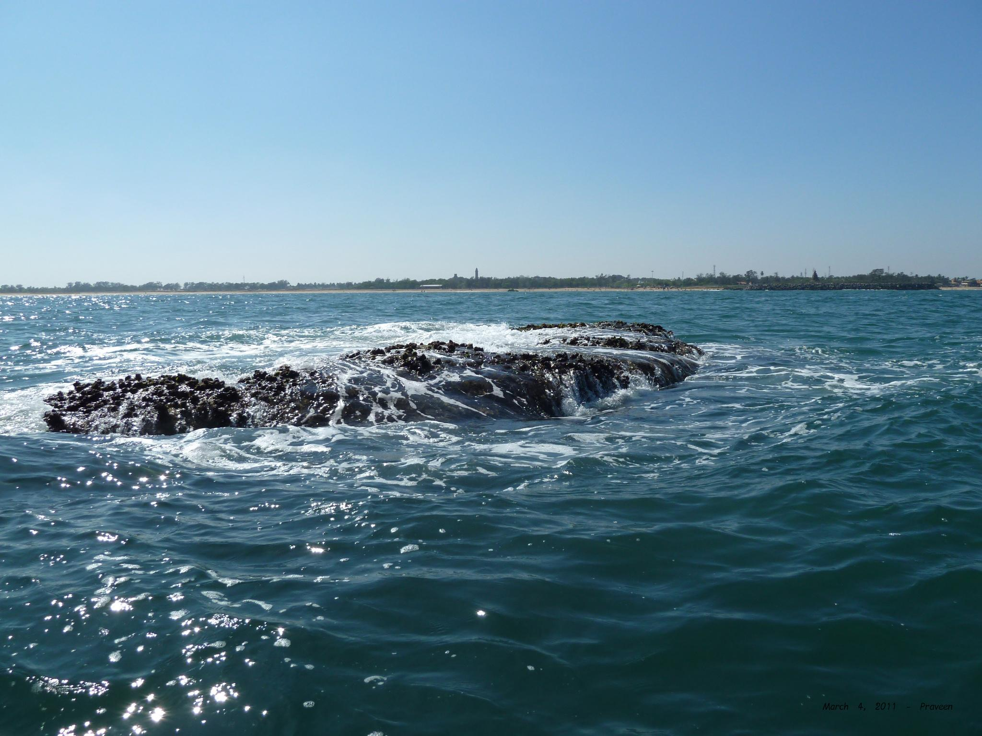
Explore your new world!
You start exploring and you discover a huge sunken temple with tiger statues on the outside. It looks VERY booby trapped. Do you…
Explore the temple!
Eh, swim to the surface?

Slide 5
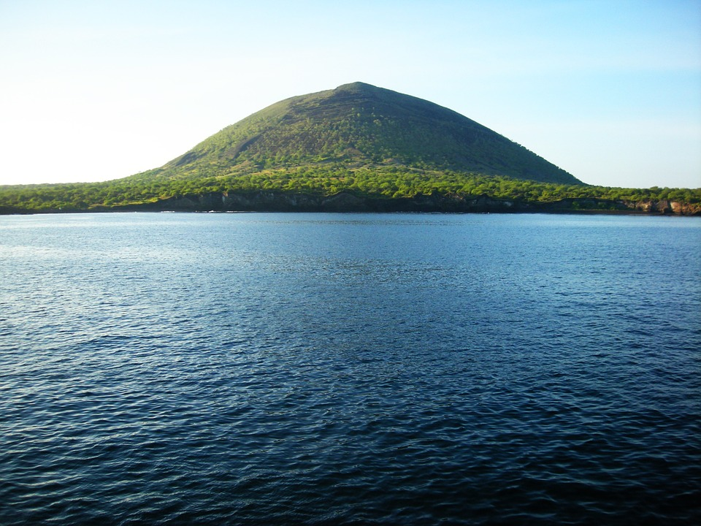
Swim to the surface!
You swim to the surface and the sudden burst of air to your lungs turns you back into a normal person. You catch a nearby ferry home.
The end!

Slide 6
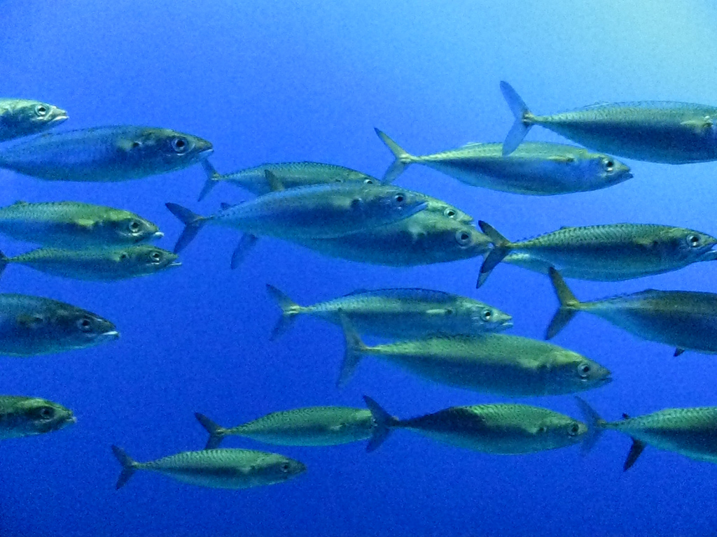
Explore the temple!
You swim into the temple… you see a bunch of other mermaids! You decide to live with them for the rest of your life.
The end!

Slide 7
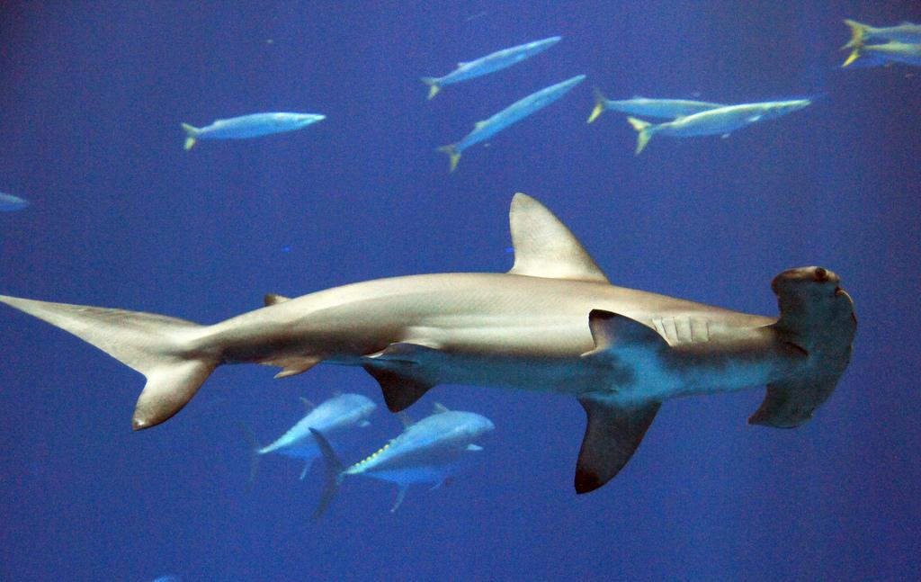
Tummy rubs!
You stare at the cute baby shark, and finally give it some tummy rubs. It turns out that that shark was poseidon's pet. He thinks that your awesome, and you get a full time job as his chef.(which is good because you've always wanted to become a chef) soon, you are transported back to your house and you live your life normally.
The end!

Slide 8
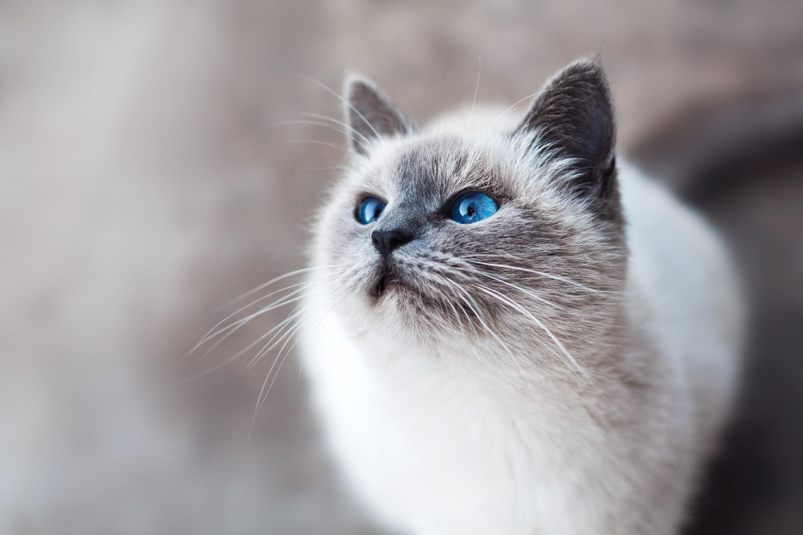
Swim away...
You decide to swim away, and then you suddenly start spinning and get transported back to your house.
The end!

