Slide 1
Path to death or survival

Slide 2
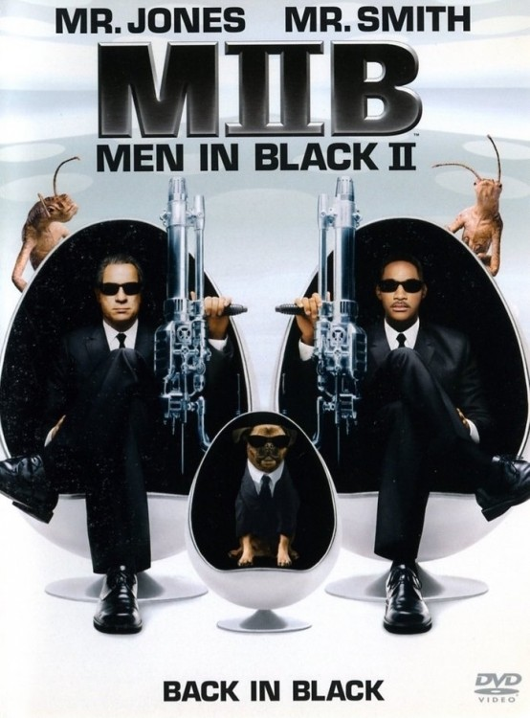
One night in the suburbs!
There was two men in black in a dark corner just standing there silent knifes in their hands!
Do you run!
Or do you just sit down!

Slide 3
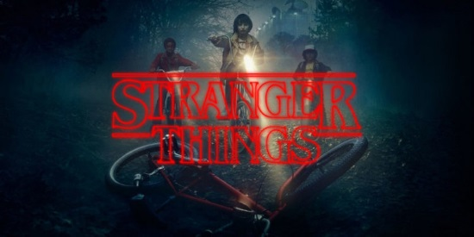
Do you run!
They just let you go but you run into a mind flayer!!And you die!

Slide 4
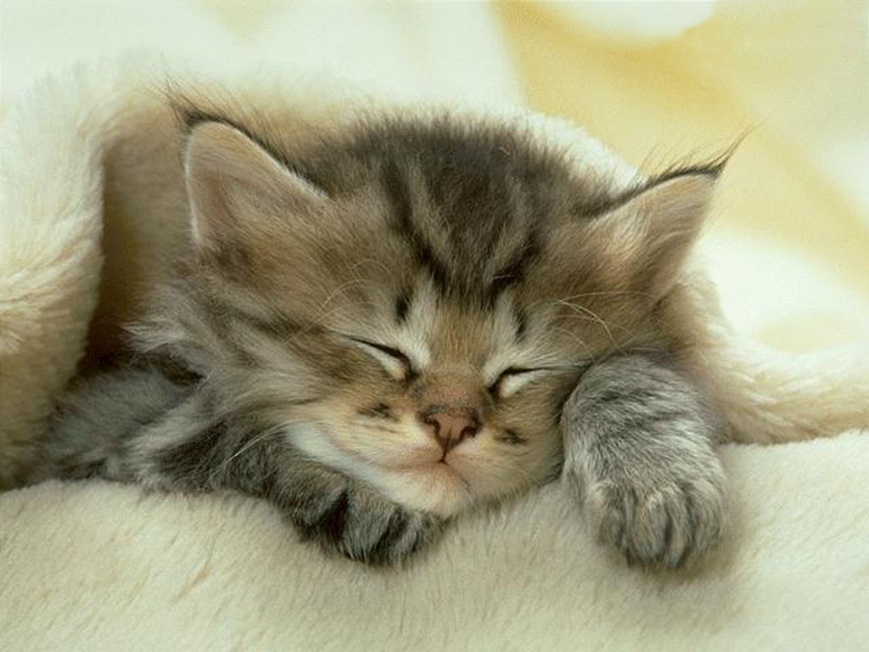
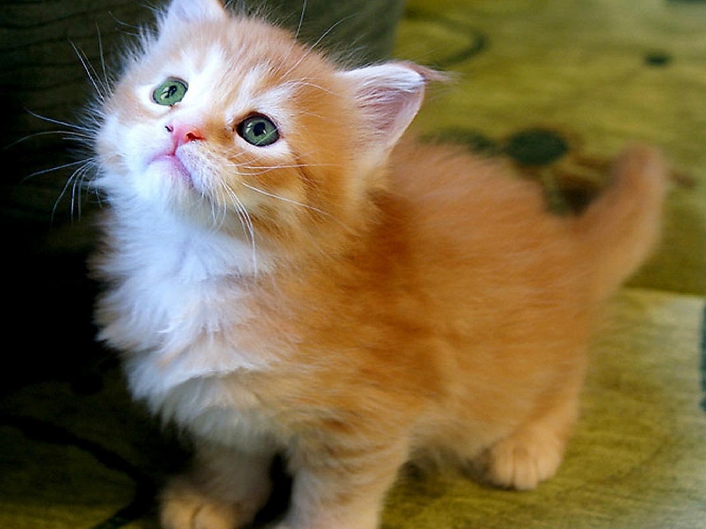
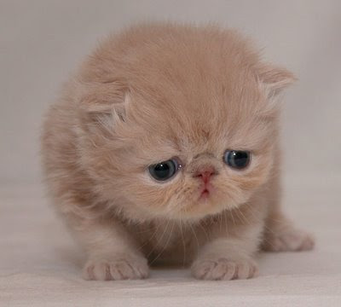
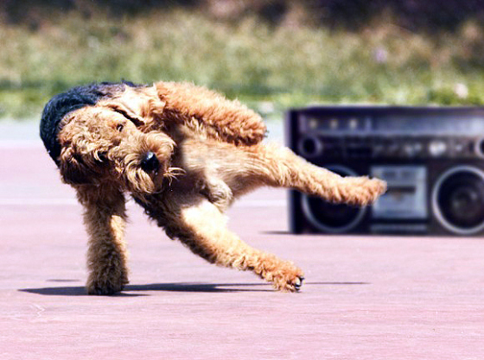
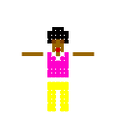
Or do you sit and break dance!
You are safe! You win

