Slide 1
THE KININGDEM OF DARKNES
By Cissy

Slide 2
ONC UPON A TIME THERE WAS A EVOL KING HOWS NAME WAS SEMBORIO HE HAD A PET DRAGON. WHO COULD SPEAK. ONE DARK NIGHT THE DRAGON WENT CRAZY. AND WOULD NOT LISTEN TO SEMBORIO.

Slide 4
THE DRAGON STARTED TO GO TO THE VILLAGE
THE PEOPLE WERE FRIGHTED BY THE BIG DRAGON

Slide 5
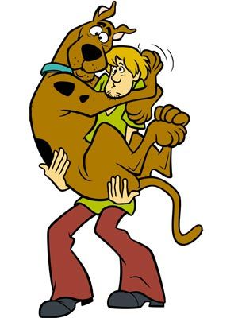
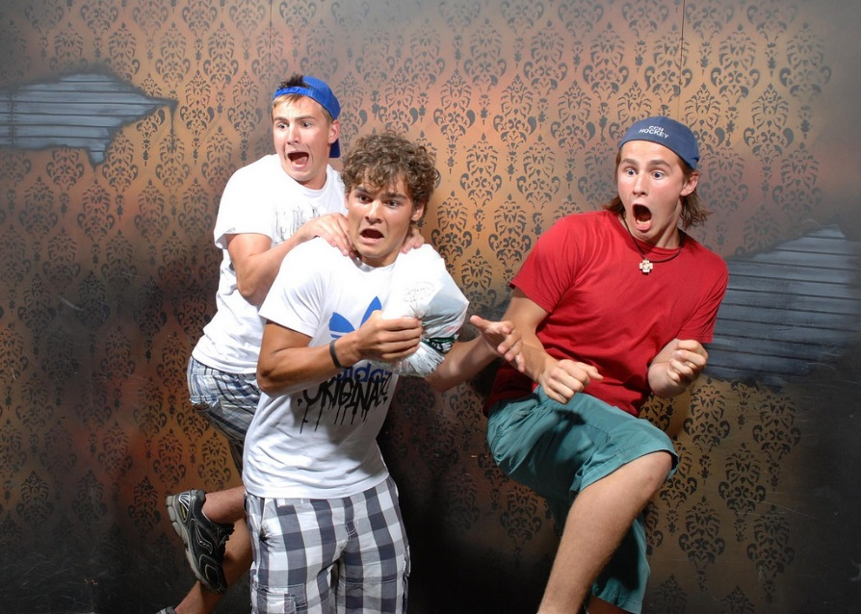
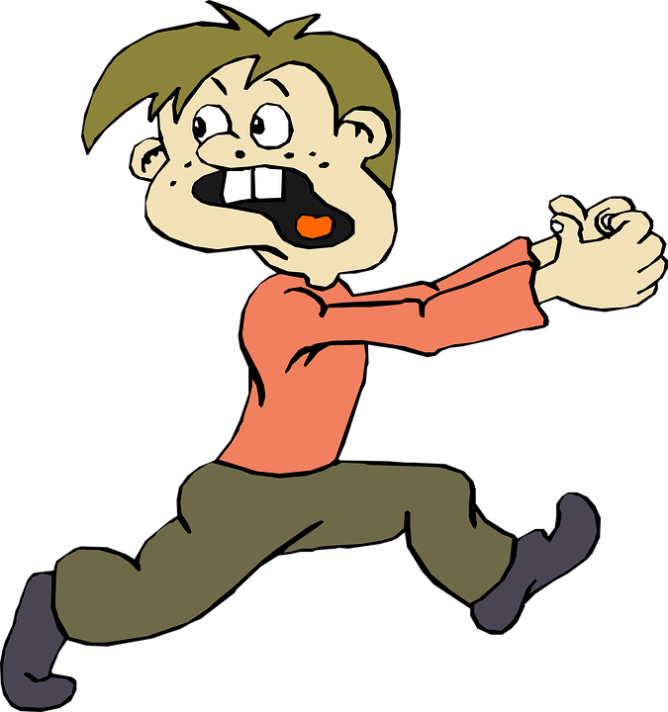

Slide 6
Does the king stand back
Does the king try to capture the dragon

Slide 7
The king stands back you survived
You win!!!!

Slide 8
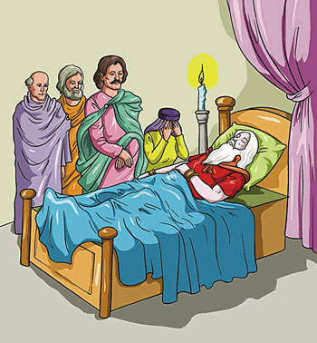
You lost!!!!

