Slide 1
The Eli The Evil Octopus
By Dana Sendelbach
Featuring: Malia the Unicorn, Mariam the fishy and last and certainly least, Eli the evil octopus ( tie in with the weird unicorn)

Slide 2
Chose your role!
Malia the Unicorn
Mariam the fishy

Slide 3
Mariam the fishy intro
You are a little fishy. Your best friend, Malia the unicorn s talking with you suddenly a face of terror floods her face. You hear him emerge behind you.
Do you
A Sit there and eat pizza
B run

Slide 4
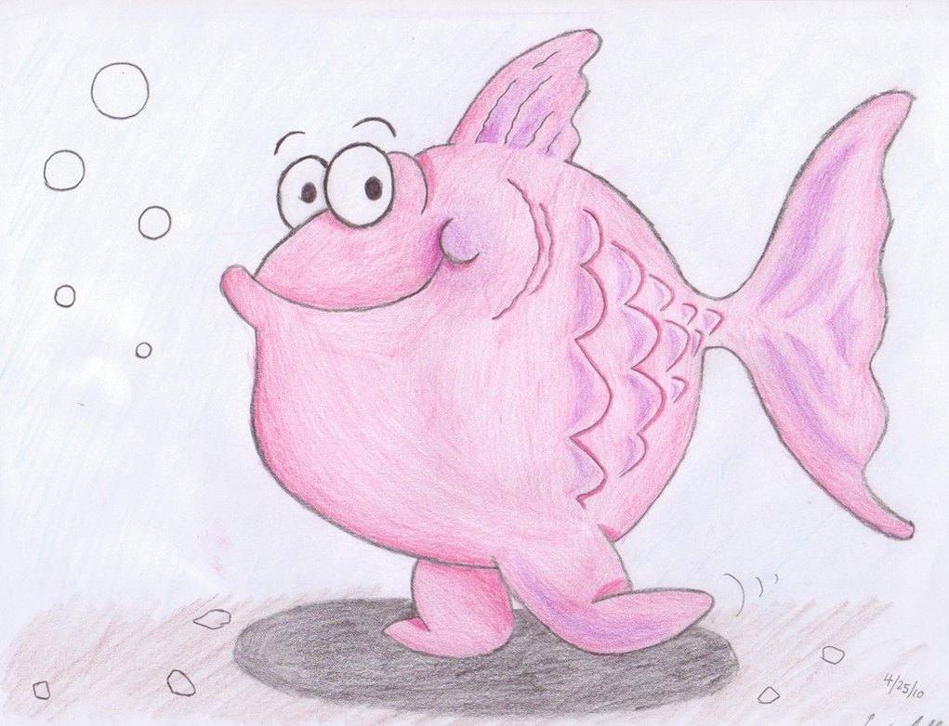
You chose to run away
You start to run, you don’t move
You have no feet you stay in the same place
You refuse to swim you need to run!
You die in a fight

Slide 5
You chose sit and eat pizza
You grab some pizza out of the ocean and start to eat
You get in the middle of a fight you die

Slide 6
Malia the unicorn intro
You are a Unicorn princess and you wake up and head to the beach. You are talking with your friend Mariam the fishy. In the back round you see you enemy, Eli the evil Octopus.
Fight
Hide in the ocean

Slide 7
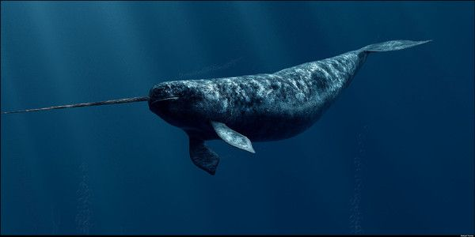
Hide in the ocean
You are unicorn, you cant swim nor can you breath under water
WHAT WHERE YOU THINKING!

Slide 8
You chose to fight
You start a fight
You use magic spells
He uses his “ arms”
You win
Go home and sleep
Go home and eat pizza

Slide 9
You chose to sleep
He come behind you, with an evil glare… you are asleep he kidnapes you live horrible life as unicorn magic provider

Slide 10
You chose to eat pizza
A boy comes up and takes you pizza!
Chase him
Just get another slice

Slide 11
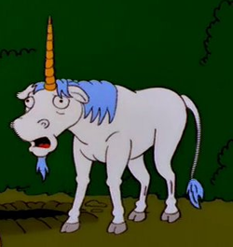
You chase him,
You run and run and run but he disappears you die of lack of pizza

Slide 12
You get another
You just make another appear, you’re a unicorn you can have all the pizza you want! You win

