Slide 1
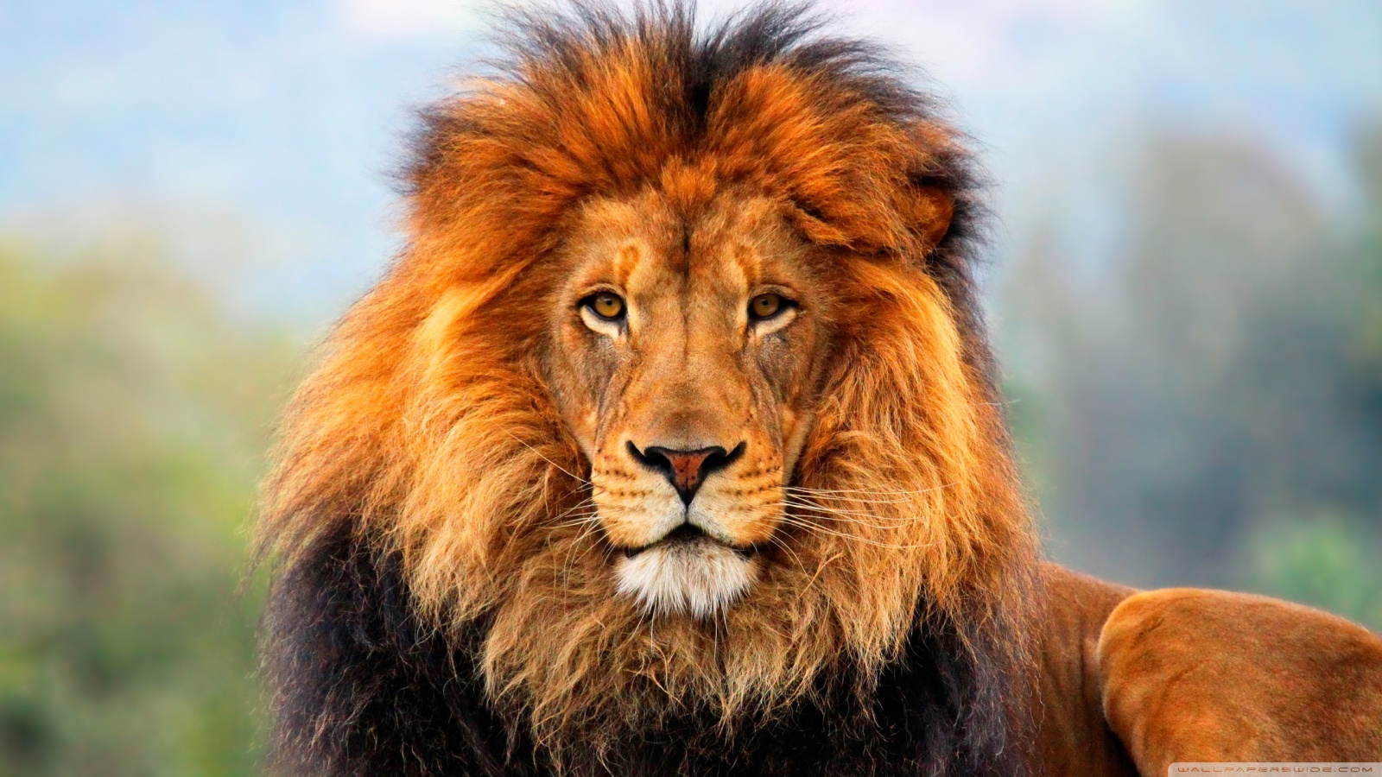
The Zoo of Meanies
By Drake

Slide 2
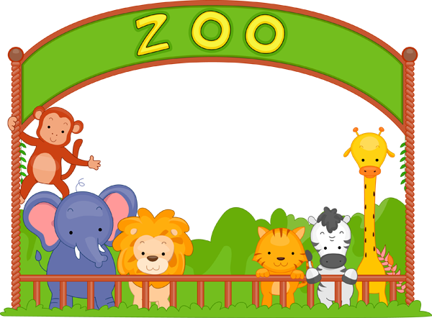
You start your shift at the zoo…
You show the other Staff your card. It says “Kyle Kertay.”
The boss gives you the option of Big Cats or Arctic
Arctic
Big Cats

Slide 3
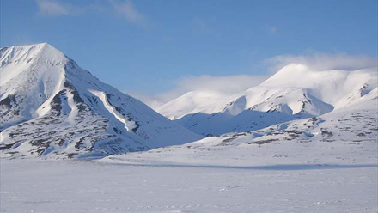
Path 1
You go to the Arctic, seems safe, just cute cuddly, penguins. AHHHHHHHHHHHHHHHHHHHHHHHHHHHHHHH.
YOU DIED!!!

Slide 4
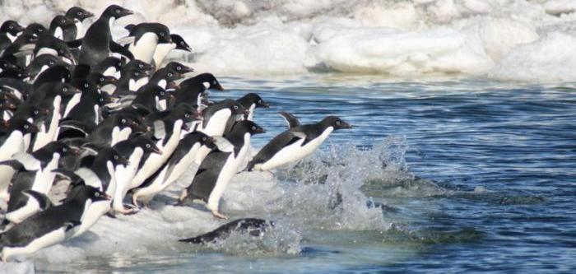
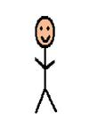
Penguins
Who knew penguins ate people?
RETRY

Slide 5
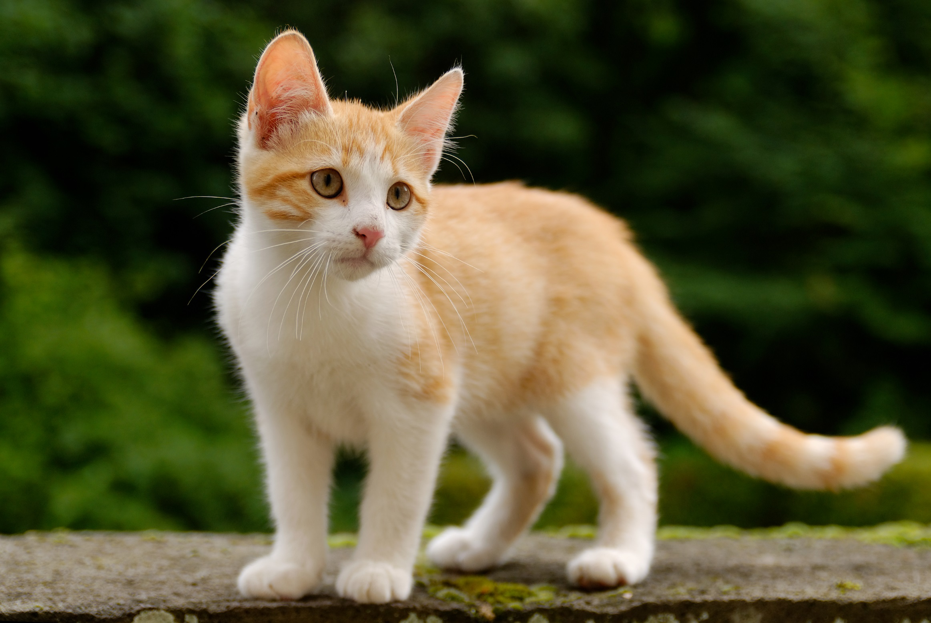
Path 2
You go to big cats. Cute little (HUGE) kittys!
Move on to next area
Continue patrolling

Slide 6
Path 2
Those kitties were looking hungry! You continue your shift. One more hour! You move onto the snake section.
Slither with those snakes
Slither away from those snakes

Slide 7
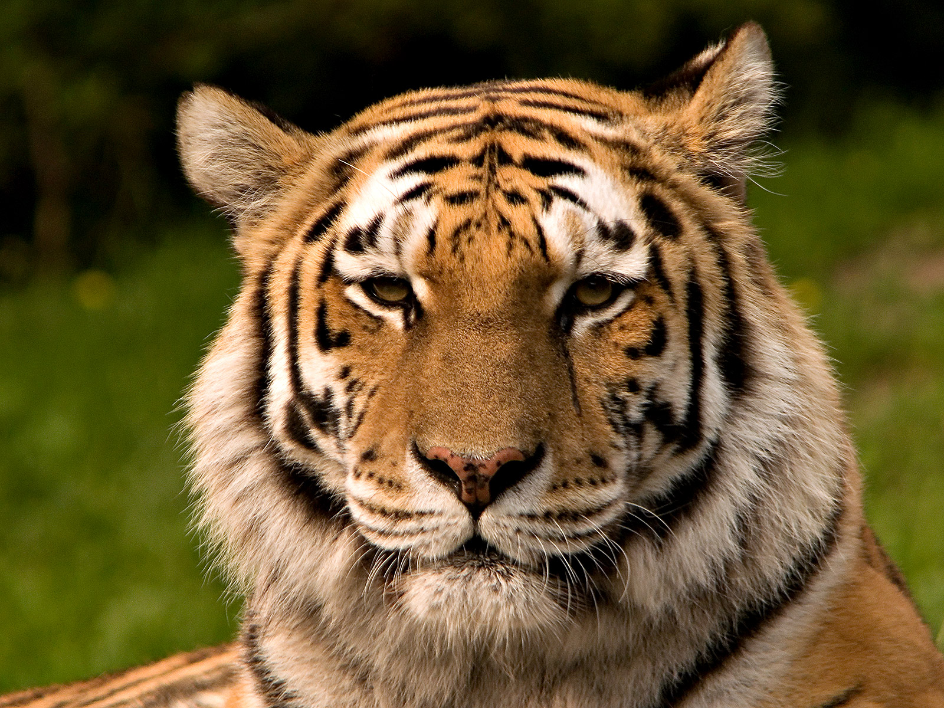
Path 3
I guess kitty was hungry, R.I.P Kyle Kertay.
YOU DIED!

Slide 8
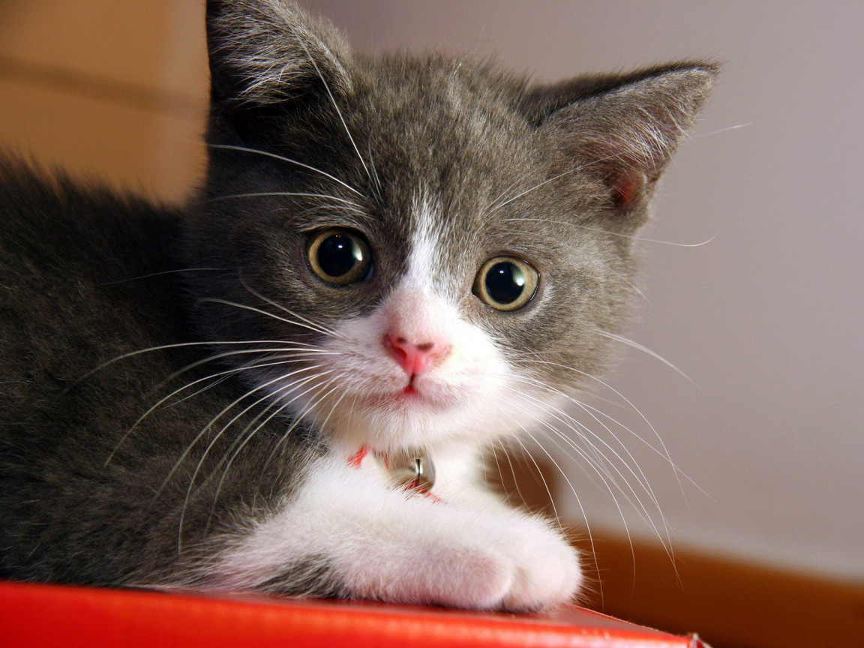
Path 3
“MUHAHAHHAHAHHAHAAHHAHAHHAHAHAHHAHAHHAH” says
Mr.Kitty
RETRY

Slide 9
Path 2
That’s all for this shift! You survived! I hope you enjoyed!
Play Again

Slide 10
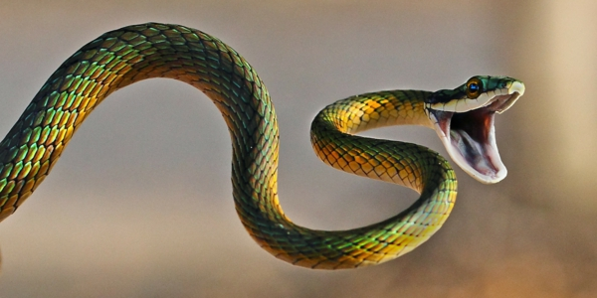
Path 4
Did I forget to mention Anacondas?
YOU DIED!

Slide 11
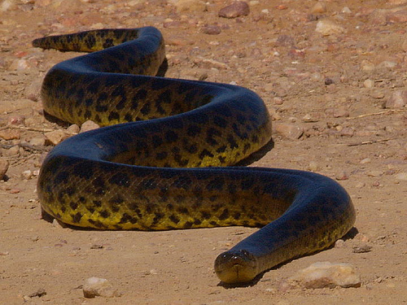
Path 4
Fun Fact! Anacondas eat people!
RETRY

