Slide 1
Percy Jackson

Slide 2
BY Duncan
And pictures by Duncan

Slide 3
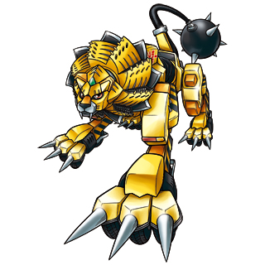
Attack
One day Percy was woken up by a metal lion
A: run away
B: fight it

Slide 4
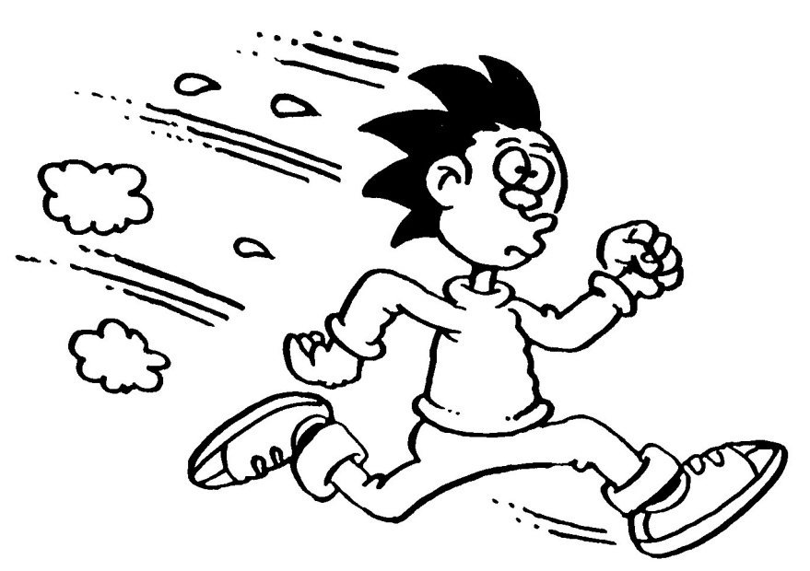
A: run away
You get trampled by a bunch of kids
Try again
Yes

Slide 5
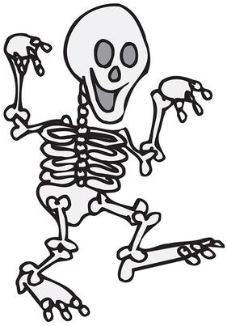
Sorry
YOU LOSE

Slide 6
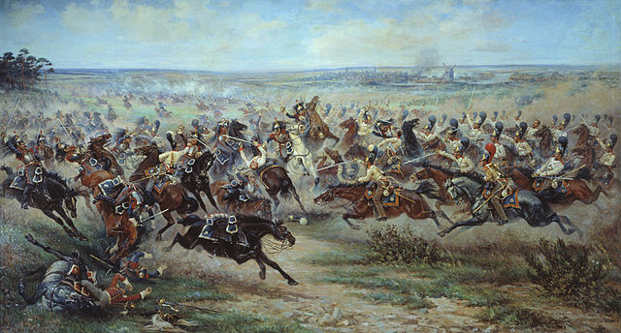
Attack it
You kill it
You win

Slide 7
You have a party
You have some coke and someone gets hurt
A! jump in the water
B! party longer

Slide 8
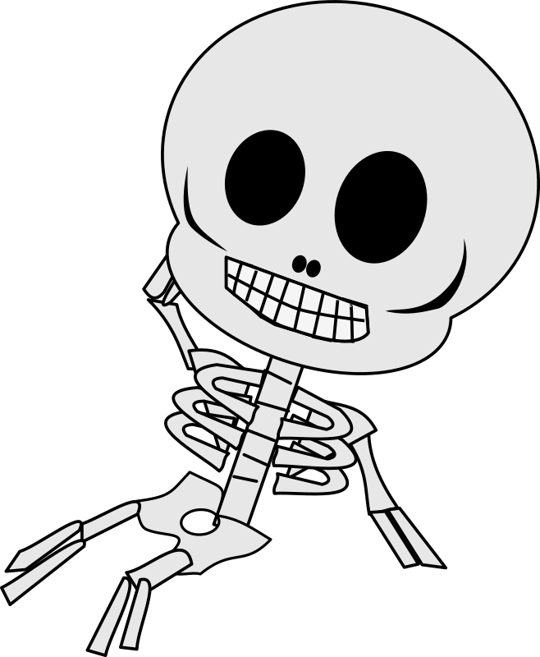
YOU DIE
THE END

Slide 9
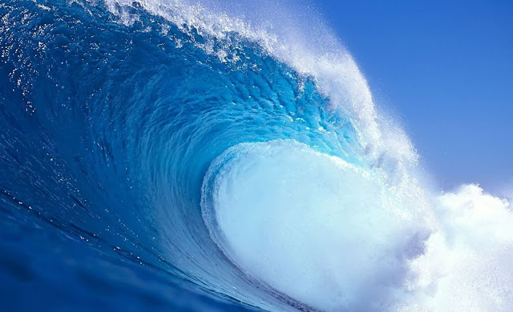
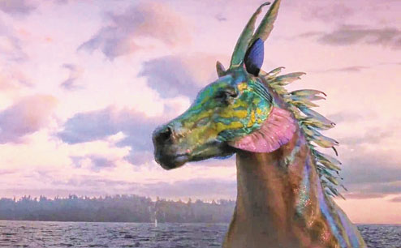
Swim
YOU meet a hippocampi and meet your DAD
YOU start to live with him
Click here

Slide 10
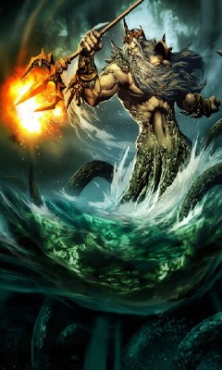
Your dad
Your dad got mad at you and Triton
He alimatated Triton
Click here

Slide 11
Go
Go to Hades 1
Go to Hades 2

Slide 12
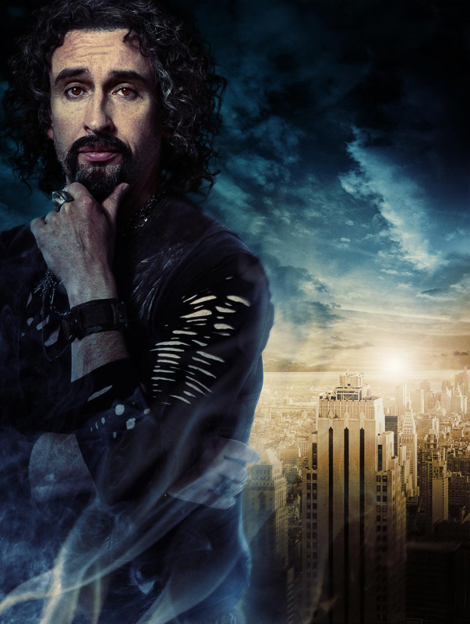
Hades 1
You fought and defeated Hades before he took over Mount Olympus
Click here

Slide 13
Hades 2
Hades took over Mount Olympus
You lose

Slide 14
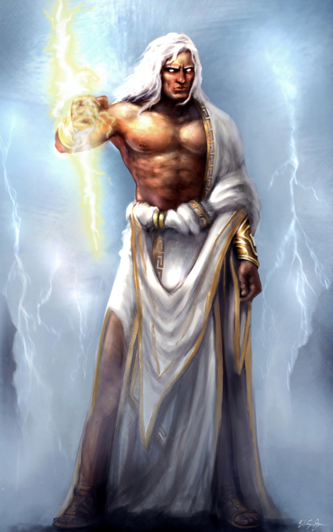
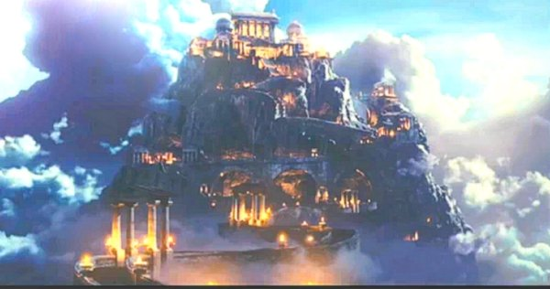
Mount Olympus
Your Uncle Zeus and your Dad Poseidon are proud of you. You become a god
THE END

Slide 15
lose

