Slide 1
Silme’s Story!
Let the story begin

Slide 2
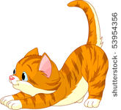
Once a upon a slime….
There was a huge cat…. You were named slime.One day you woke up and was very hungry you looked out the window and saw a elephant. You were so hungry that you wanted to break your window and eat it
Break the window and eat the elephant This is you→
Just look for something else to eat

Slide 3
You ran there
Your at the slime store but it was black Friday.
There was only one of your favorite slime
But a robot had it.
Do you..
Fight the robot
Or
Just stand there

Slide 4
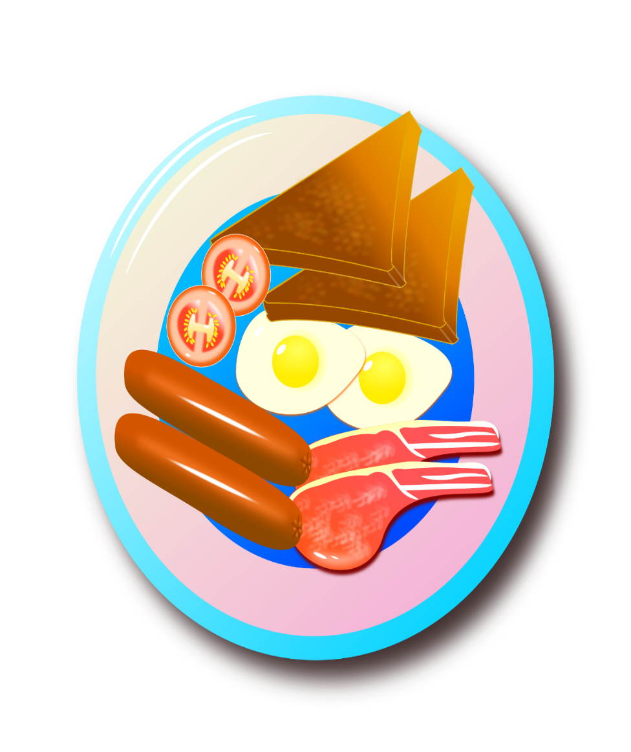
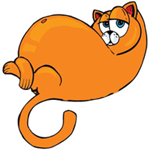
Wise choice
You were full but you later want to
Get your daily grass and yes you eat grass. But you need
Your nap.
Do you…
Run there
Just go to sleep
Take your time

Slide 5
R.I.P
You couldn’t find anything to eat so you starved to death

Slide 6
You died

Slide 7
YOU DIED
Without grass your nothing

Slide 8
YOU WON
YOU GOT YOUR GRASS AND YOUR OK!!

Slide 9
Take your time
You died because you needed your daily slime

Slide 10
You went to sleep
You’re gone without your daily grass your
nothing

