Slide 1
Choose your own adventure
By Eli Wheeler

Slide 2
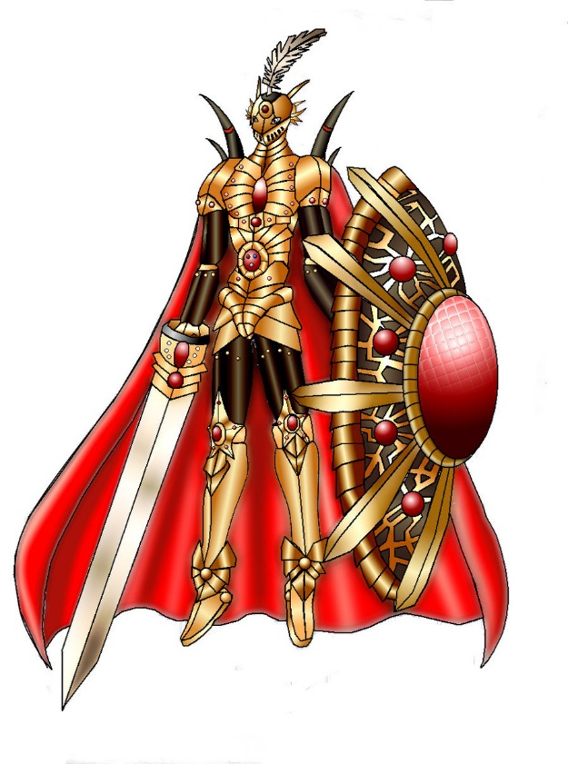
Our story begins
You are in your room in the castle late at night trying to find that file to sharpen your sword. You just bought the most expensive armor in town and had it plated in gold. You hand crafted your sword with iron you mined yourself. The king was impressed with your skills and dedication, you are his personal knight. You find the file and sharpen your sword. You should get some sleep to guard the king tomorrow.
What do you do?
Stay up and practice on your dummy
Get some sleep, you already have a lot of practice

Slide 3
You stay up and practice
You swing your sword high and instantly knock the head clean of your burlap and straw dummy, oh no!, your dummy jumps off it’s post and picks up its head and puts it back on and punches you! You fight back, but your dummy is just to fast! He is very strong, he picks you up and throws you next to your bed. There is a oil lantern next to your bed, what do you do
Light your straw dummy on fire
Keep fighting

Slide 4
You go to sleep
You go to sleep, but are awakened by a dragon roaring outside the castle, he shoots a fireball at your chamber and it breaks the wall down
Do you
Jump out and slay the beast
Run to save the king

Slide 5
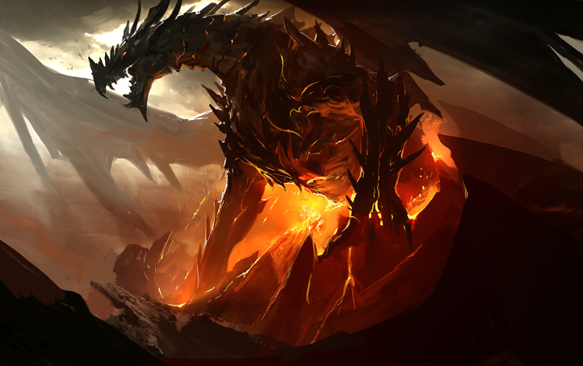
You try to fight the dragon
you grab your sword, no time for the armor, just the helmet. You jump and attack the dragon no use. He simply shoots fire at you, you hit the ground, but you get up to attack a wizard that appears to be shooting fireballs at the castle! You swing your sword, he sees you just in time and hits you with a spell that sends you flying into the dragons mouth!
YOU DIED

Slide 6
You go to save the king
As you run towards the kings chamber you realize that a wizard already turned him into a bug and steps on him! You jump and attack the wizard, he dies in a puff of smoke, after the fighting is over you are declared the new king!

Slide 7
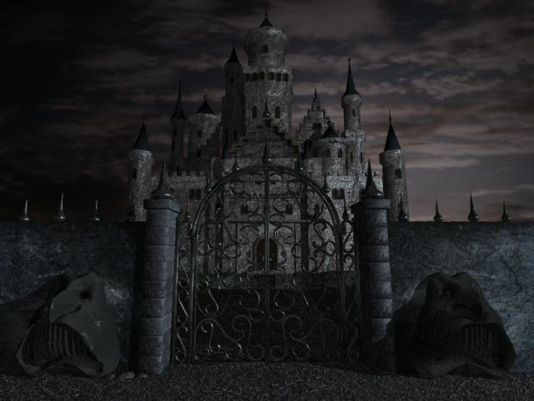
You Win
But at what cost? The people are so affected by the kings death that your kingdom literally turns black from sadness. This is worse than anything!

Slide 8
You light him on fire with your lantern
You throw the lantern at him! It breaks the oil splats on him and he burns until he is a pile of dust! The only thing you can think of saying was “yaaaaaaaaaaaaaaay!” but then a witch comes out and hits you with a spell and you fly out the window, you land in the moat then the castle tower explodes, a dragon come out with the king in his mouth! the king died. You attack the dragon but are consumed in a ball of flames.

Slide 9
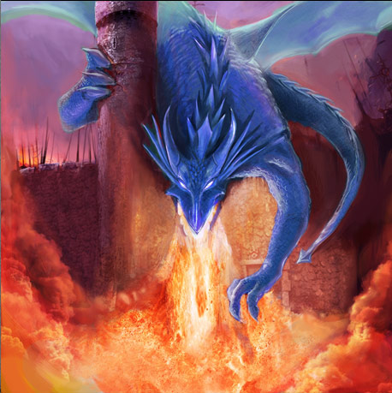
You failed!

Slide 10
You keep fighting
You keep fighting, you pick up your sword and impale him and stick him to the wall. He keeps clawing at the sword until he speaks “gotcha!” he yells “what do you mean?” you ask “this” he answers. He turns into a dragon and you pull yourself onto his head! You use your small knife to stab him in his weak spot and he crashes and you live, you and the king survive and live on in peace and happiness!

Slide 11
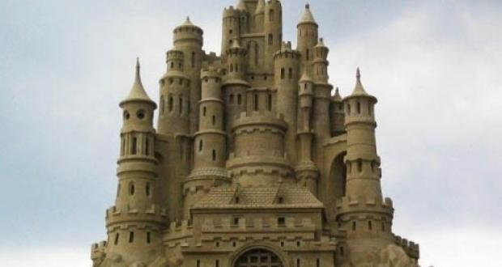
You win!

