Slide 1
An Oatmeal Morning
By Elissa Pelletier

Slide 2
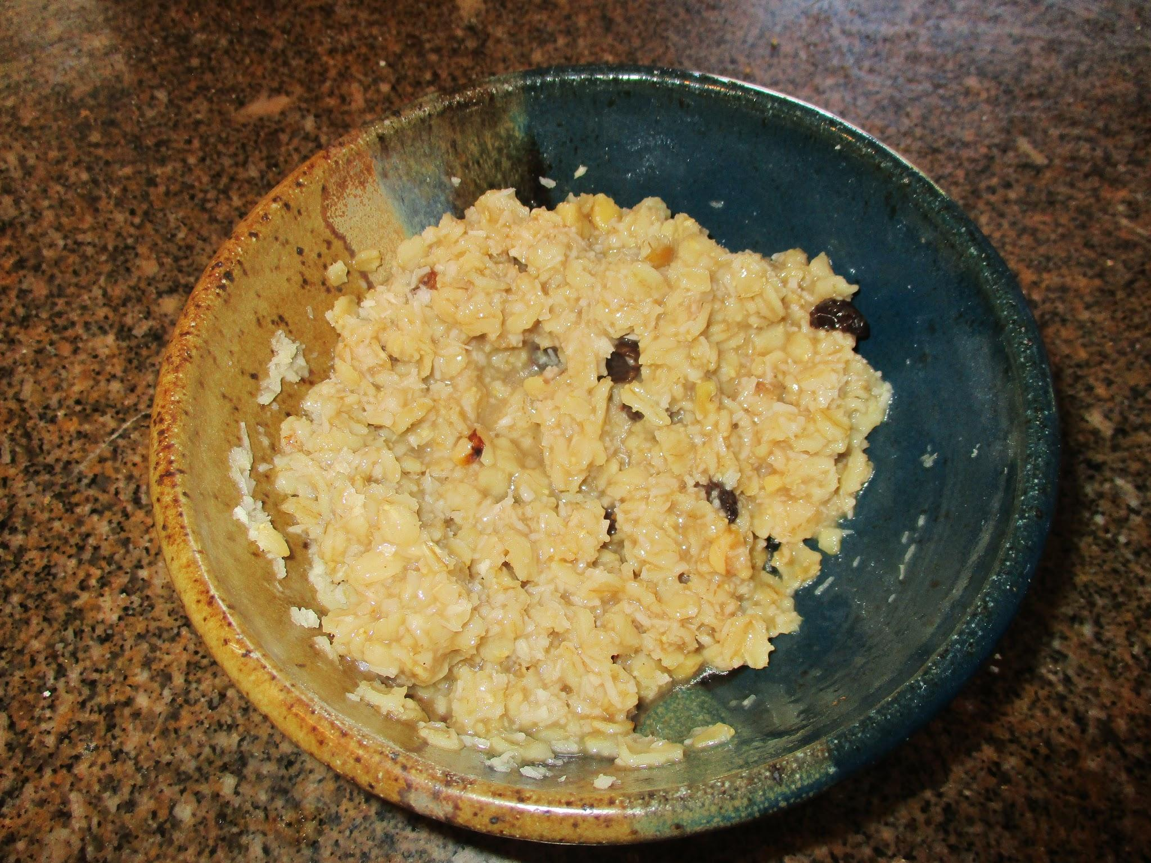
It was a normal morning so far....
You wake up and go down stairs to eat breakfast. It is oatmeal, your signal that it will be a bland unexciting day. On the way to school you meet up with your friend Silvia. When she says that she will go in the back door you are faced with a decision, will you….
Go in the back door
Go in the front door with everyone else

Slide 3
Go in the front door….
You go in the front door with everyone else and start chatting with other friends, you are so caught up in your conversation you pass your classroom door and are on the other side of the school when the bell rings, do you….
Run to class without getting a late slip
Go to the office to get a late slip

Slide 4
Go in the back door….
You go in the back door with Silvia and get thrown into a trap door and die of starvation. Well, you say sadly “oatmeal is no longer a sign of a boring day.” Those are your last words.
GAME OVER!!!!
Try again

Slide 5
Run to class
You run to class and get in the middle of aton of confusion about where you were
GAME OVER!!!!
Try again

Slide 6
Go to office
You walk calmly to the office and get a late slip. When you get to class and hand in the slip you are thanked and get on with your day
YOU WIN!!!!

