Slide 1
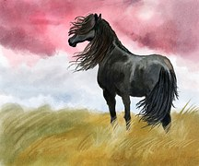
By Elissa Soot’s adventures Introduction……
It was a sunny June day and Soot herd was running through the meadow. A storm hit, and Soot was separated from the herd.

Slide 2
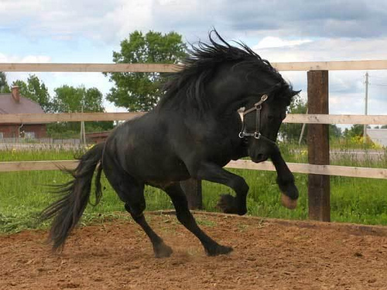
A week later……
After Soot was separated from her herd a group of bandits came and took her from the humans that took her in as their new pet, and she was planning a escape.
Soot knew what her plan was and very well to, but didn’t know when to take action.
Choice 1 Soot does her plan in the middle of the night
Choice 2 Soot does her plan during the day, when her owners are away

Slide 3
Middle of the day
It was a very hot day in the middle of the summer and Soot’s owners went to the pool. Soot was left alone and wanted to do her plan as soon as possible. She went through her plan one more time. Her plan was: wait in tell the owners are gone. Then I jump over the pen fence or open the gate with my mouth. I escaped but after that I have to find a herd to live with for the rest of my life.
Choice 1 soot opens the gate with her mouth
Choice 2 Soot jumps the gate

Slide 4
At midnight
It is the middle of the night and Soot’s owners were asleep and soot wanted to carry out her plan now. She reviewed her plan in her head. It was: wait intel the owners were asleep and sneak quietly out of the stable. Then you escape. How soot is going to do it she hasn’t decided yet.
Choice 1 soot stays put and decides to not do her plan at all
Choice 2 soot jumps over the fence

Slide 5
Choice 2
Soot decides to jump the fence. The owners come just as soot cleared the fence.
YOU WIN

Slide 6
Choice 1
Soot opens the gate with her mouth, it is right when the owners get home, they hear the noise and run to investigate Soot is caught.
YOU LOSE

Slide 7
CHOICE 1

