Slide 1
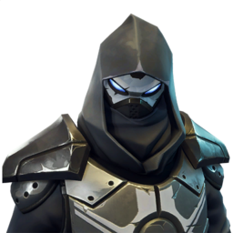
The ice king vs the fire king
The ice king had impolses.The fire king was in tilted towers.

Slide 2
Qweshten
Would you…
Stay
Leave

Slide 3
The ice king yoused a lounch pad he was still not thear.

Slide 4
Yes you made it.

Slide 5
The BIG fight
The ice king left.It took him hours.Finaly he met the fire king.The fire king started to bild so did the ice king.The ice king impolsed the fire king.The ice king got some wepons so did the fire king.They came back they are both low.

Slide 6
Qweshten
Do you…
Start to fight
Team

Slide 7
The fight
Soon they have full helth and shiled.Again they bilt the fire king shot him down.

