Slide 1
Prisoner
Gabriela morejohn

Slide 2
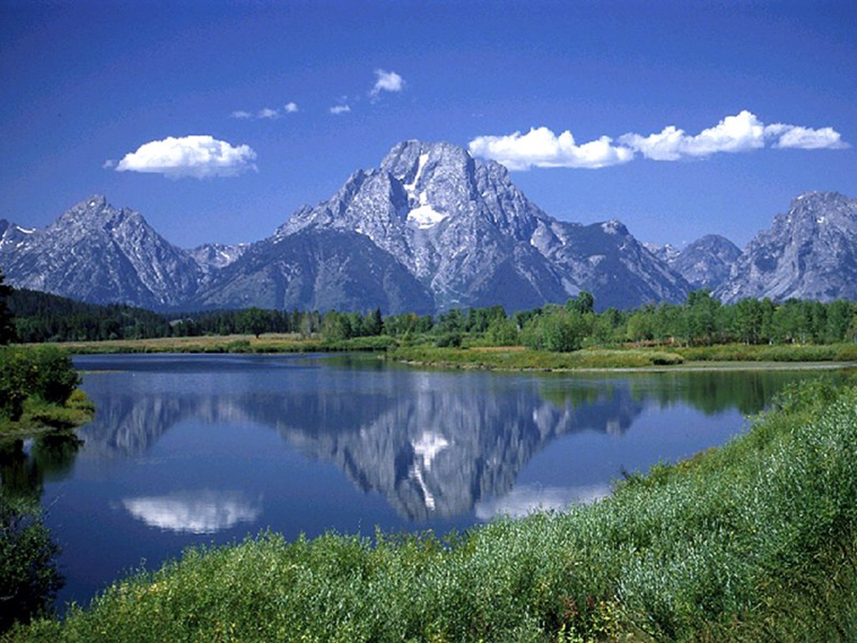
The air was cold and it slapped amaranth across the face. Something flickered out of the corner of her eye. It was coming from the dark mountains.
Journey to the mountains
Go to your cottage and forget about it

Slide 3
Desperately climbing, you reach the mountains.
climb to the top
Give up

Slide 4
As you reach the top you see a large dragon warming its eggs, its wing is torn, and you feel a wave of sadness wash over you. Then you use your magic to heal the wing. In return it gives you one of its eggs to raise. You win!!!!!!!!!!!!!!!!!!!!!!!!!!!!!!!!!!!!!!!!!!!!!!!

Slide 5
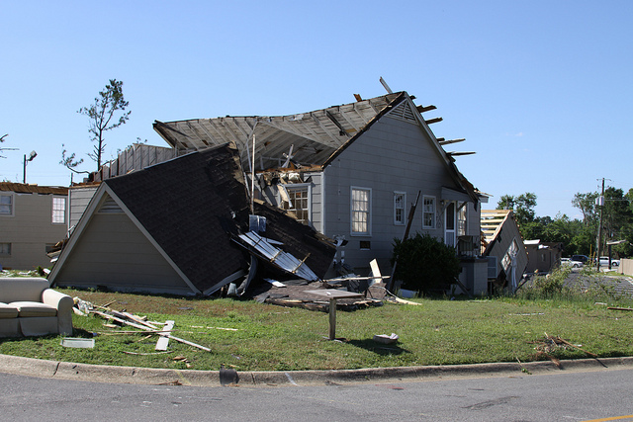
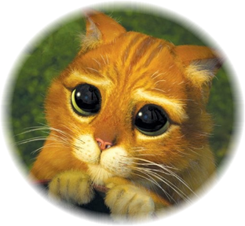
As you come to your village your cat is scared you know why. A dragon is tearing your house apart! You lose!!!!!!!!!!!!!!!!!!!!!!!!!!

