Slide 1
The horse of wonder

Slide 2
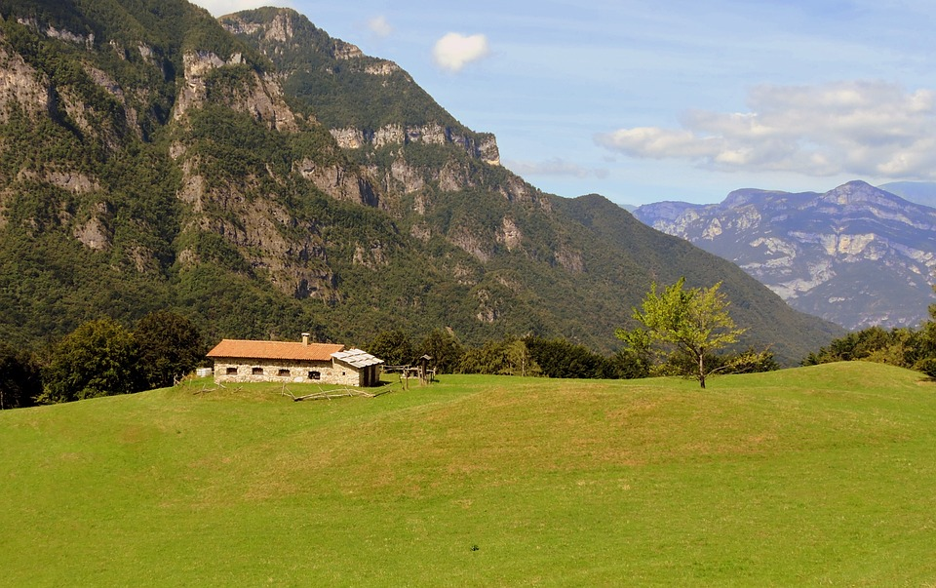
You live in a small cottage by the edge of a large and beautiful mountain, suddenly an erie neigh of a horse in pain fills the air!!!
Do you:
Follow it
Feed your chickens

Slide 3
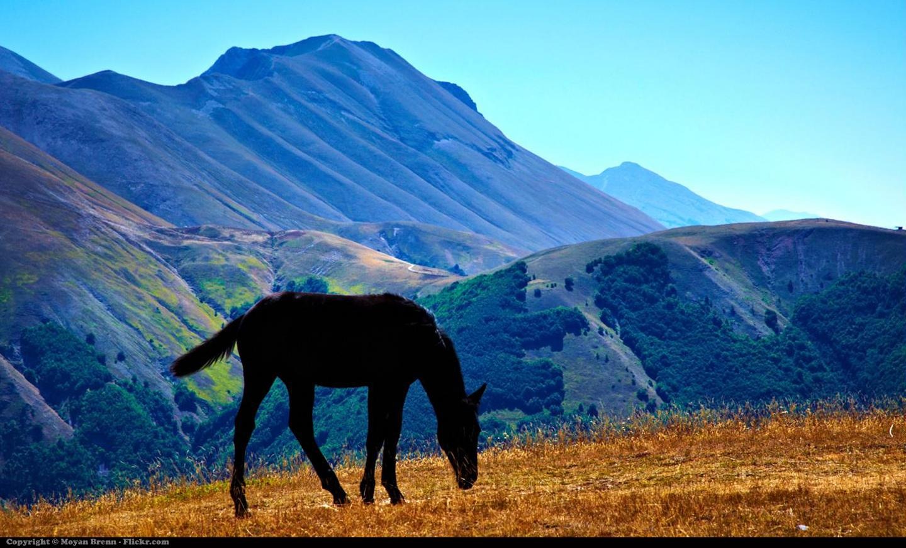
As you near the sound you happen to glance up at the mountain, you see a magestic stallion up at the top and you start climbing. You are halfway up and you stop to rest.
Do you:
Keep going
Go down and eat lunch

Slide 4
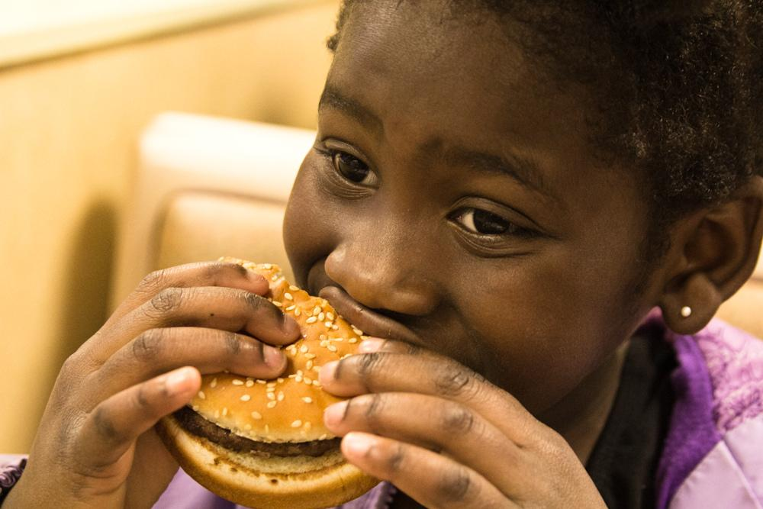
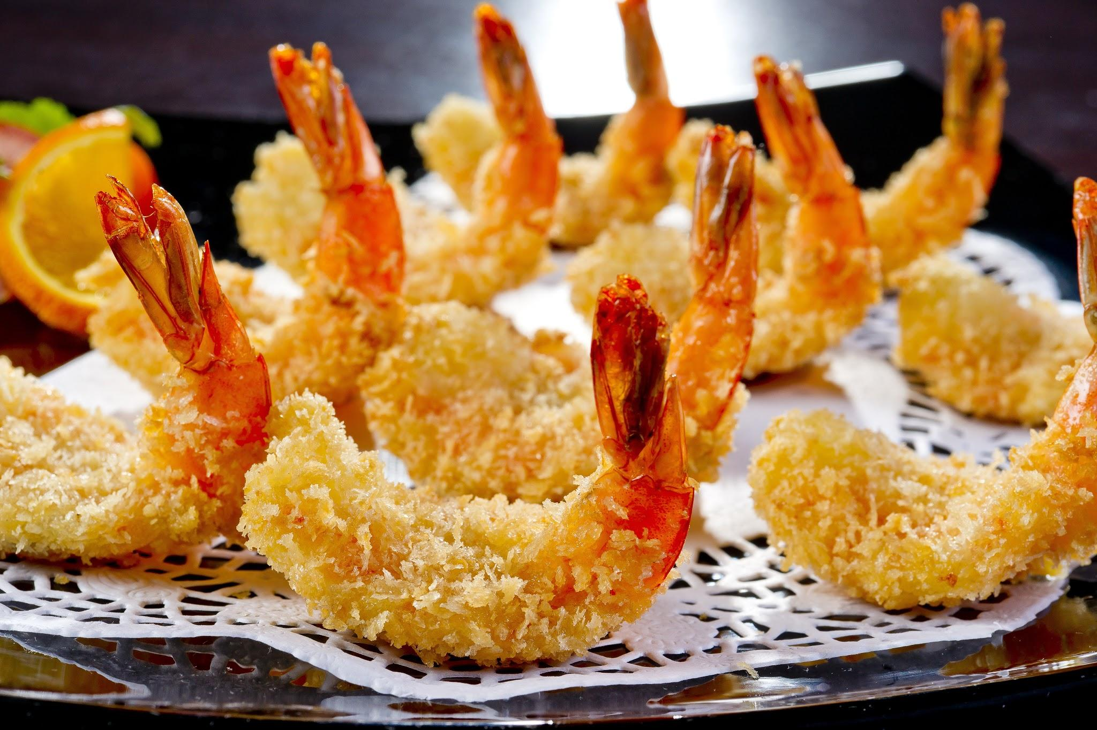
As you sit down to eat lunch, you see you have a choice: cheeseburger or shrimp.
Do you:
Eat cheeseburger
Eat shrimp

Slide 5
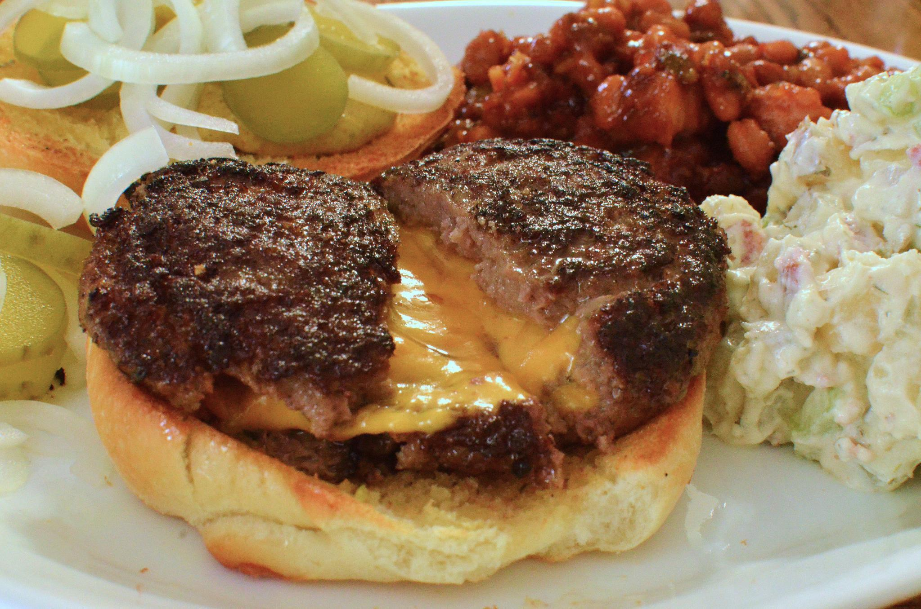
As you go to a restaurant to get the burger you see they are out.
GAME OVER!
GAME OVER

Slide 6
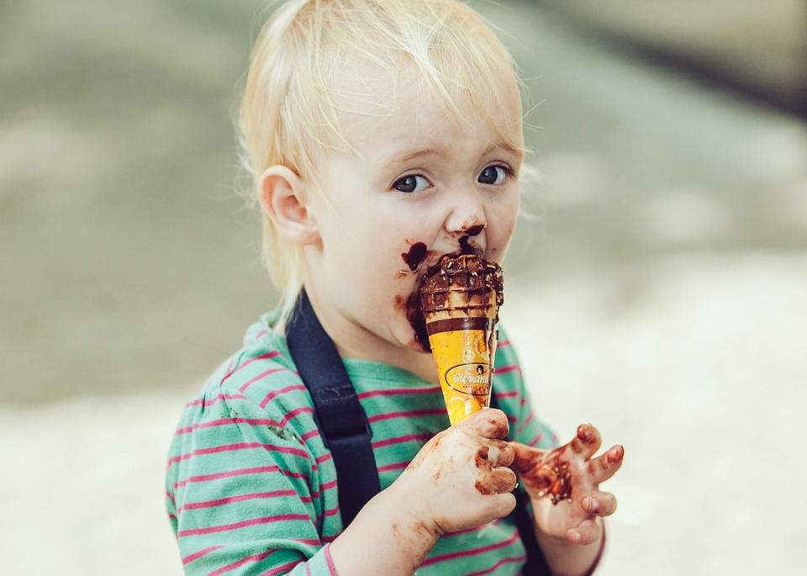
You happily enjoy the shrimp and you get some ice cream.
YOU WIN!

Slide 7
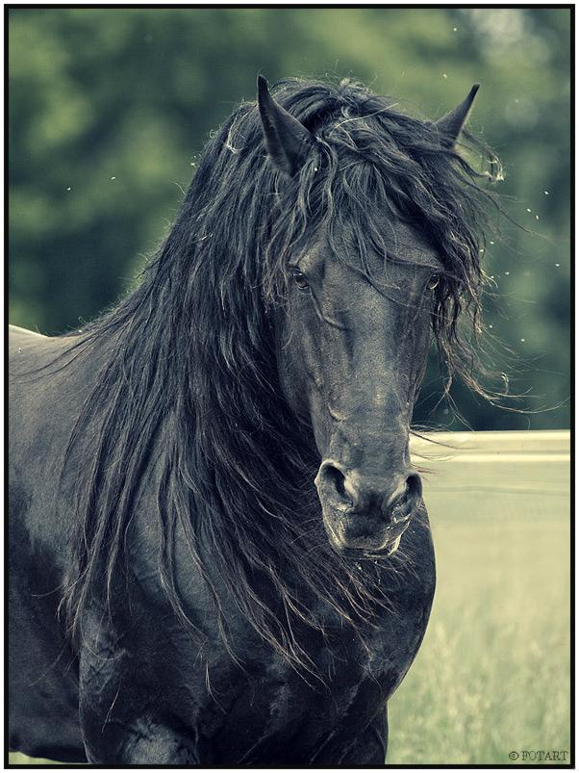
You get up to keep going. As you near the high point of the mountain the neigh grows weaker and you race to the top. Soon you are face to face with the stallion. You see he has a thorn in his neck.
Do you:
walk up and get the thorn out
Bow and take a step backward

Slide 8
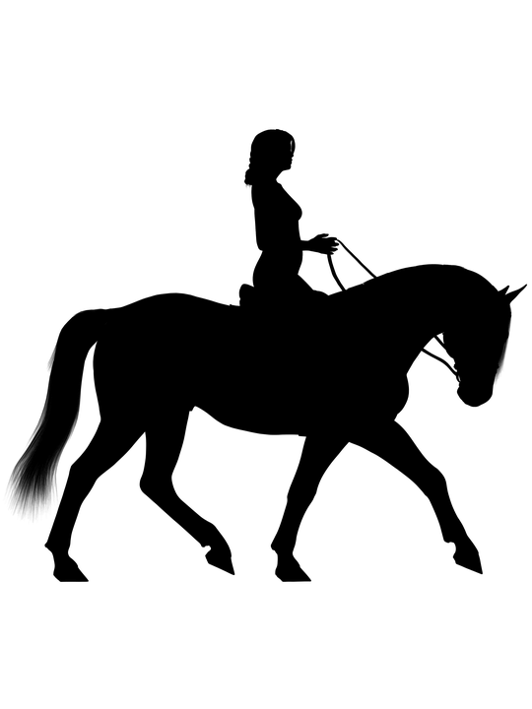
You gently tug the thorn out and the black stallion bends his beautiful head down in thanks and lets you get on him, now you
have a free,beautiful horse!
YOU WIN!

Slide 9
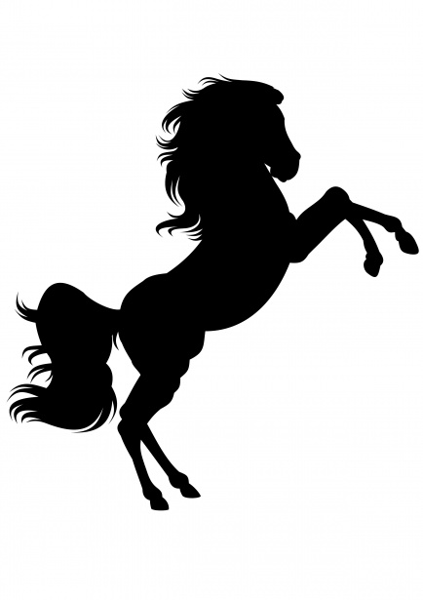
You walk up and get yank out the thorn, but the stallion rears and chases you down the mountain.
GAME OVER!

Slide 10
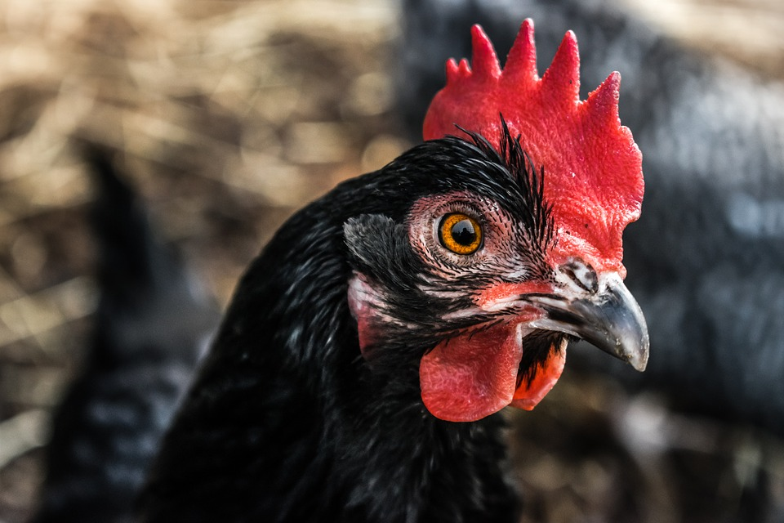
As you feed your chickens, the fiercest of them all bites you and you get an incurable disease.
GAME OVER!

