Slide 1
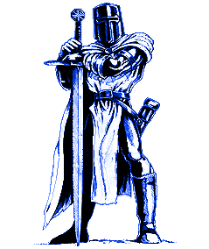
sir Lathonian III
Your story starts you hear the screams of your fellow townspeople and look out your small window and see you village is being attacked and raided by your neighboring kingdom. This could not have happened on a worse day when the 3 fourths of your royal guard are off fighting in the frontier. You know you must do something you are a dangerous person being a skilled swordsmen. Just then you realize your king is in grave danger he must be helped but what about the fait of the towns people.
Do you go to the aid of the king
Or do you fight of the horde of warriors in the town

Slide 2
You have chosen to save the towns people
You grab your sword laying on the side of your bed and dawn your armor you are ready for battle you open your small cottage door and see the royal knights fighting the enemy warriors with all their might you run to join their formation. You all bring up your shield just in time to deflect a barrage of arrows only a few knights where wounded, suddenly you are attacked the enemy hey charge swords drawn they stab the man in front of you blood dribbles down his back while he groans you got lucky. You see that they have the situation under control you think of now coming to the aid of your king
Continue helping in the village
Sprint to the aid of your king after helping in the village

Slide 3
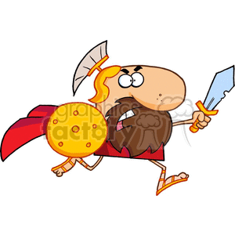
You chose to go to the aid of your king
After you dawn your gear you join a group of the royal guard and run into the castle you see a group of enemy's in the distance, but a group of archers disables them you take them out up close in range.you spot the king and create a formation around the king you hear new that the village was burned down. SUNDENLY the whole enemy army storms into the castle you, the king, and your allies try to run but the king is slow and you are to in your heavy armor you all die
you lose

Slide 4
You have chosen to keep fighting in the village
Soon the enemies use fire as a weapon that try to burn the houses use flaming arrows but then you remember that your kingdom has great firepower so a big group of men bring out the catapults and trebuchets you turn the tables but you hear that the castle has been overrun and the king was stabbed in the chest R.I.P king fizzelpop
You lose

Slide 5
After helping in the village you go to the aid of your king
You run to the castle after ensuring that the village was safe you lung up the long spiral stairs to the panic room where the king is hiding you tell him you have come to his aid he is grateful, and says you will be treated like a hero after this you fight the enemy's with some ally's until the enemy gives up the raid is over and the village, and king are safe
You win

