Slide 1
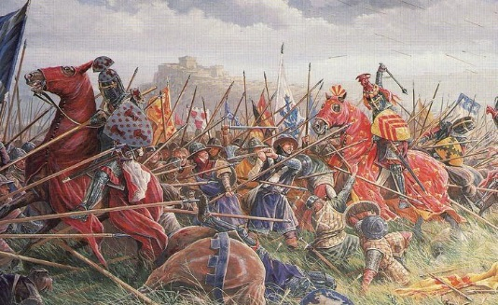
Medieval war
By: Grant Alsbury

Slide 2
Once upon a time
Our hero wakes up in a old cave with skeletons that are lying on the floor
Choice 1 wake up and go explore the new land
Choice 2 stay in the cave with the skeletons

Slide 3
Outside
You see a giant castle outside
Choice 1 go to the castle
Choice 2 go explore something else

Slide 4
In the cave
You get to scared and faint
Choice 1 Try to wake up
Choice 2 keep sleeping and wait to wake up
Skip like 6 slides optional

Slide 5
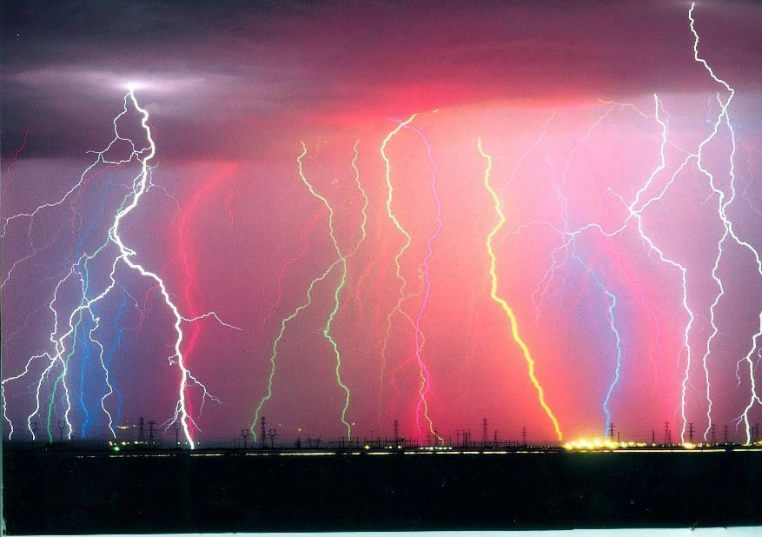
Death
You died by shock

Slide 6
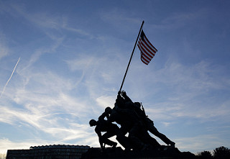
The WAR!!!
THE war has started do you join or not

Slide 7
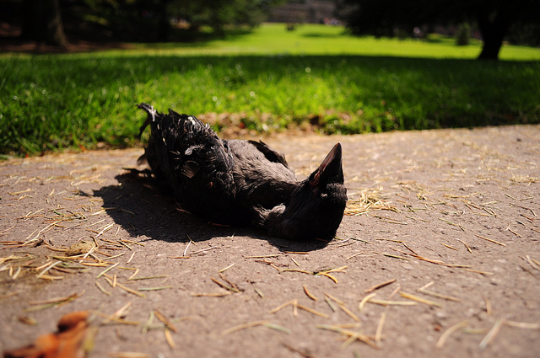
Death
YOU LOSE ☹

Slide 8
In the castle
You find the vault and take the money You win!!!! $$$$$$$$$$$$$$$$$$$$$$$$$$$$$$$$$$$$$$$$$$$$$$$$$$$$$$$$$$$$$$$$$$$$$$$$$$$$$$$$$$$$$$$$$$$$$$$$$$$$$$$$$$$$$$$$$$$$$$$$$$$$$$$$$$$$$$$$$$$$$$$$$$$$$$$$$$$$$$$$$$$$$$$$$$$$$$$$$$$$$$$$$$$$$$$$$$$$$$$$$$$$$$$$$$$$$$$$$$$$$$$$$$$$$$$$$$$$$$$$$$$$$$$$$$$$$$$$$$$$$$$$$$$$$$$$$$$$$$$$$$$$$$$$$$$$$$$$$$$$$$$$$$$$$$$$$$$$$$$$$$$$$$$$$$$$$$$$$$$$$$$$$$$$$$$$$$$$$$$$$$$$$$$$$$$$$$$$$$$$$$$$$$$$$$$$$$$$$$$$$$$$$$$$$$$$$$$$$$$$$$$$$$$$$$$$$$$$$$$$$$$$$$$$$$$$$$$$$$$$$$$$$$$$$$$$$$$$$$$$$$$$$$$$$$$$$$$

Slide 9
The spooky forest
After you wake up from fainting you find yourself in a random spooky forest
Choice 1: Go find the cave you fainted in
Choice 2: Explore the new land

Slide 10
In the spooky forest
You see a swamp monster what do you do
Grab your sword
Or run away

Slide 11
Holding your sword and about to fight a monster
Choice 1: slash your sword at the monster
Choice 2: block the monsters tentacle

Slide 12
The monsters tentacle
Do you slash the tentacle
Block it

