Slide 1
The zombie
by:ikhlas

Slide 2
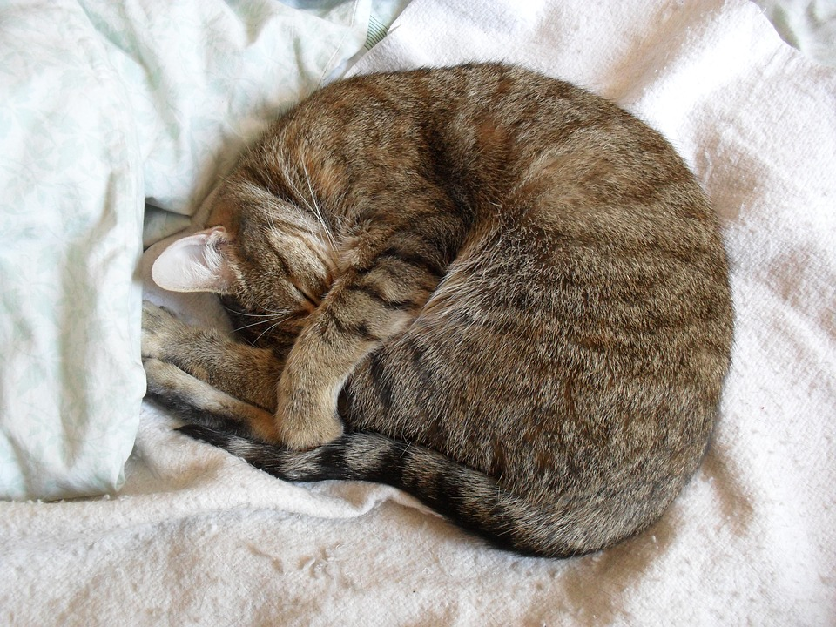
Once upon a time…..
You wake up for school and you hear bus leave…
Do you...
Take nap
Run to school

Slide 3
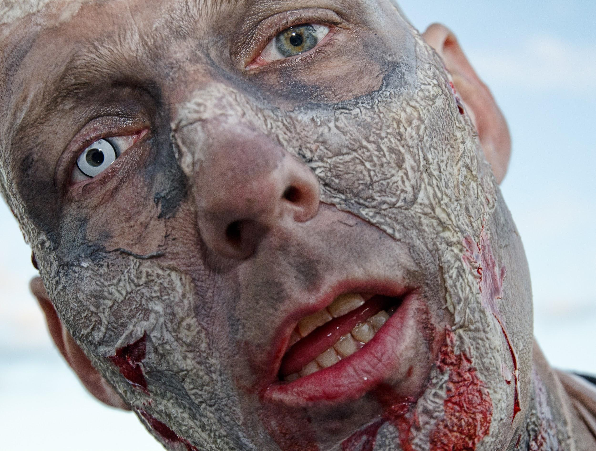
Take nap
You take nap and you hear footsteps…
Do you..
Look
keep staying in the bed

Slide 4
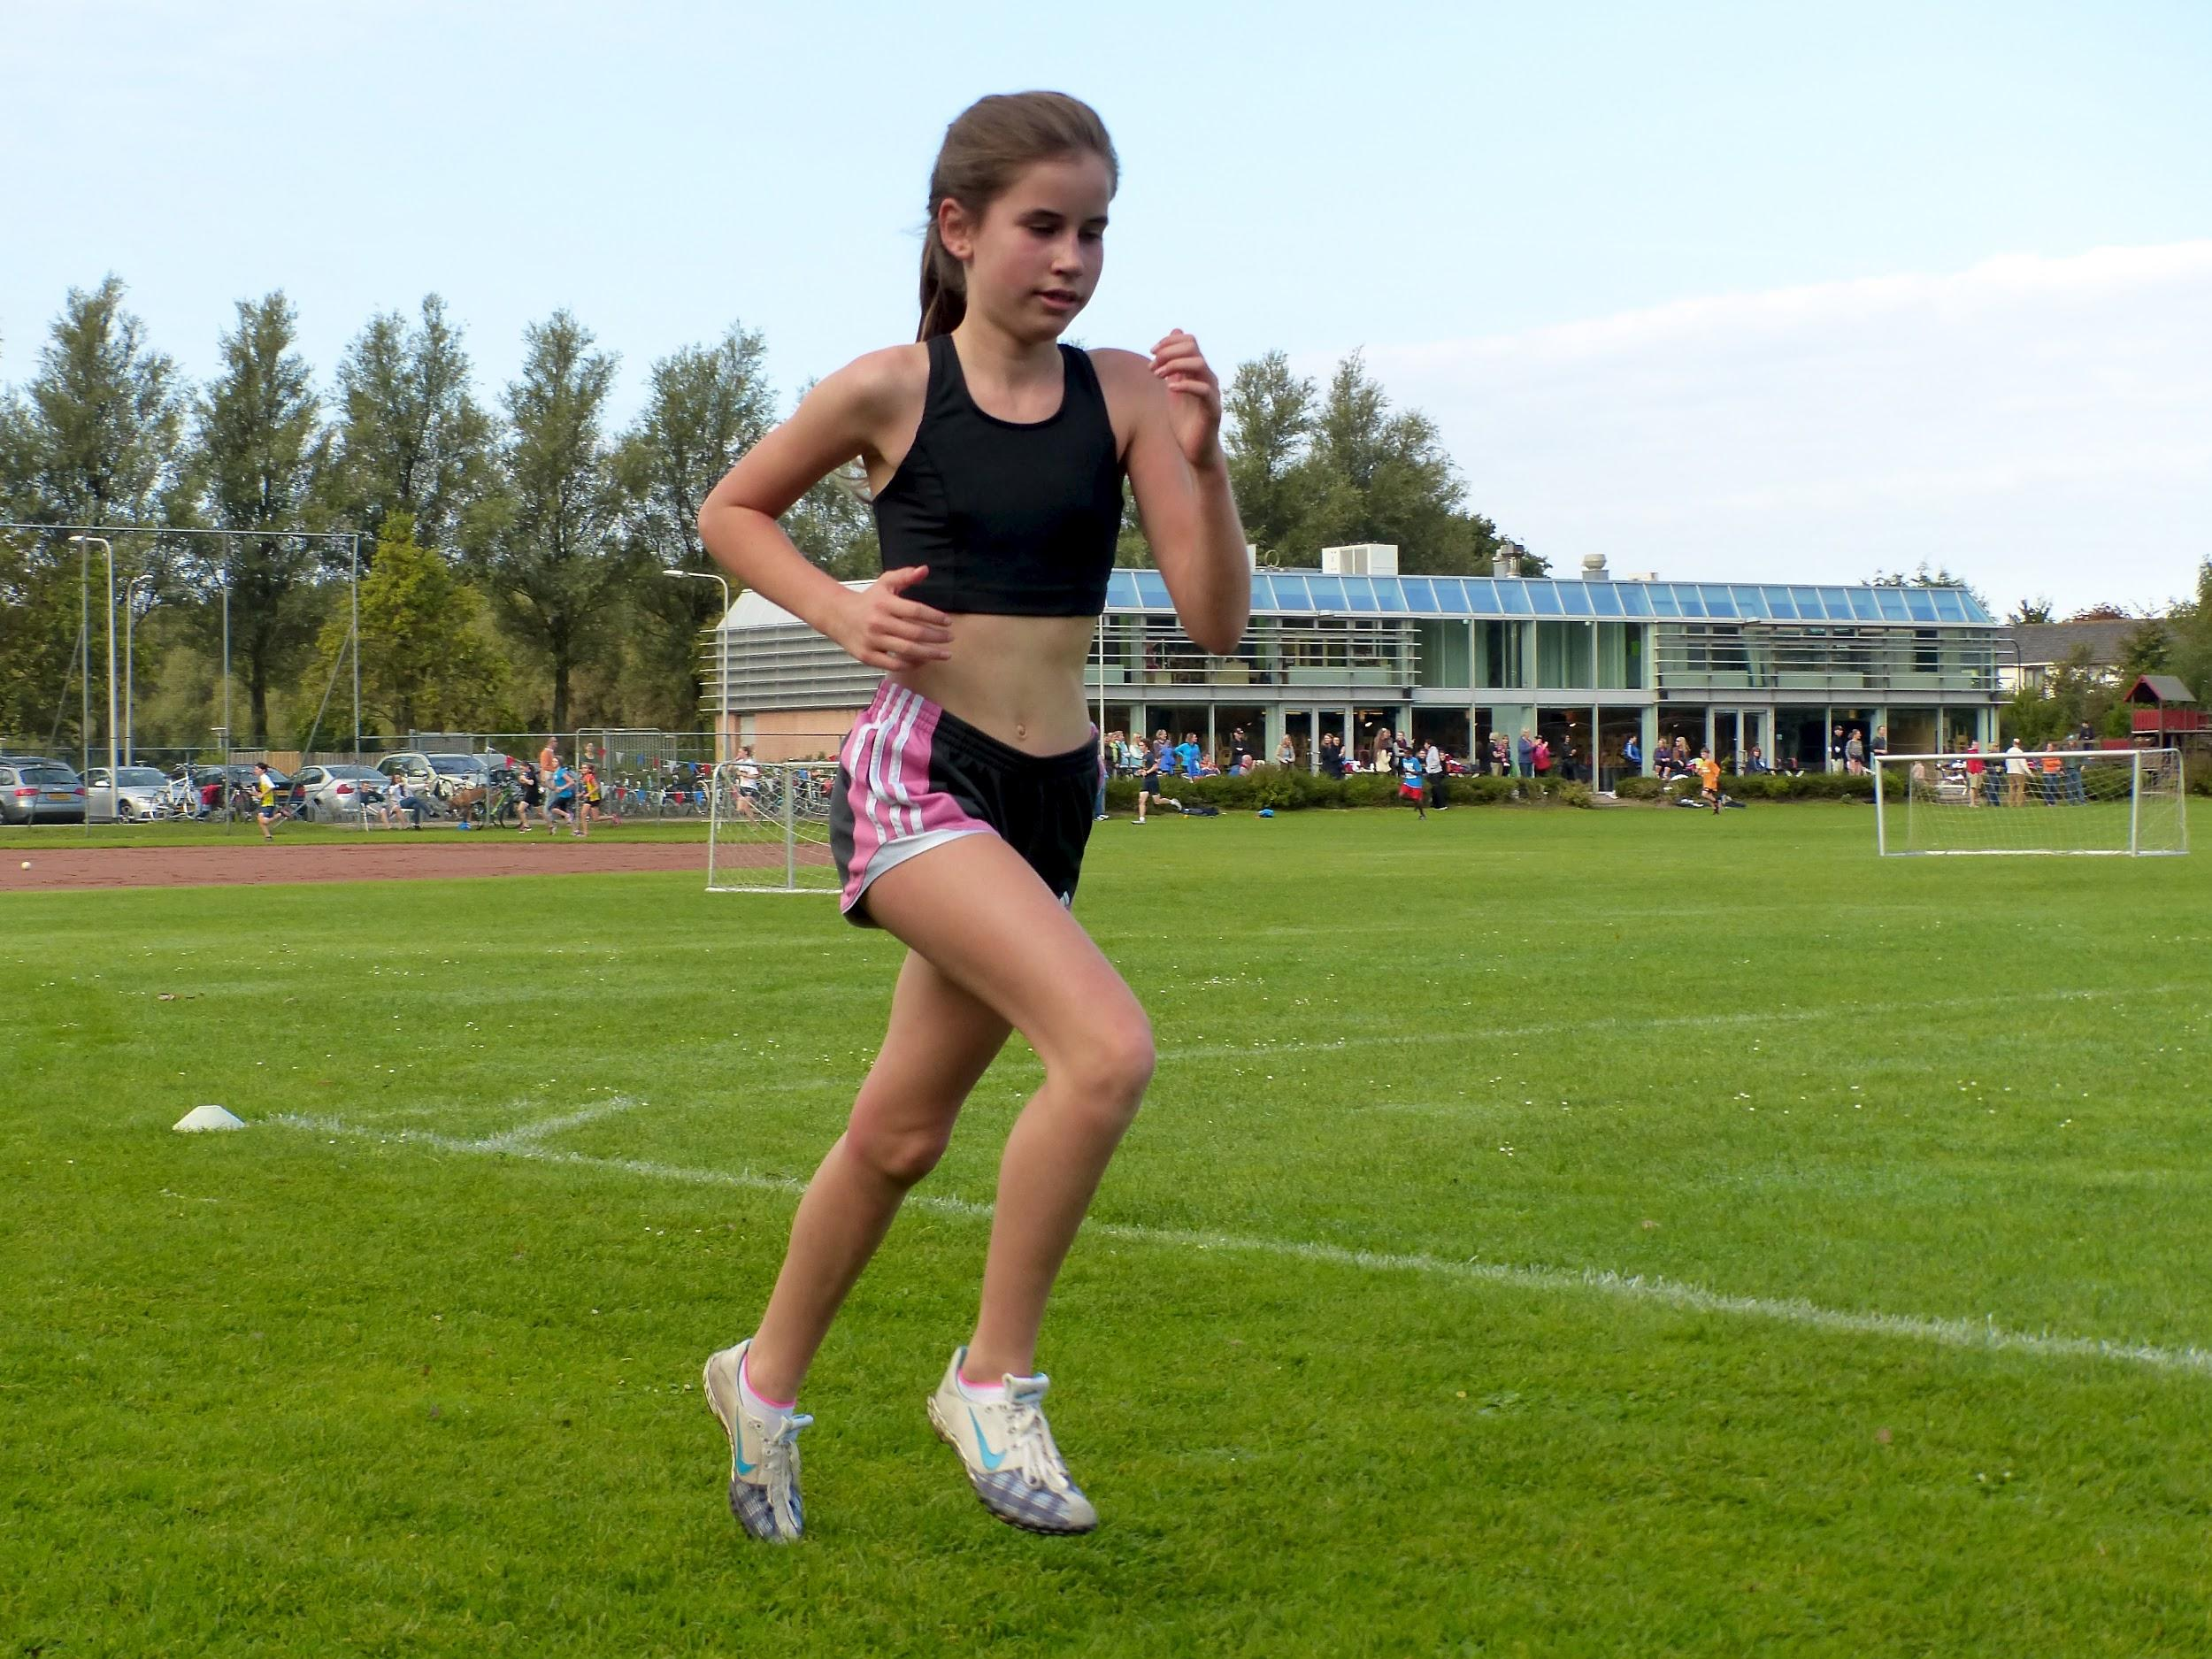
Run to school
You get dressed eat breakfast and run to school..
Do you
Open front door
go in back door

Slide 5
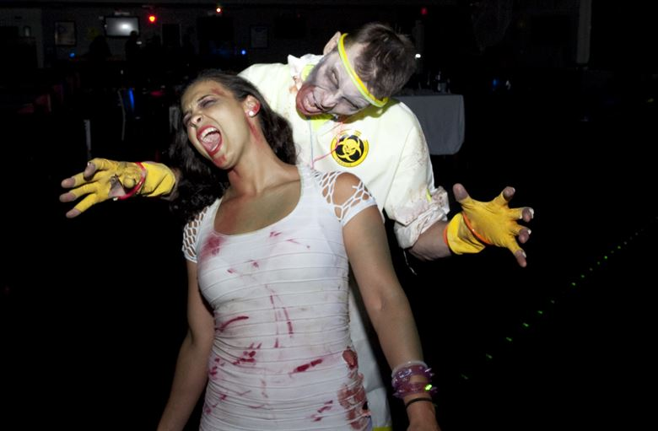
Look
You look and zombie eats alive
Game over!
Try again

Slide 6
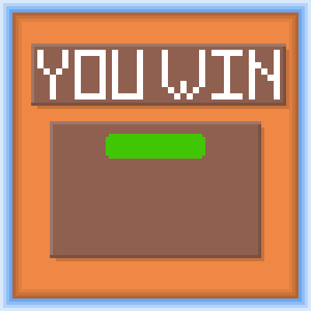
Keep staying in the bed
Your in bed and they go back out .
You win!!!

Slide 7
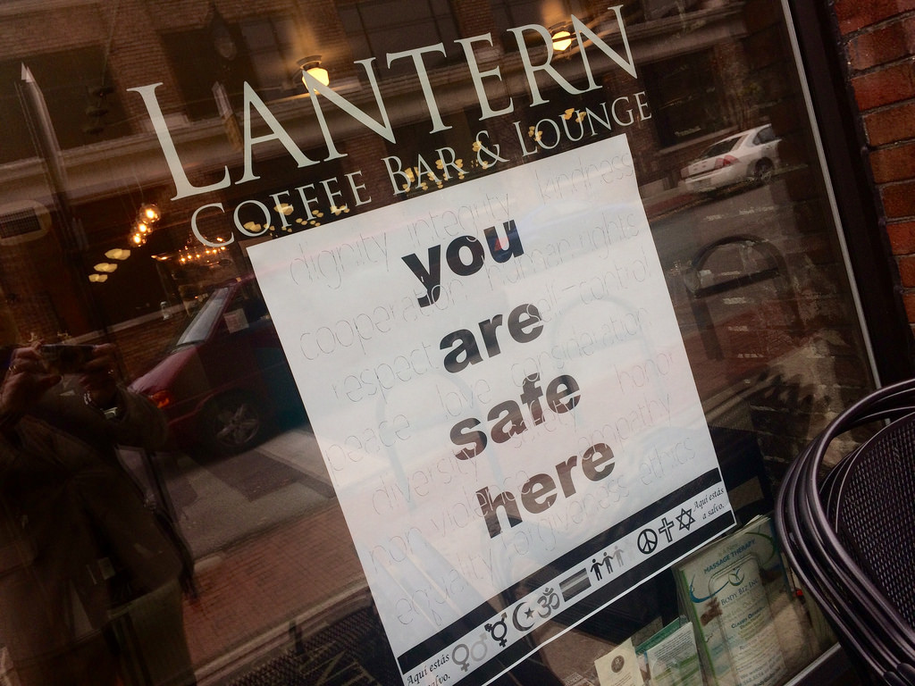
Open front door
You open front door and u go safely to school
You win!!!

Slide 8

Go in back door
You go in back and zombies kill you
Game over!!!
Try again

