Slide 1
The Purge
W4 jack

Slide 2
Its march 23rd and it’s the purge what do you do
Hide
Be on the street

Slide 3
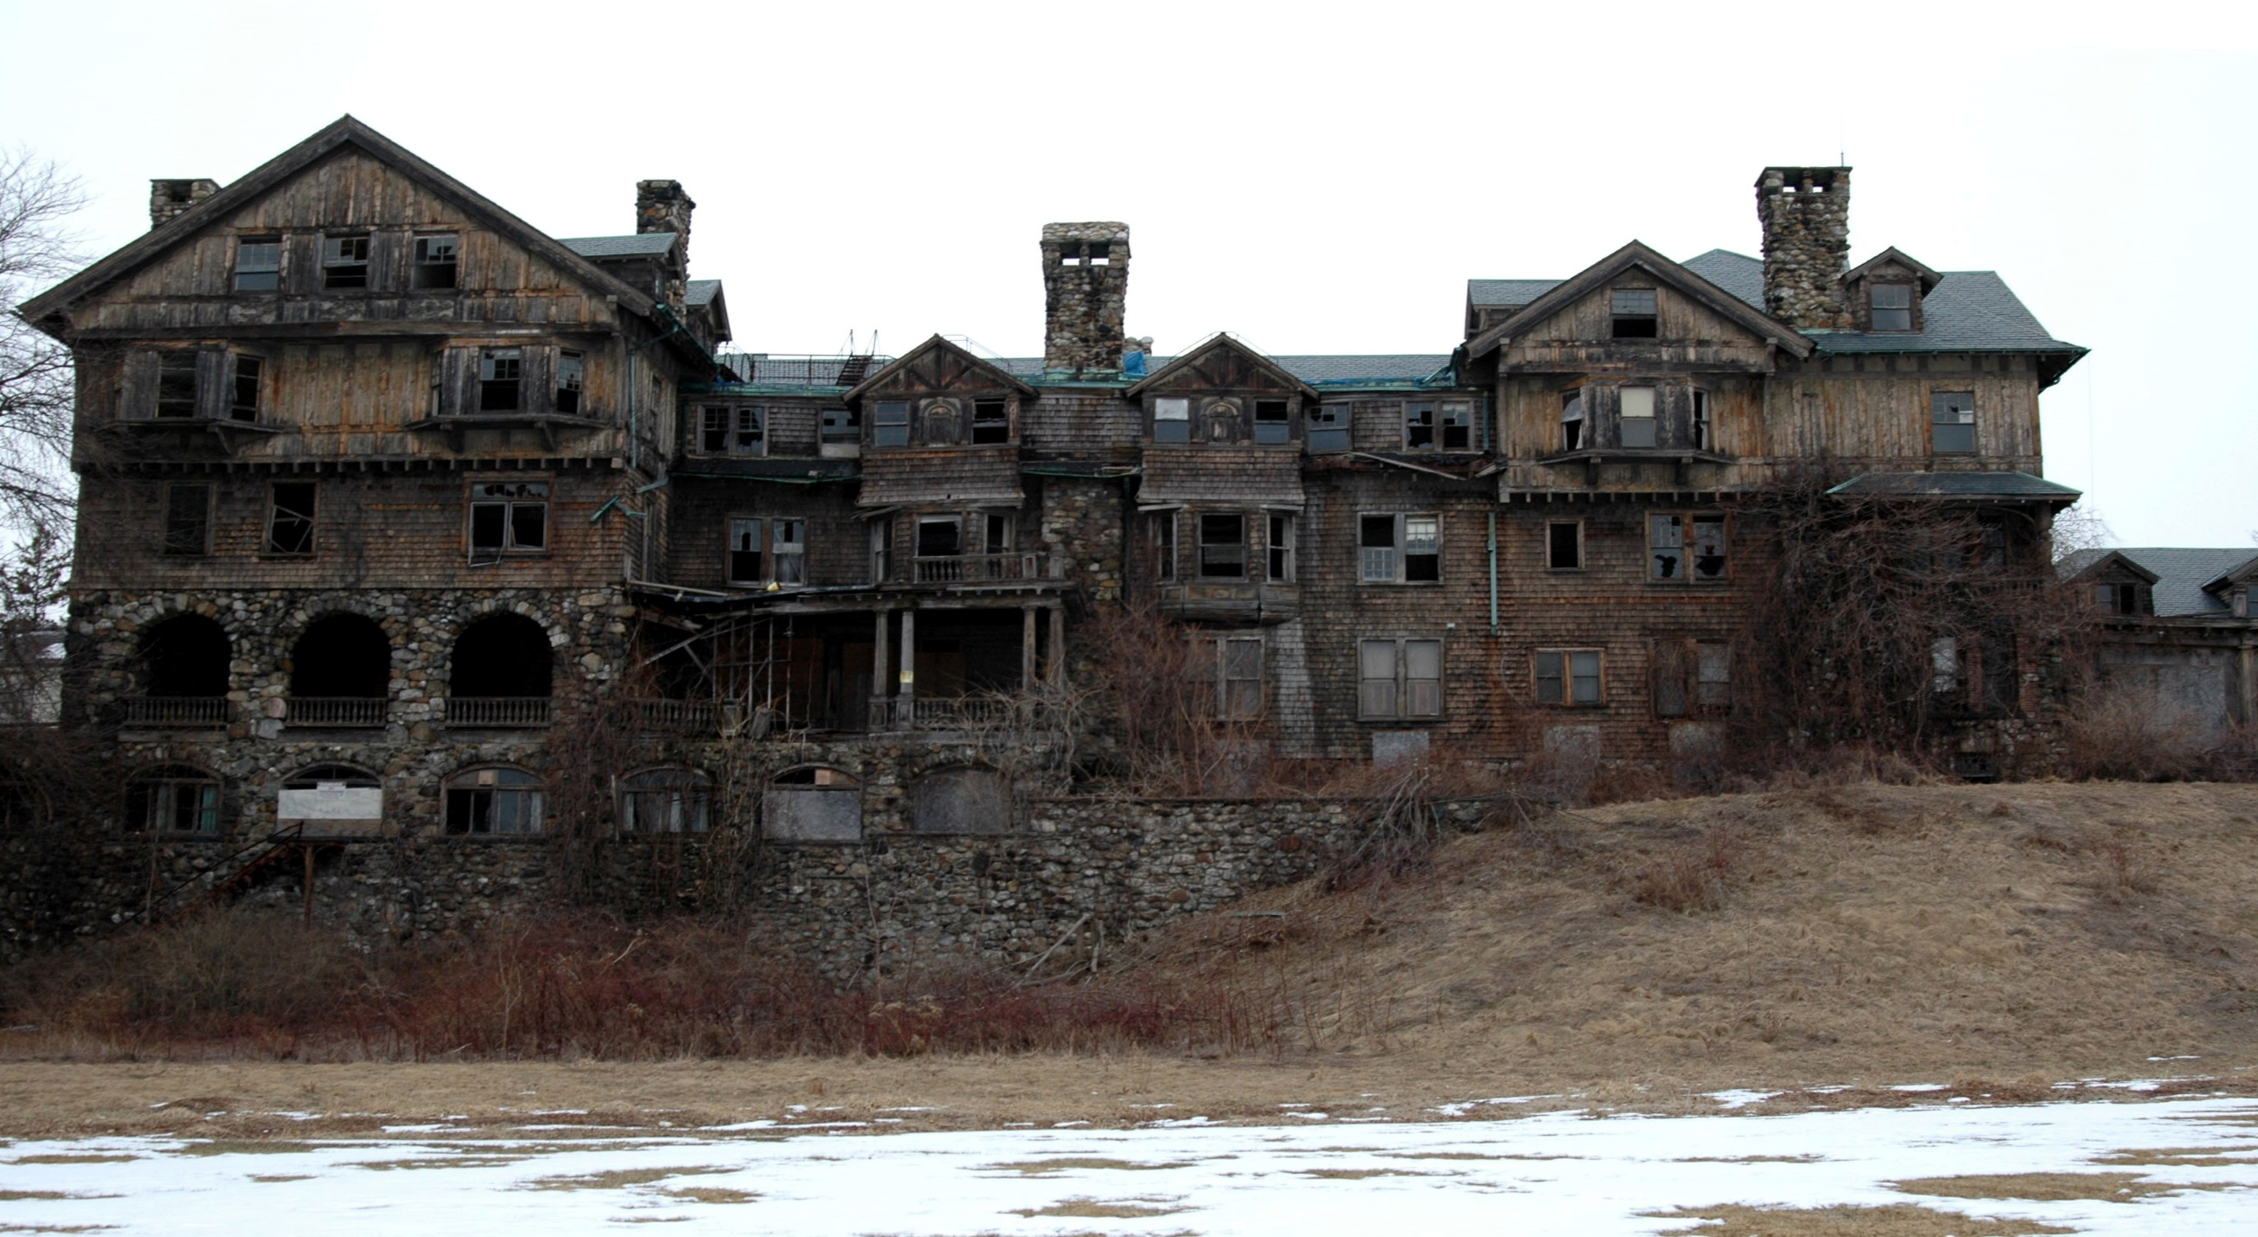
Hide
You hide in a abonded house there a gang of purgers inside what do you do

