Slide 1
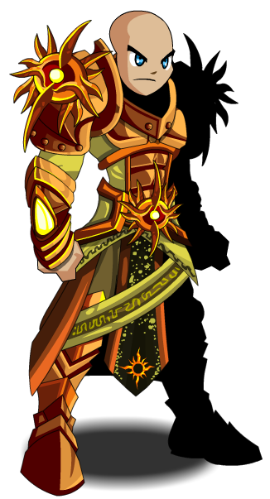
The warrior

Slide 2
You wake up and notice your sword is gone you wonder where it went so you leave your cabin inside the castile You see a shadow behind the kings domain
1|chase him
2|Leave the figure alone

Slide 3
Path one
You follow the figure you go behind the castile then he shows himself he was a solider in the great war where dragons killed his army he was poor and wanted your sword he STABS YOU YOU FALL ON THE GROUND You have died game over

Slide 4
Path 2
You leave him alone you go to the market to buy another sword so you can find the person who stole your sword you also buy a bow and two potions
1|leave the castile the normal way
2|you leave the castile from the broken gate behind the castile

Slide 5
Path 3
There is a gang of goblins you are beadle injured.
1 do you us a potion
2 do not use the potion

Slide 6
Path 4
There is a clear path but a shadowy finger is in the dints.
1RUN AS FAST AS YOU CAN
2 use your bow
Go over there

Slide 7
Path 1
A grad he thinks you are a thief so you died.

Slide 8
Path 2
You shot your bow and her ow my foot.
1 Run over there
2 Shot your bow

Slide 9
Path 3
He sabs you with your sword.

Slide 10
Path 1
You find the man that stool your sower you stab him with your new sowed and shoot him In the hade with the bow and grab your old sword
You win

Slide 11
Path2
he is so mad that he randomly throw his sower in the are and sume how it hit you.

