Slide 1
Abducted by aliens

Slide 2
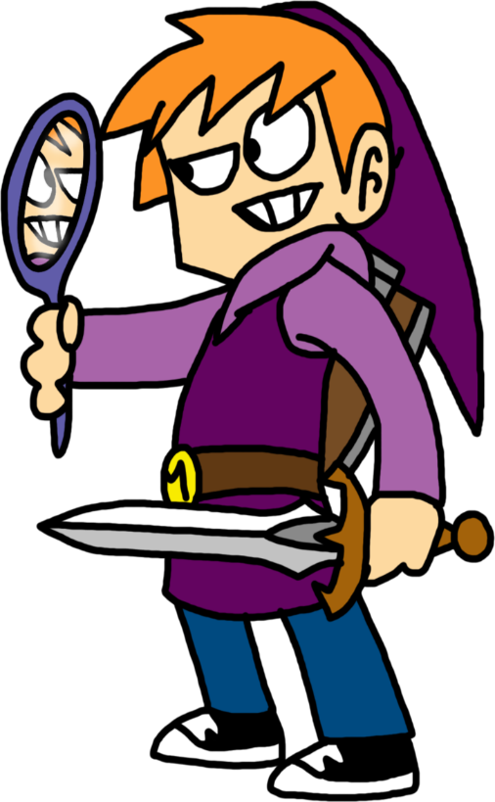
Once upon a time
There was a kid who lived in a apartment he was the 2 child in the family he went out side and to practice his fighting skills and when he go his sword out of the case he saw a bright light and it landed by a near by tree

Slide 3
Choices
Go to the tree and check it out
Ignore and keep practicing

Slide 4
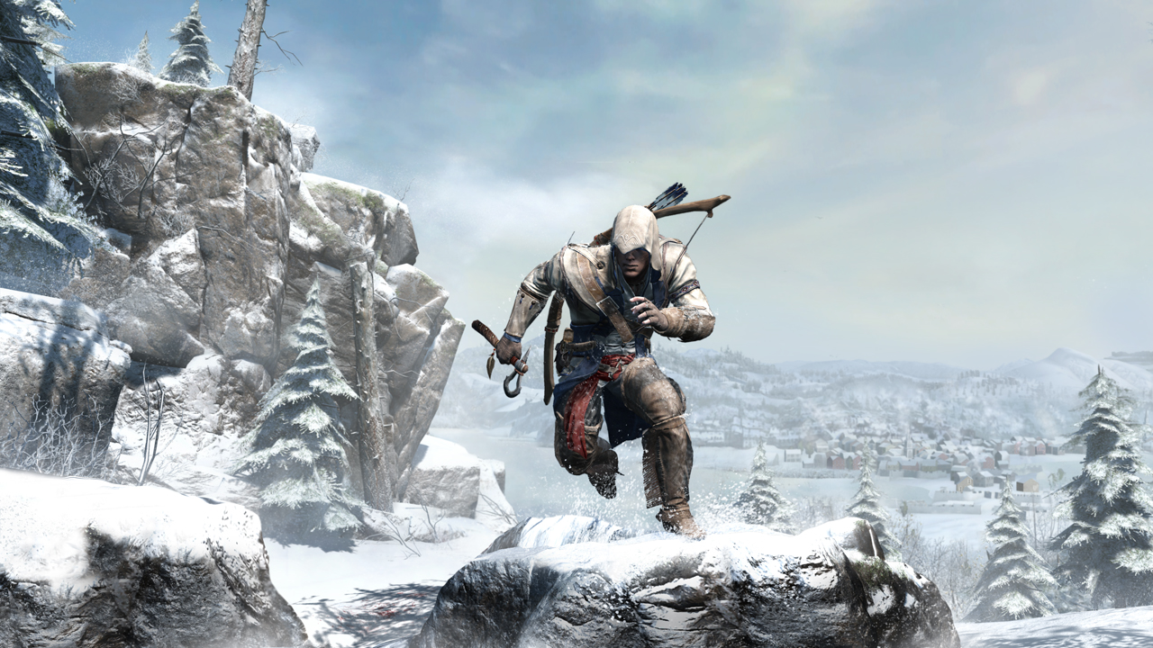
You go to bed and the alien send out assassin aliens to kill you
sorry your dead

Slide 5
Path 1
So you went to the tree and got abducted and they studded you and they put you in a deep sleep when you woke up you were in a room with cameras and stuff hooked up to your body and bobby pins next to you do you ether
On hook the wires Put the blanket over your head and go over to the camera and cover it up and unlock the door with the bobby pins
Lay there and go back to sleep

Slide 6
Path 2
SO YOU IGNORE IT AND YOUR MOM YELLS AT YOU TO COME IN SIDE AND EAT DINNER
EAT DINNER AND GO TO BED
KEEP PRACTICING

Slide 7
PATH 1

Slide 8
PATH 2

