Slide 1
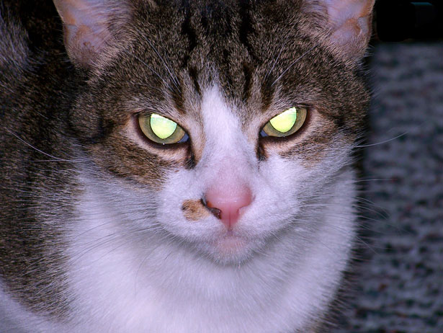
Attack by cats

Slide 2
One day you buy a cat then in the Night the cat was very very mad and look at you what well you do fight the cat or run then lock the door and run

Slide 3
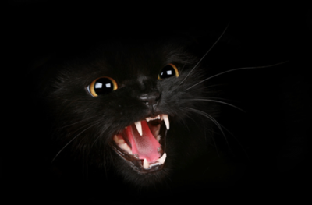
Fight the cat oh no the cat fights back it jump up the air bite you the cat will never stop then you die

Slide 4
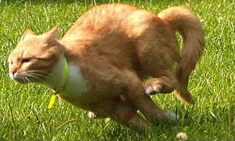
Run away and lock the door the cat breaks the door and chases you intill the cat stop running the cat fainted on the ground you survived

Slide 5
The survived then you move to a different place the end

