Slide 1
Adventure story
By James

Slide 2
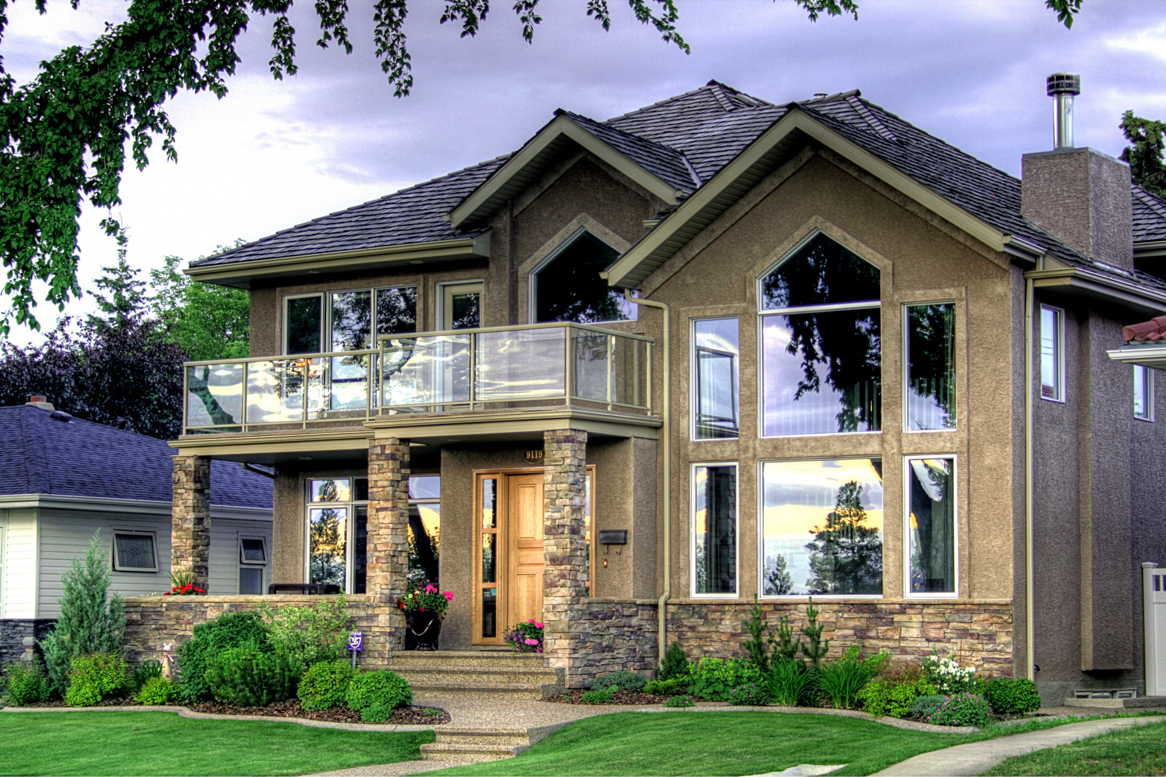
There was A guy who was going to the forest
.Choice 1 walk to the forest
.Choice 2 drive a car to the forest

Slide 3
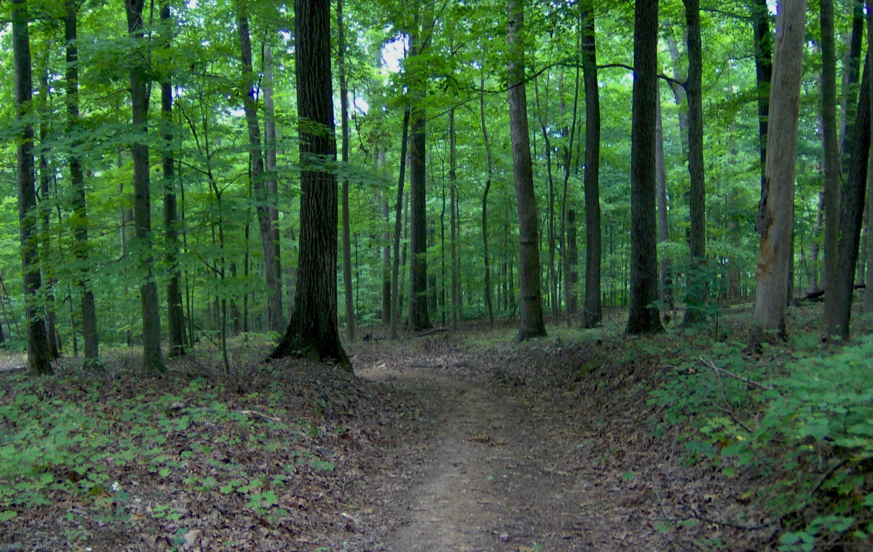
You have your camera
The end you die

Slide 4
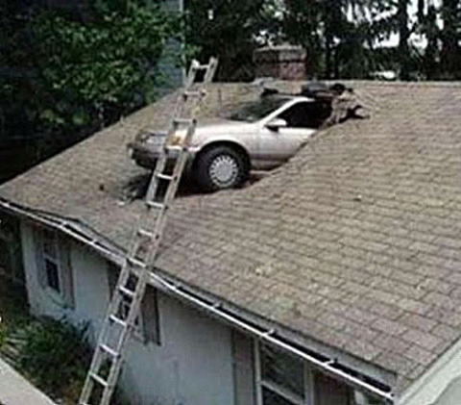
Drive to the forest
You die because you hit a car

