Slide 1
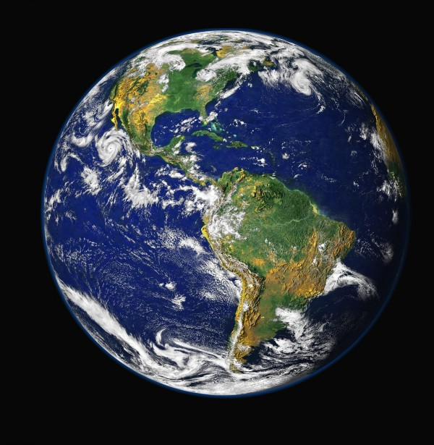
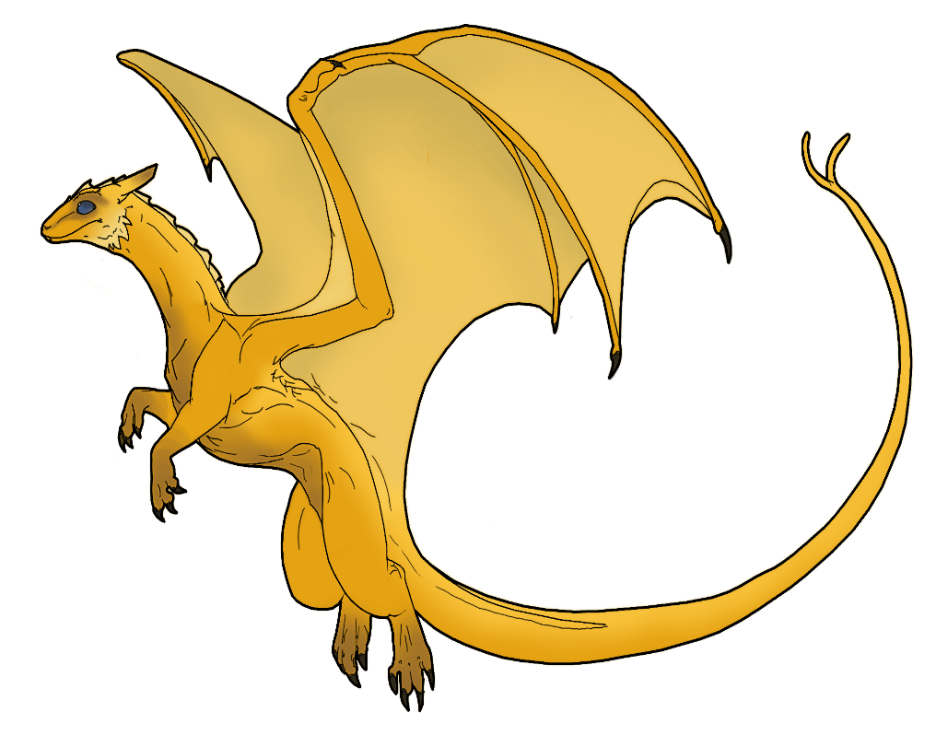
Welcome to dragon world as we astronomers call it

Slide 2
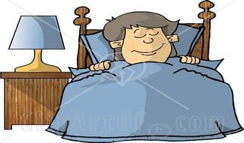
You wake up ready for your first day at dragon training years of scooping dragon droppings have finally paid of.
You have 2 choices
1 wallow in bed
2 get ready as fast as you can

Slide 3
1 you wallow in bed
You miss dragon training you loose
Try again

Slide 4
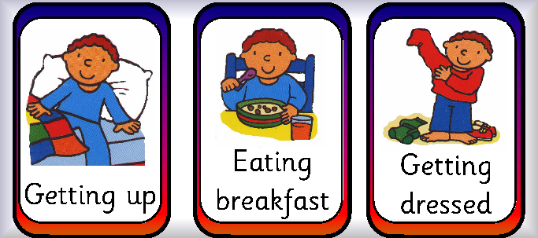
2 you get ready as fast as you can
You get ready as fast as you can and don’t forget anything
You go to the training grounds

Slide 5
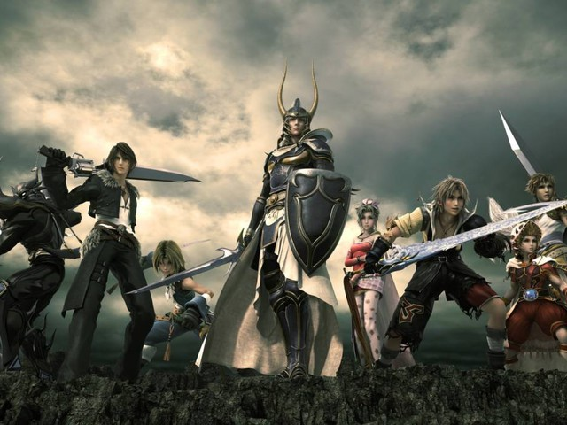
You are at the training grounds
You get a crossbow and wonder if you should get on your dragon right away.
You have 3 options
1 ask for dragon
2 start training
3 steal your dragon.

Slide 6
You ask for your dragon the teacher says no
You loose
Try again

Slide 7
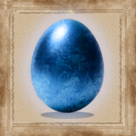
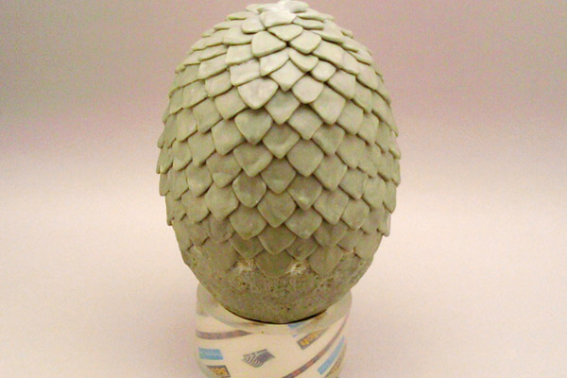
You train after a while you get to choose your dragon

Slide 8
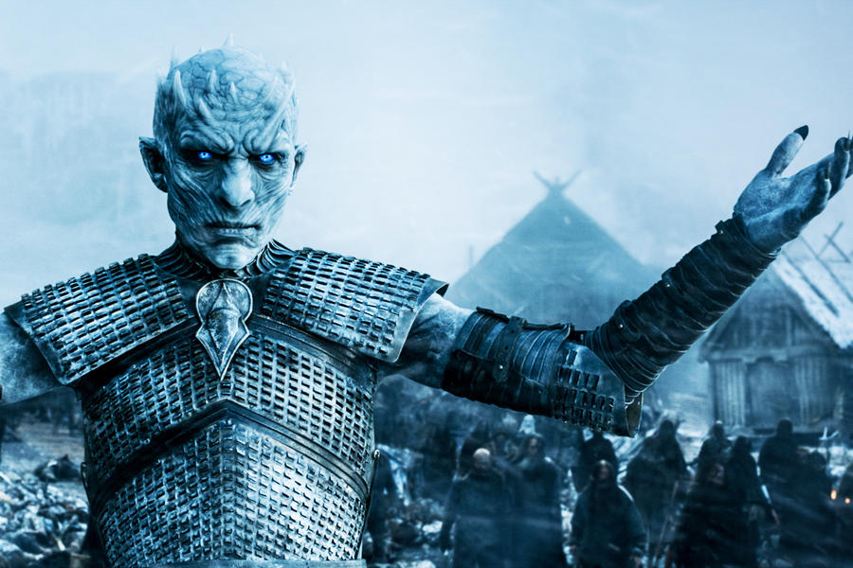
You are not playing the game of thrones you loose
The end

Slide 9
You get a good dragon you train it and get the legendary deathskin
You win!
See yourself on the deathskin

Slide 10
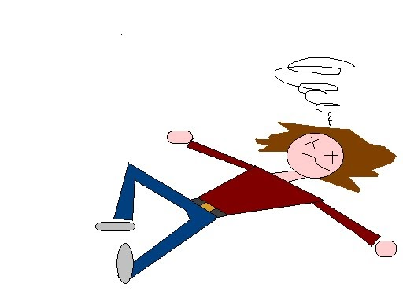
You die!
Try again?

Slide 11
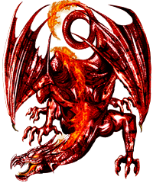
You try to steal yourself a dragon and get killed I guess you should have paid attention
Try again

Slide 12
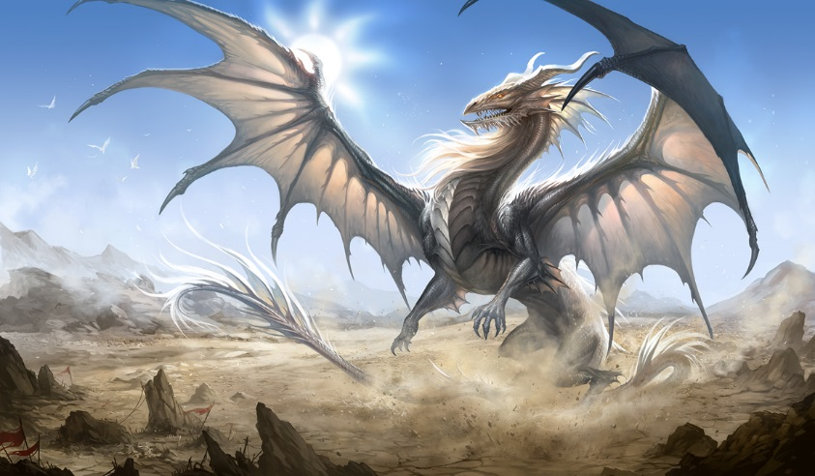
This is you on the deathskin

