Slide 1
King BOB
By:kai

Slide 2
Once upon a time…
There lived a king who lived in a castle. His name was BOB. He’s late for his meeting.
Do you rush to the meeting
Do you walk

Slide 3
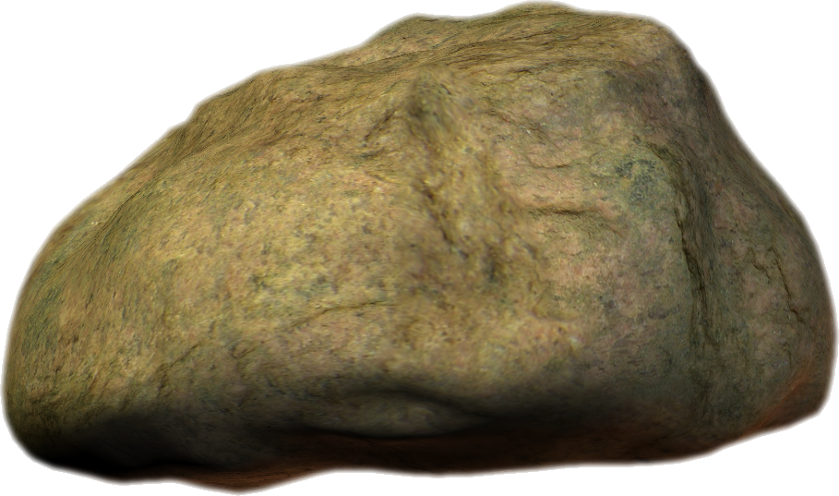
You rush
You choose to rush. You trip and fall on a rock.
Do you…
Call first aid
Or keep walking

Slide 4
You walk
You choose to walk and take your time. when you get there you are safe because you’re the king.
YOU WIN!!!!!

Slide 5
First aid
You call first aid. They say that they ran out of safty supplies.
Do you…
Keep walking
Or go home

Slide 6
Keep walking
You keep walking. You finally make it but your knee is infected.

Slide 7
You go home
You choose to go home.
Turns out that you’re the boss. Your safe!

