Slide 1
My scary street

Slide 2
WALKING HOME……..
As I’m walking home I see some one fallowing me
Walking home on my phone

Slide 3
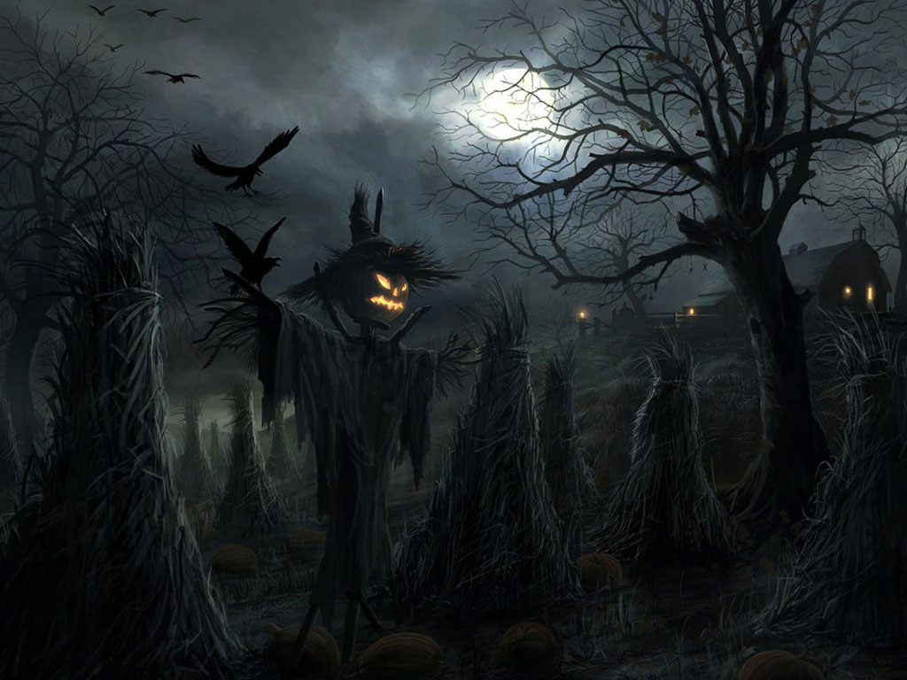
Path 1
Say stop fallowing me
Slide
Walk faster

Slide 4
Path 2
I stop and go to the park

Slide 5
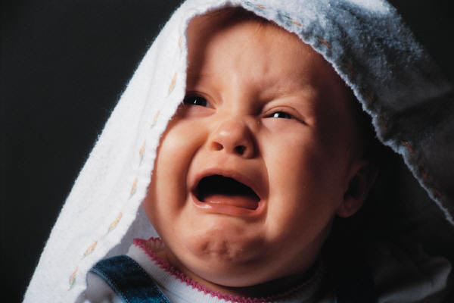
He grabs you and takes you away
You lose

Slide 6
He yells ok you win

Slide 7
You lose

