Slide 1
The dark night
By:korben

Slide 2
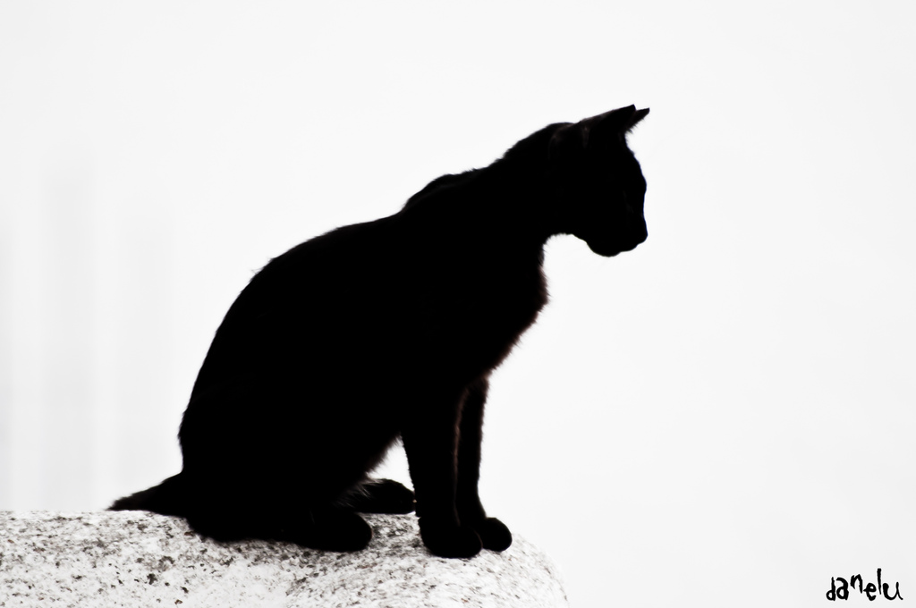
the cats name is Gioia

Slide 3
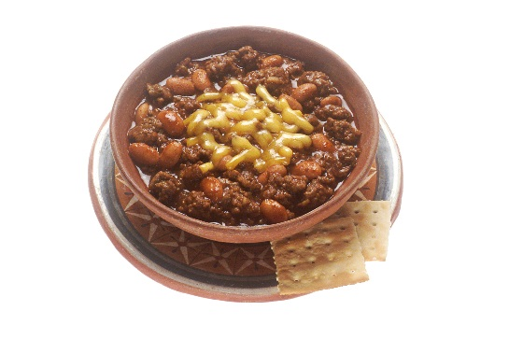
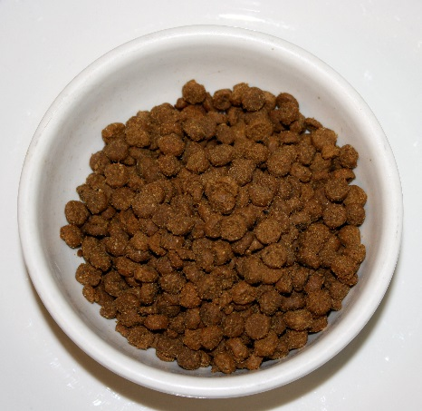
Choice 1eat a bowl of chilly
Choice 2eat a cat food

Slide 4
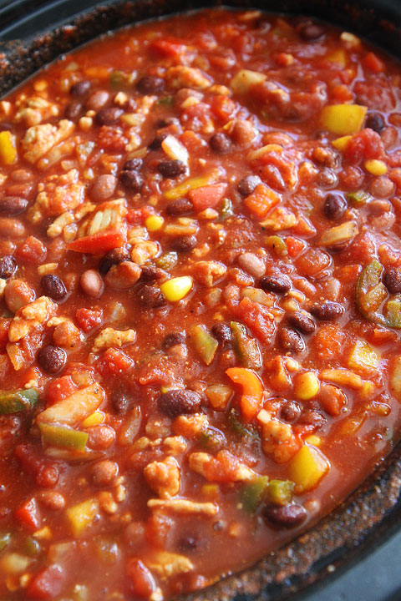
I am sorry you are dead

Slide 5
I am sorry you are dead

