Slide 1
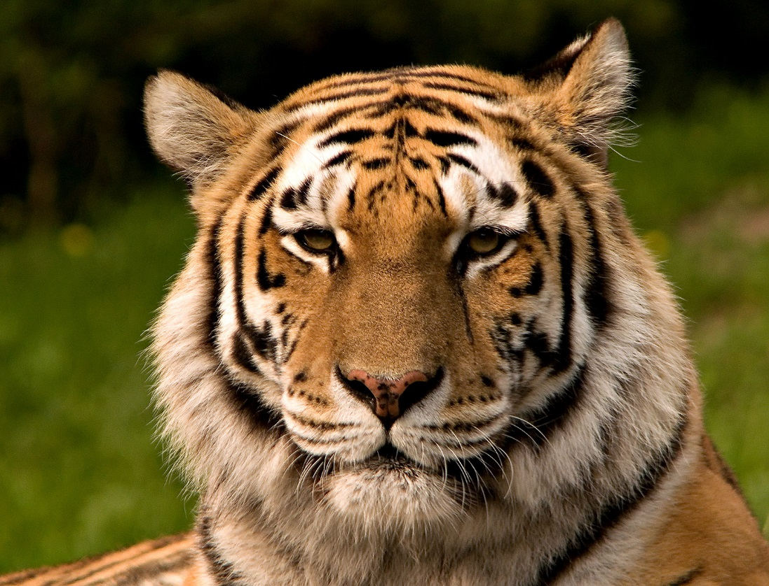
Survive the unexpected

Slide 2
There was a tiger, he was a pet…
THEN HE WENT SAVIAGE!!!
Path one, RUN!!!!!.
Path two, try to tame.
Path three, try to ride the tiger.

Slide 3
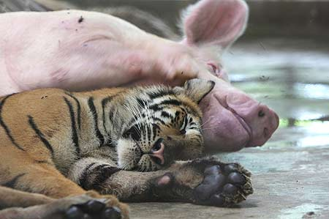
You ride the tiger!!!!
You are on the tiger!!!You and the tiger are best frinds!
Go out side
Stay inside

Slide 4
YOU ARE DED

Slide 5
YOU WIN!!!!!!!!!!!!!!!!!!!!!
YAY!!!!

Slide 6
Try to tame the tiger
You try to tame the tiger, then he eats you.
you ded ☹
sorry bro

Slide 7
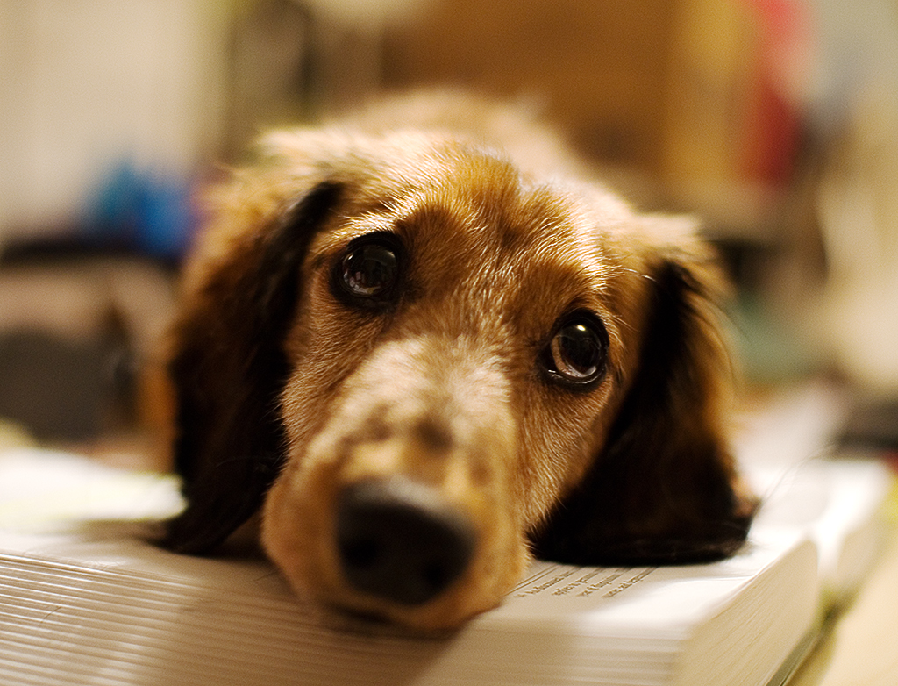
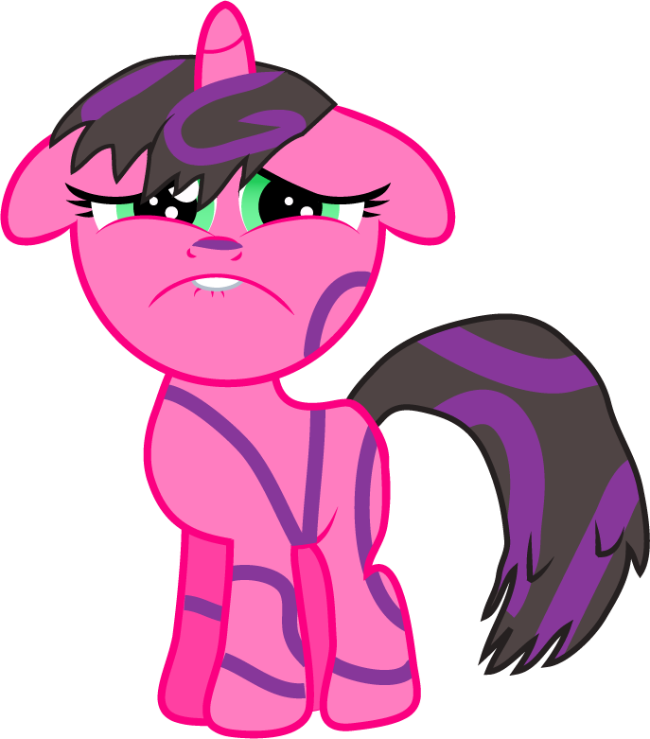
RUUUUUUUUUUUN!!!!!!!
You run out the door, THERE ARE 10 MORE TIGERS!!!!!!
Waaaaaaaaa!!!!!
\I/
YOU DED : (
sorry bro

