Slide 1
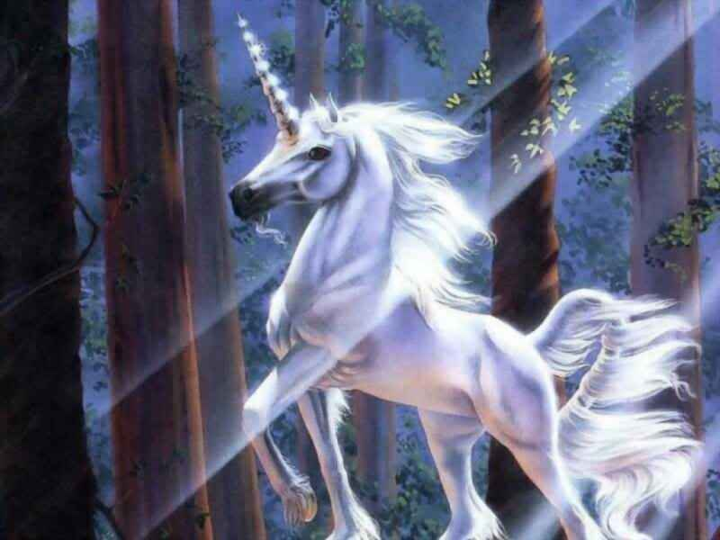
Unis The Unicorn
The Happy Unicorn
By: Lily Shelton

Slide 2
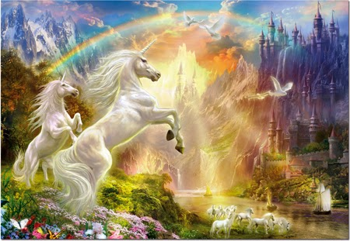
You Choose
He lives on a rainbow
He lives under a bridge

Slide 3
HE IS HAPPY AND PLAYS WITH FRIENDS
YOU WIN

Slide 4
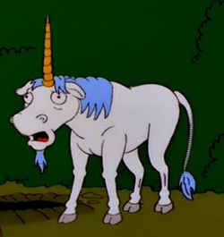
He runs out of food and dies
YOU LOOSE

Slide 5
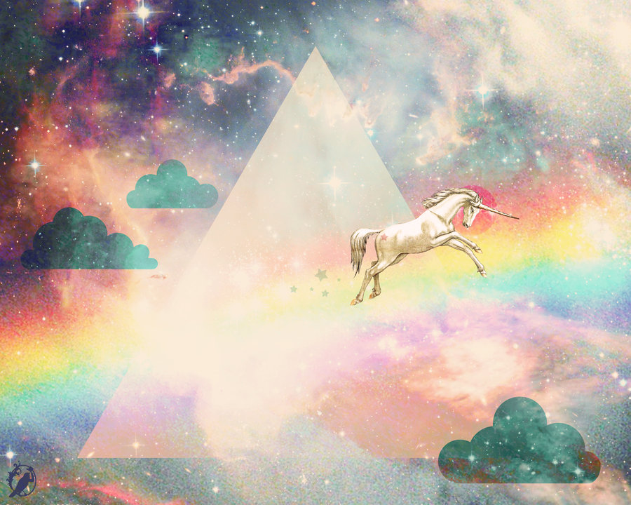
What do you think?
He lives hapaily ever after
He crawls in a hole

