Slide 1
An ARBY’S Adventure
By: Luna Simpson
And Maddi Lewis

Slide 2
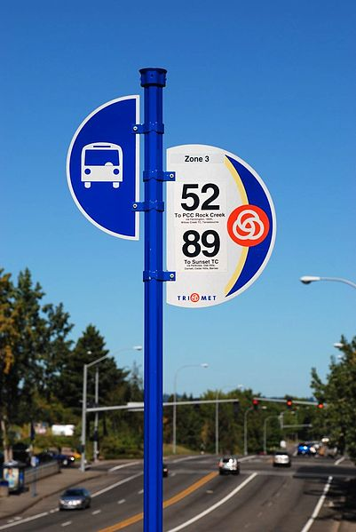
Once upon a time…
You wake up to terrible news, your boss at Wendy's says that you have been fired for eating the food there.
You get up and find something on your front porch, it’s a hiring flyer for Arby’s. there is only one more spot left, and you have to be there at noon. The Arby’s is 20 mins away.
What do you do to get there before someone else? You don’t have car.
bike
bus

Slide 3
Path 1
You get up and get dressed
You decide to ride the bus
You walk to the nearest bus stop that takes you to arbys
You get on the bus
your halfway there, the bus brakes down, everyone evacuates the bus
Arby’s is 10 mins away
Ask random person to borrow a bike
Walk the rest of the way(you don’t know what will happen)

Slide 4
Path 2
You choose to bike all the way to Arbys
It takes 30 mins to bike
You get up and you are tired
You start up the hill
Your move and you crash into the road
You get hit
YOU LOST!!!!!!!!!!!!!!!

Slide 5
Path 3
You choose to walk the rest of the way
You keep walking and walking
Then you see Arby’s across the street
You are waiting at the cross walk
A guy asked you where your going you don’t know if he wants to work at Arby’s too
Tell the truth
Keep silent

Slide 6
Path 6
YOU CHOOSE TO KEEP silent
The guy keeps asking you
“ANSWER ME,ANSWER ME”! He says
You still keep silent
He drags you away and you are too late to make it to Arbys
YOU LOST!!!!!!!!!!!!!!!!!!!!!!!!!!!!!

Slide 7
Path 7
You tell him your going to an interview at Arby’s
The walk sign turns on
You walk across walk into Arby’s
You are the first one
YOU WIN!!!!!!!!!!!!

