Slide 1
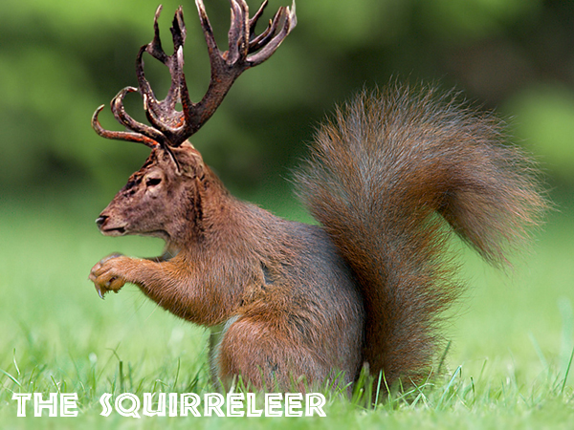
Weird Unicorn
By: Malia Fernandez

Slide 2
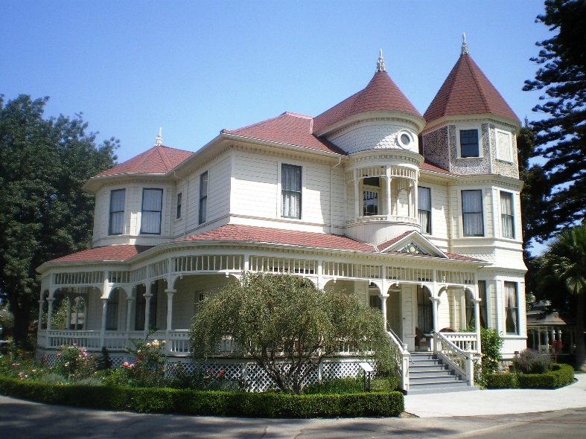
The beginning…
Casually walking down the valley you see a unicorn eating pizza you decide that you need the pizza more than him
YOU:
. Take the pizza and run
. Talk to the unicorn
You go home and buy your own pizza

Slide 3
PATH 1 talk to the unicorn
You sit down, the unicorn gives you a slice of pizza and tells you her magical powers ta da your a unicorn!
YOU WIN!!!!!!

Slide 4
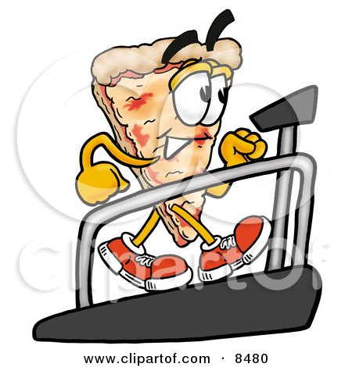
PATH2 take the pizza and run
You grab the pizza and run away the angry unicorn charges, you open the box only 1 slice left, it wasn't worth it dude
you died!!

Slide 5
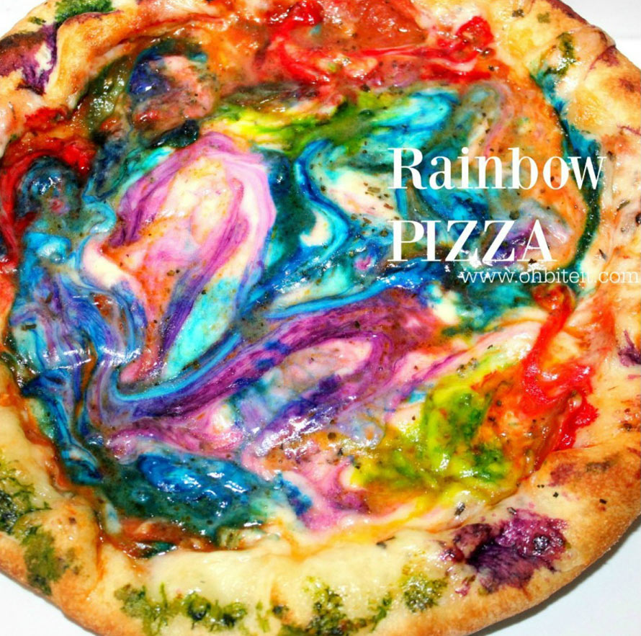
Path 3 get your own pizza
You head back home
You go to your local supermarket
You see a derpy purple octopus behind the counter
YOU
trust him and order your pizza
You call 911

Slide 6
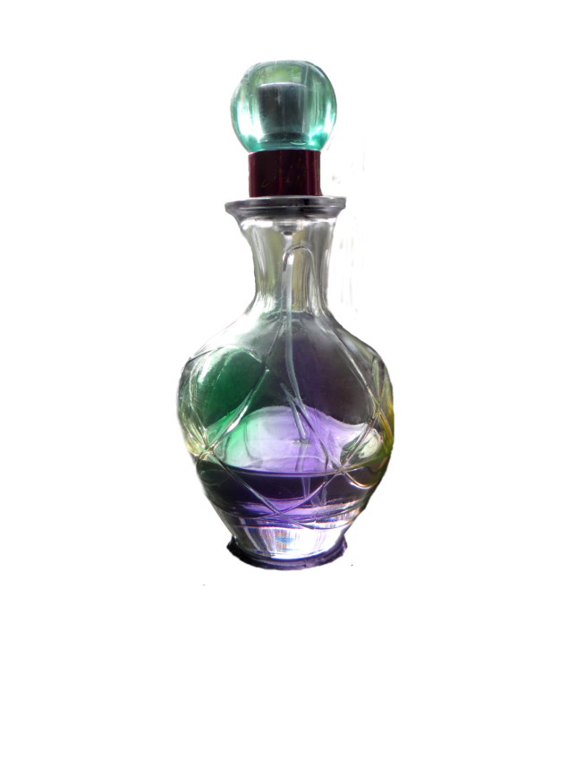
Trust and order
You trust him and order your pizza
You went home and ate the pizza he poisoned you
YOU DIED

Slide 7
Call 911
You call 911
Turns out Eli the evil octopus is a muder
YOU WIN

