Slide 1
Your Attack!
By Mariam

Slide 2
A Normal Day Becomes Weird
It was a nice day at Green Lake High and you were walking to the library to do your home work. When you were walking, you saw your best friends. “hey guys” you say. “hey want to come with us to the palace restaurant instead of your study session?”
Go with your friends
Go to study

Slide 3
Going To Study
I feel bad that I didn’t go with them. Oh well. You finish studying and look at your texts and the news. On the news it shows your best friends attacking your family.
Save your family
Go home

Slide 4
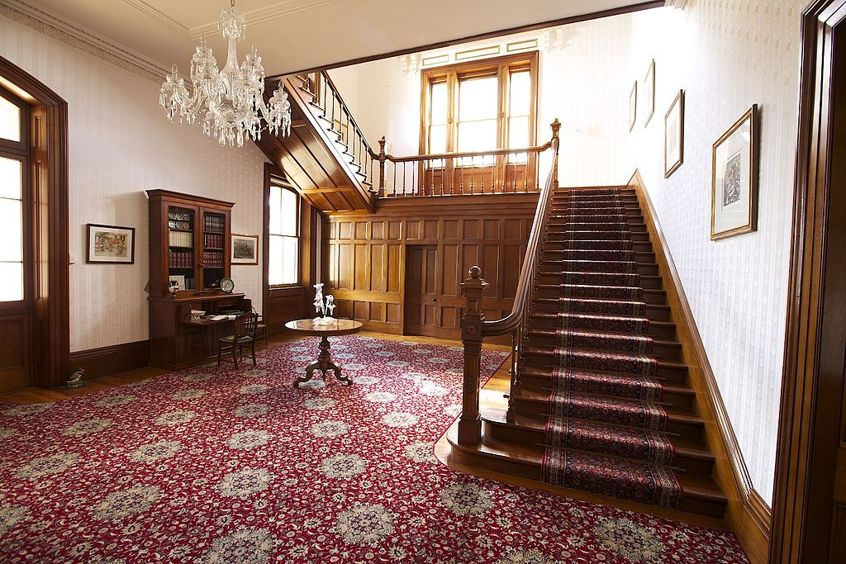
Going Home
You go home and your mind drifts from the situation. You hear a knock and when you open you get grabed
You died!

Slide 5
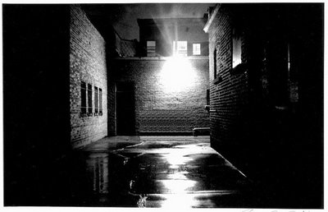
Going To The Palace
“Thanks for coming.” no problem you say. Your friends go into a dark ally that you don’t want to go into. You stay outside and eventually they come back. Your about to come home when your friends say “want to go to… anything really?” You and your friends don’t like the same things so pretty much the only reason you hang out with them is that they make you seem like the nice ,cool friendly person even though you know you're just a bookworm. Your about to say yes but before the words are out of you they say “never mind” and they leave.
Go home

Slide 6
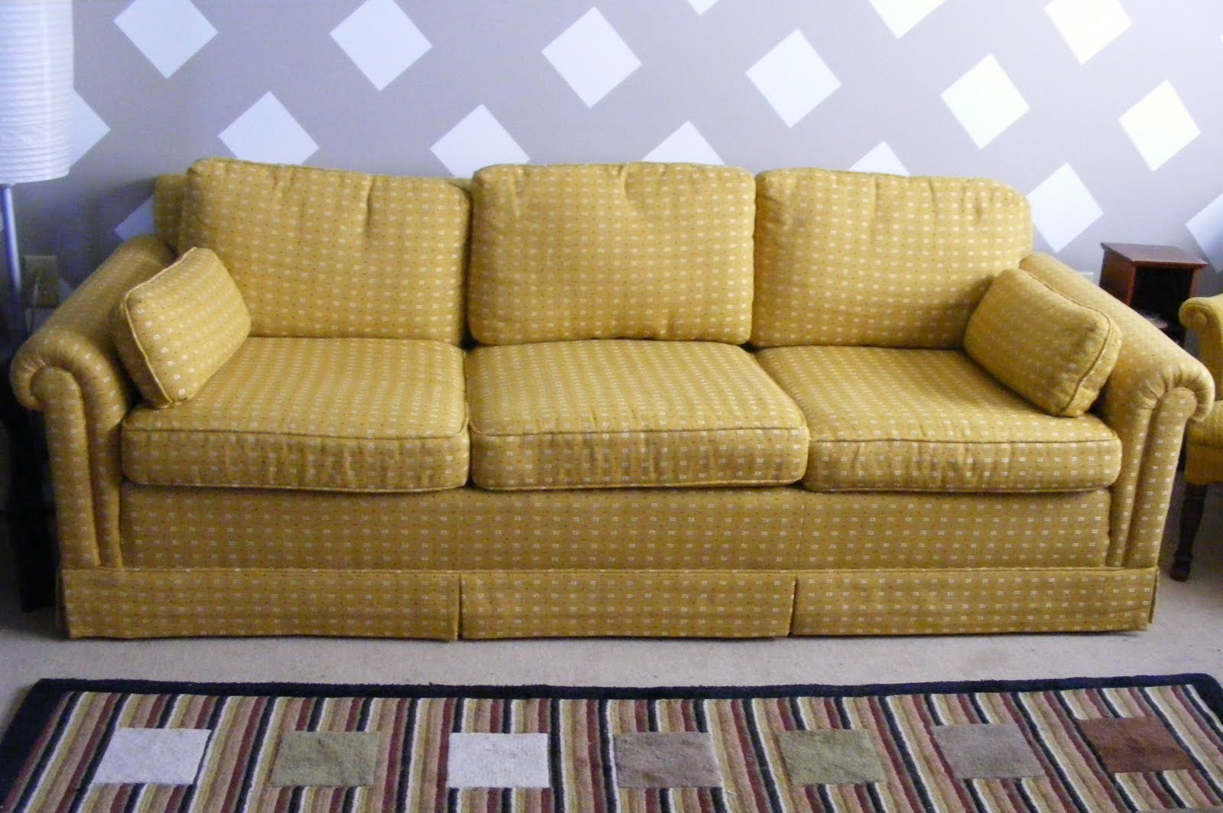
Going Home From The Place
You go home and just sleep till the next day. When you wake up you realize your family is gone. But your “friends” are gone too.
You win and lost.

Slide 7
Saving Your Family
You run to the place and see your family getting tortured but they are 100% fine. You are mad at your friends but soon calm down. Oddly enough, your friends just walk away
Go follow them
No way I’ve had enough excitement today

Slide 8
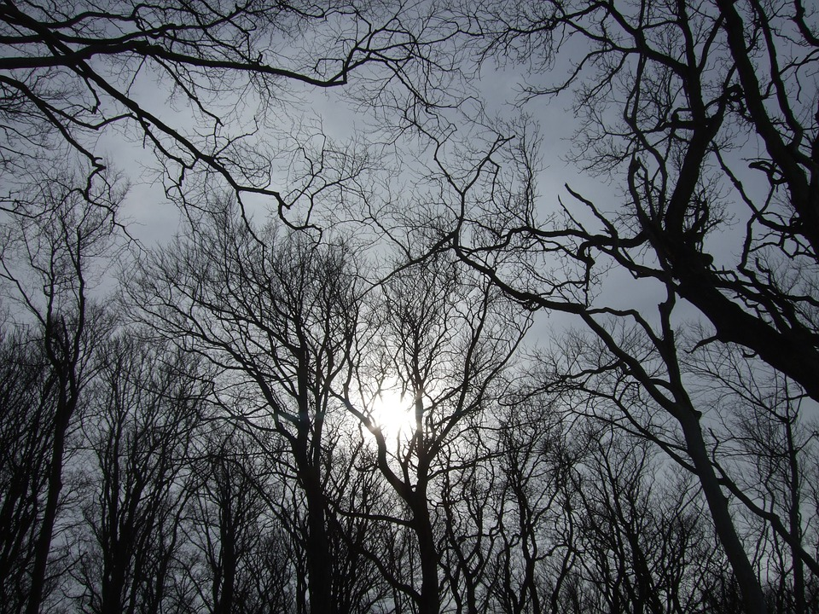
Following Them
You start to follow them but you get the feeling you’re being followed. You ignore it and keep walking. You hear something in the bushes but still ignore it. The noise is now louder than ever and your head is full of fear. Soon your about to ru-oh sorry your in a better place now.
You died!

Slide 9
Done With Excitement Today
You go home with your family and sit on the couch and watch TV. You soon make new friends that are actually good. You have a good life and enjoyed it.
You win!

