Slide 1
minecraft
mason

Slide 2
interduction
You spawn in a village.then you realize your in minecraft!

Slide 3
First choices
You have 4 choices.
To the village
To the mountians
To the forest
Build a house

Slide 4
village
You go the village and take shelter . Do you go to
Blacksmith
librarian

Slide 5
mountians
You go to the mountians.
A mob of creepers kills you.
again

Slide 6
forest
You go to the forest and a zombie kills you.
again

Slide 7
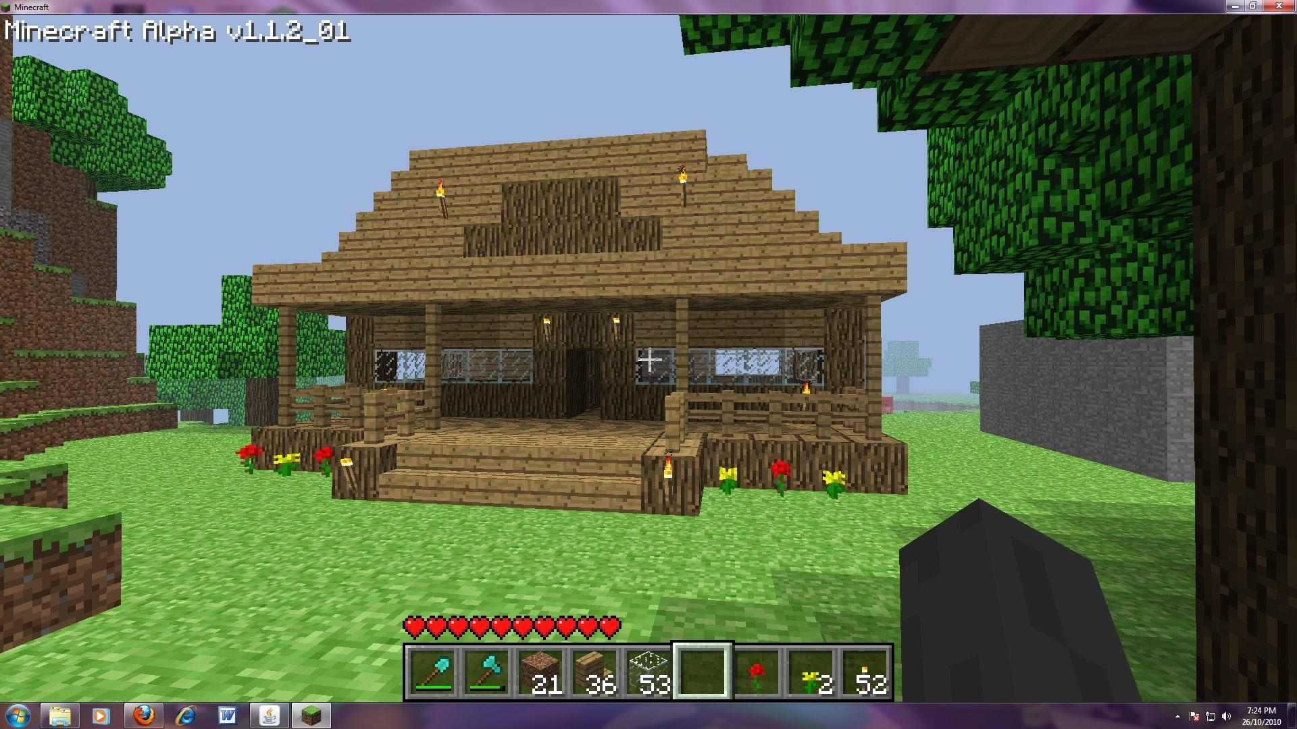
house
You build a house.
In the morning do you go to
The village
stay

Slide 8
blacksmith
You go to the blacksmith shop.do you
Take armor and get out
stay

Slide 9
library
You wait out the night.do you
Stay
go

Slide 10
Stay at house
You stay at the house and are killed by a creeper.
restart

Slide 11
Stay at library
You stay .do you
Go outside
Go through a tunnle

Slide 12
go
You go and you knock into a lava caring blacksmith.
restart

Slide 13
Stay at blacksmith
Do you
Tear it down
Build a house

Slide 14
Tear it down
You tear it down and a angry villager kills you.
restart

Slide 15
tunnle
You go through a passage.there are 3 other passages.
Right
Left
Forwards

Slide 16
right
You go right and see a glowing stone.
Grab it
Don’t grab it

Slide 17
left
You go left and 90000 zombies kill you
again

Slide 18
forwards
You go forwards an die by lava
again

Slide 19
Grab it
You grab it and teleport to the real world.
You win!
again

Slide 20
Don’t grab it
You stay and a trapdoor opens beneath you.
You fall into lava and die.
again

