Slide 1
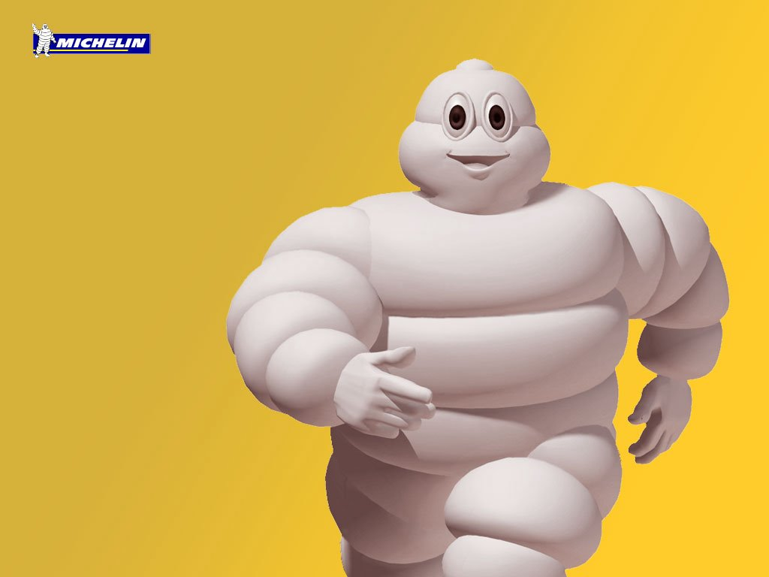
Mr.Ball By Max Wheeler
Your name is Fredrick D. Ball, you are a Collage physics teacher, your body and head are very round like a ball, you are a teacher by day and a super hero by night. You get home after a long day of teaching people how gravity and space works. And then, suddenly you hear a giant BOOM!!!! You have 3 choices.
Choice 1. You don’t care, your tired
Choice 2. You quickly get on your costume and travel through space to the location of the sound.
Choice 3. you venture to the mall to get a new pair of sneakers

Slide 2
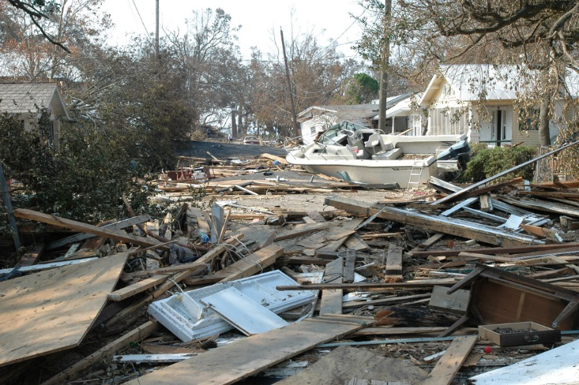
Path 1
You are tired and go to bed. The next day you wake up and see that a lot of people have died, and more importantly, your favorite burger place gets demolished!!!!!!!!!!!!!
YOU LOSE

Slide 3
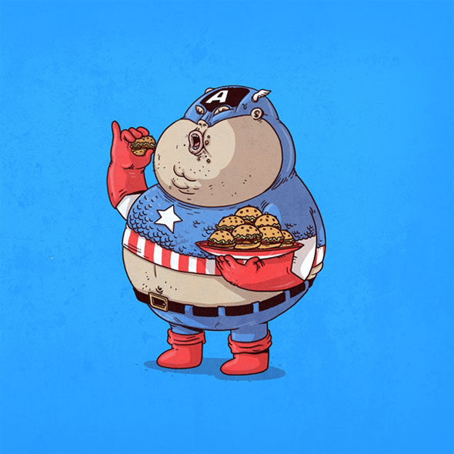
Path 2
once you got your costume one you got your burgers and left. You found out that the big noise was a GIANT SQUID!!!!! You
can:
1.Run away in horror
2.Try to fight the giant squid
3.Eat your burgers than fight

Slide 4
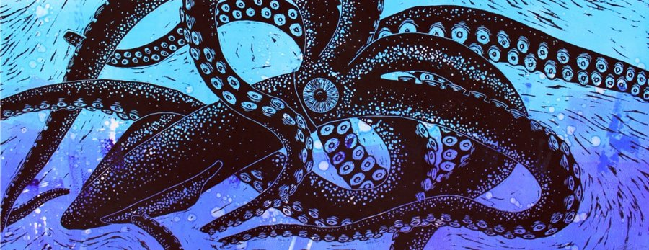
Path 4
You quickly run away and drop your burgers, so you run back to get them and the squid noticed you, so you only get a couple before the squid eats you!!!!!!!
YOU LOSE

Slide 5
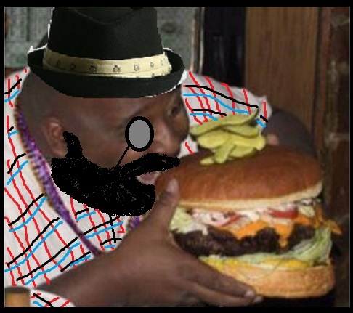
You go to the mall and get some yeezys and KDs. You go to the play groung and even though your fat you show up some kids talking smack by breaking their ankles. I guess we will never know what that sound was, COOL!!!!!!
YOU WIN!!!!!!!

Slide 6
You try to eat your burgers but you just make yourself fatter for the squid!!!!!!!
YOU LOOSE

