Slide 1
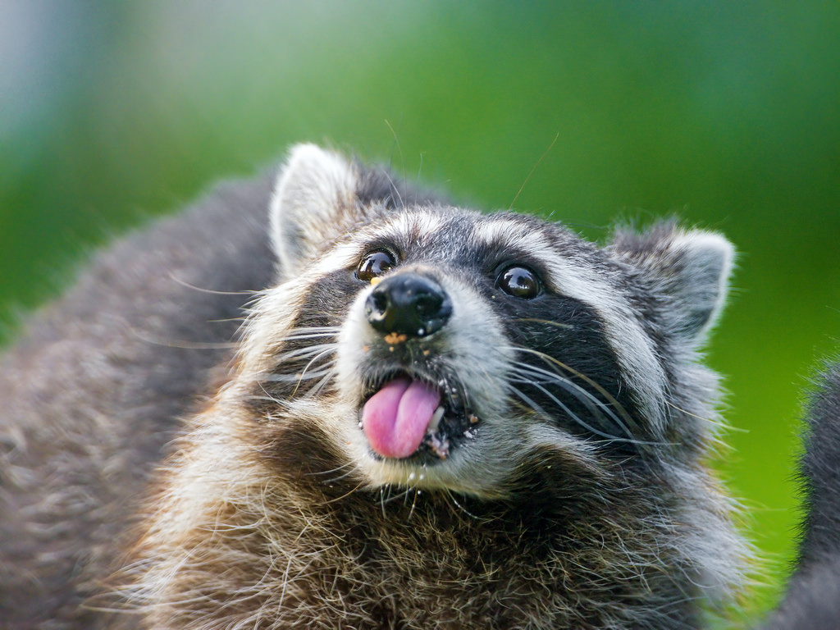
Animal picshrs

Slide 2
moose

Slide 3
Wolf

Slide 4
T rex

Slide 5
mouse

Slide 6
porcupine

Slide 7
kiten
kitten

Slide 8
pig

Slide 9
owl

Slide 10
penguin

