Slide 1
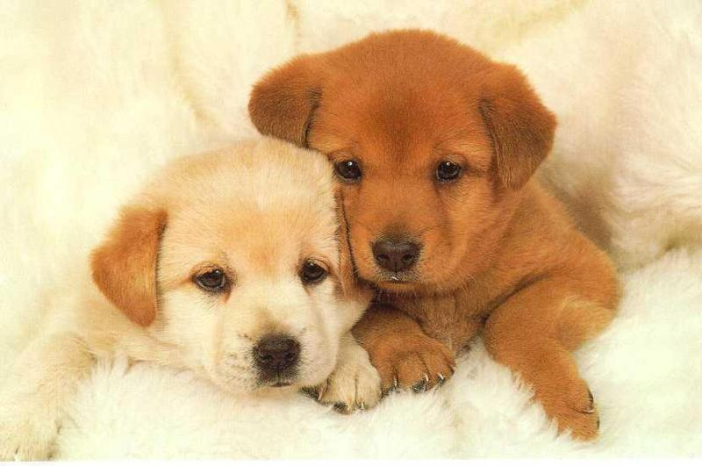
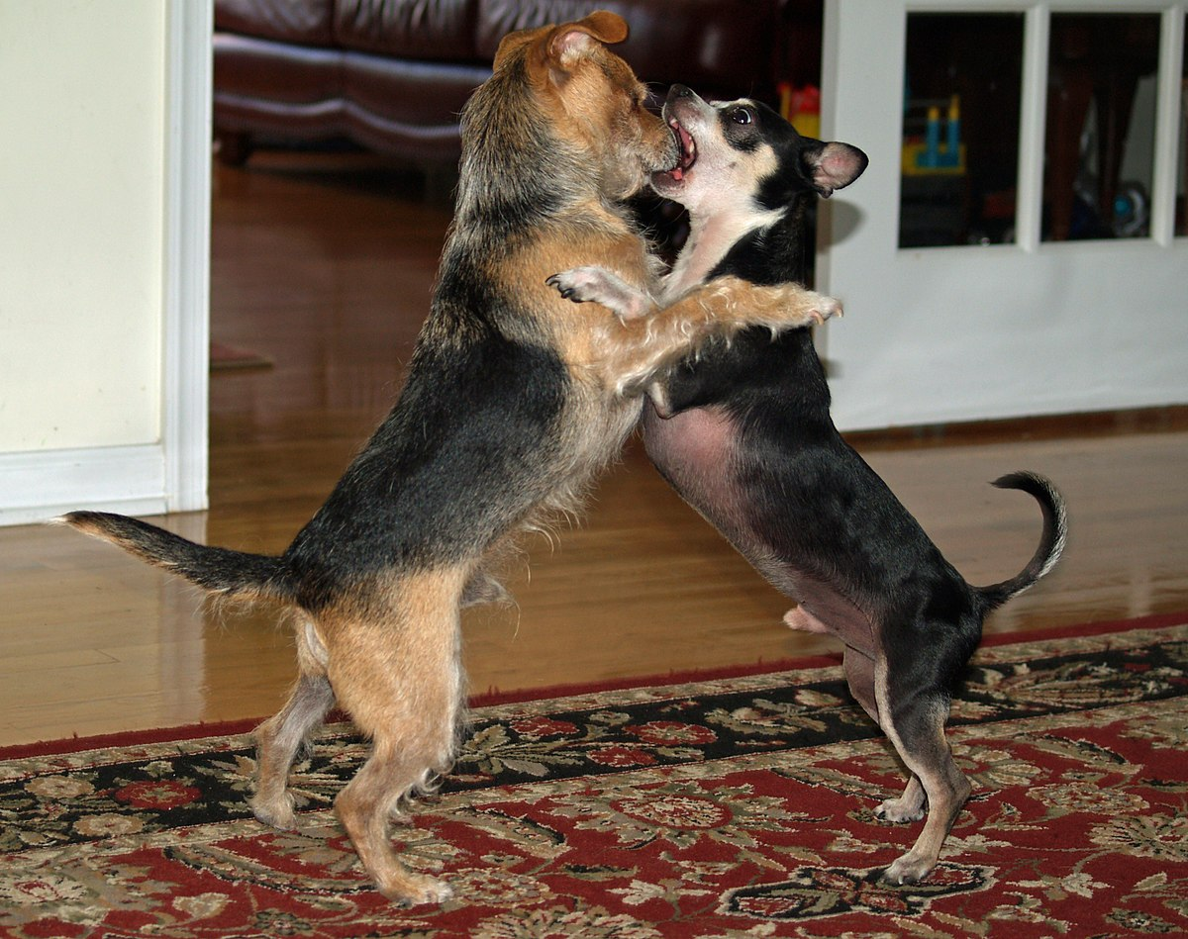
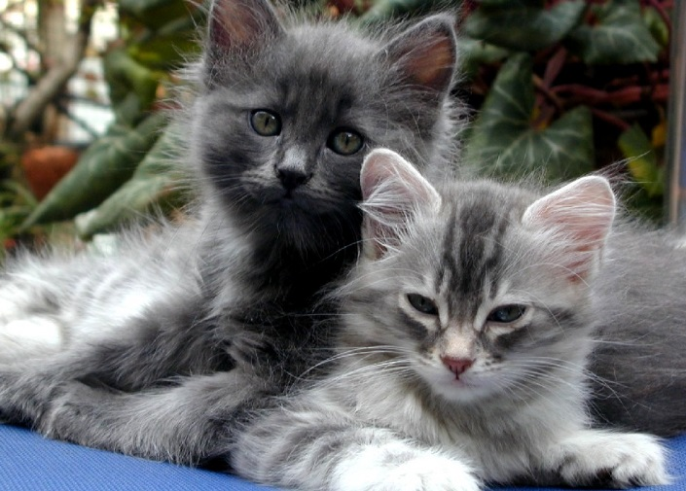
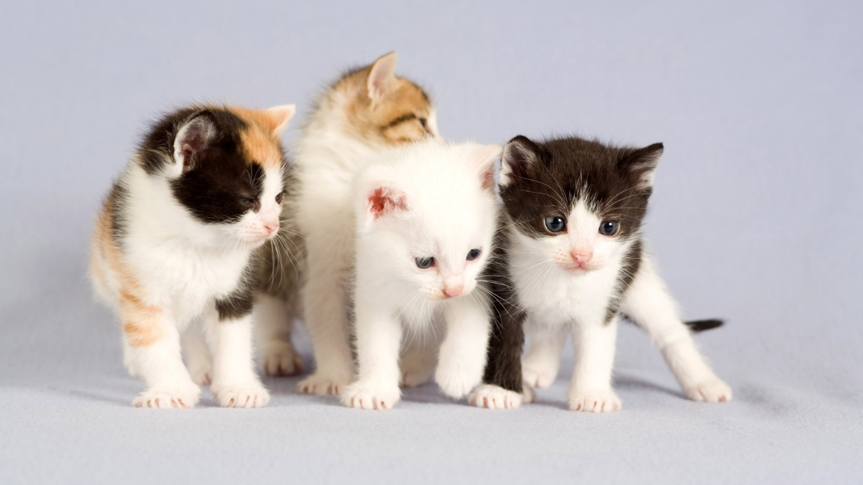
Maynard
Its raining cats and dogs

Slide 2
The adventure begins…
Its morning, you wake up. You hear a noise outside….
Go back to sleep
Investigate

Slide 3
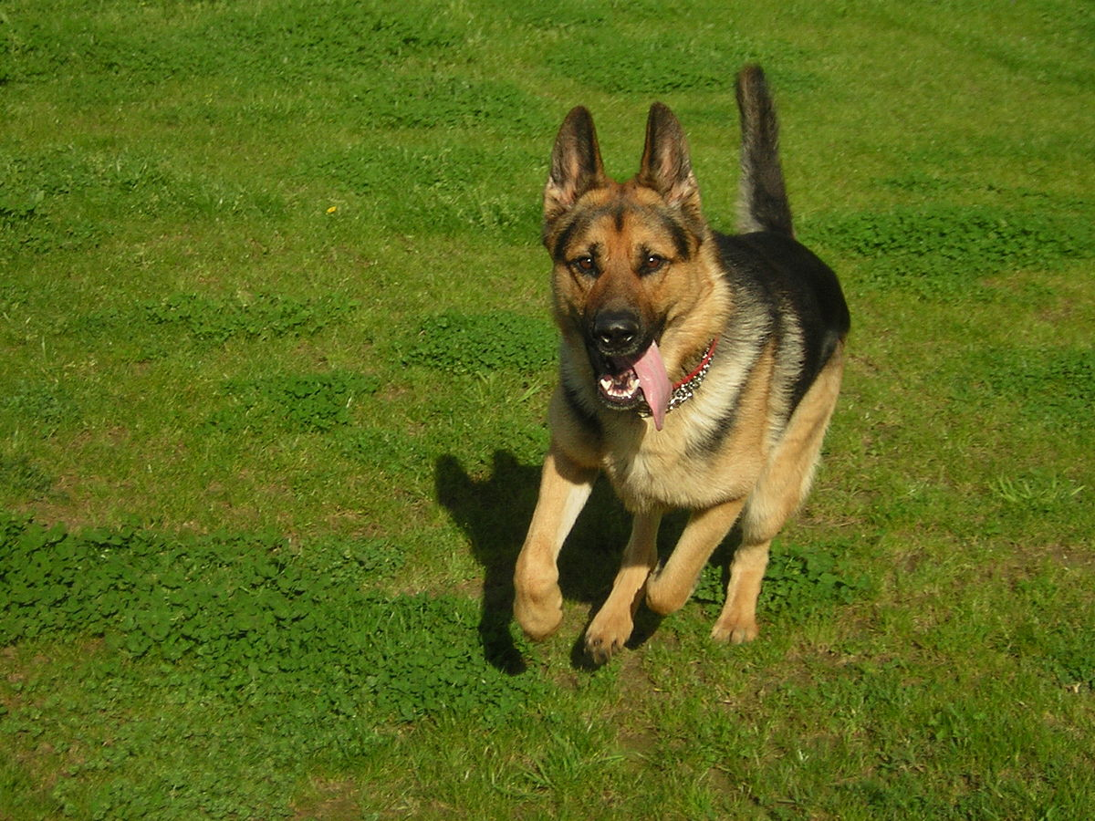
Go back to sleep
The mother dog jumps on you
GAME OVER

Slide 4
Investigate
You look out your telescope. You see 1000000000000000 dogs and cats what do you do
Adopt one or
Kill them

Slide 5
Adopt one
You adopt one and you live forever

Slide 6
Kill them
The mother dog jumps on you
Game over

