Slide 1
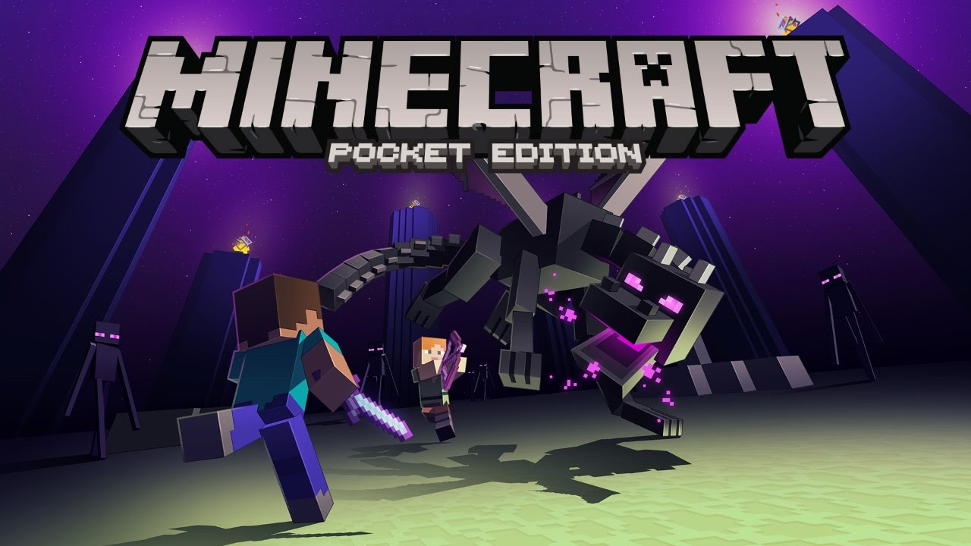
minecraft

Slide 2
Once apon a time , there was a minecraft person named Steve and his Friend Alex.

Slide 3
You suddenly, change into Gabriel in the End.

Slide 4
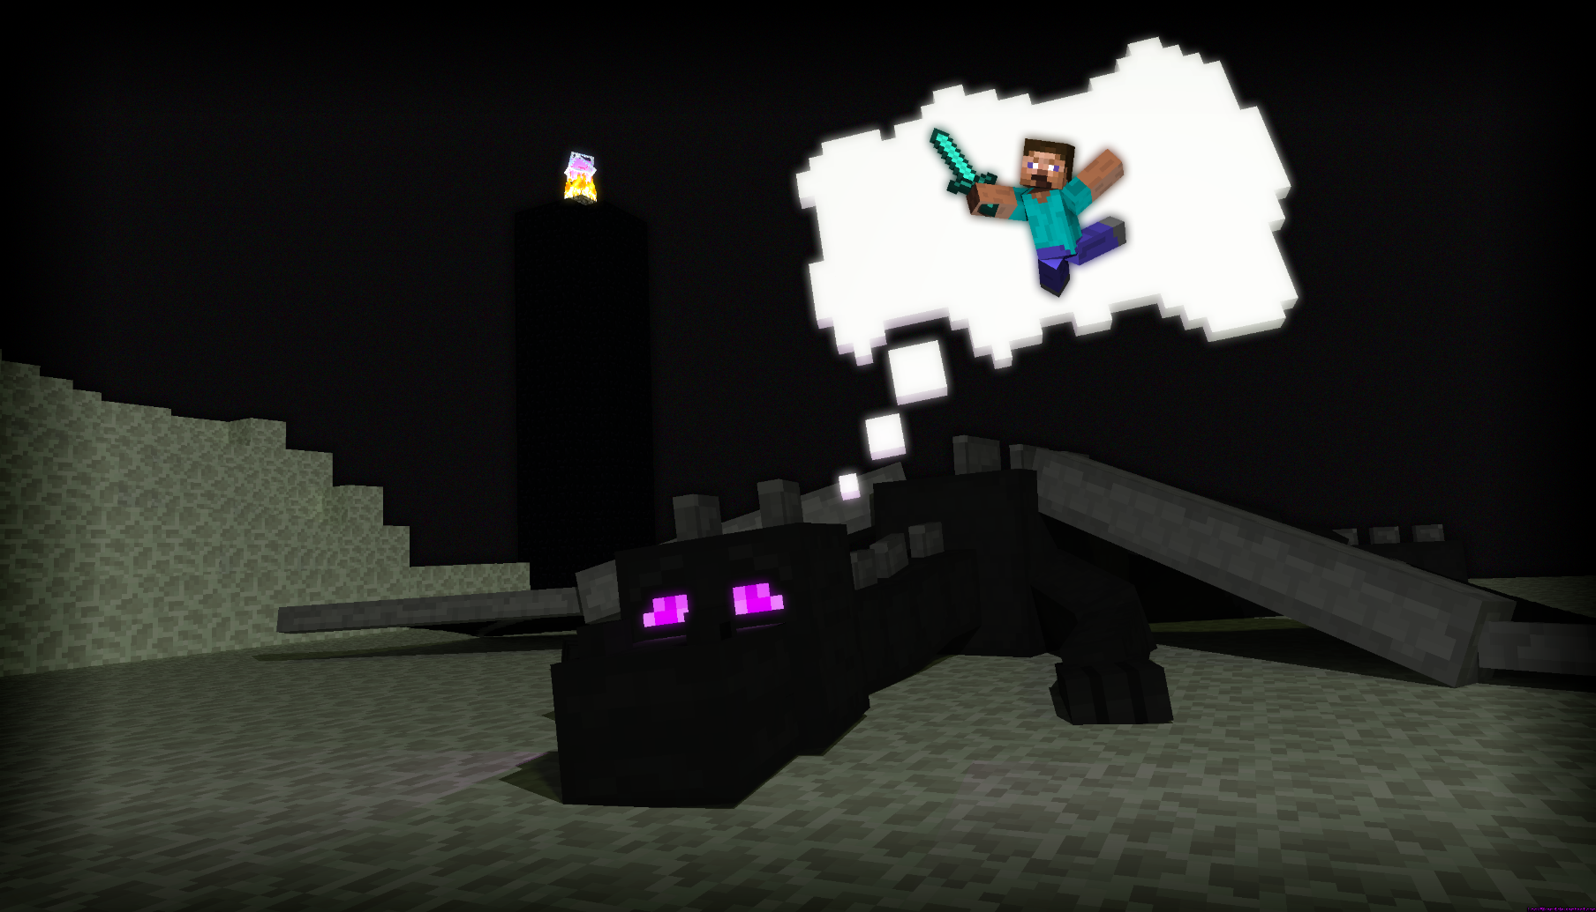
Sudenly, Alex saw the Ender Dragon. She quickly called Steve and Steve. You have three choises.
Get out your sword.
Get out your bow.
Tell your dog to attack

Slide 5
DOG
Your dog fights and he wins.!
you 1

Slide 6
sword
YOU TAKE OUT YOUR SWORD.YOUDIE.!

Slide 7
bow
You take your bow.YOU DIE.!

