Slide 1
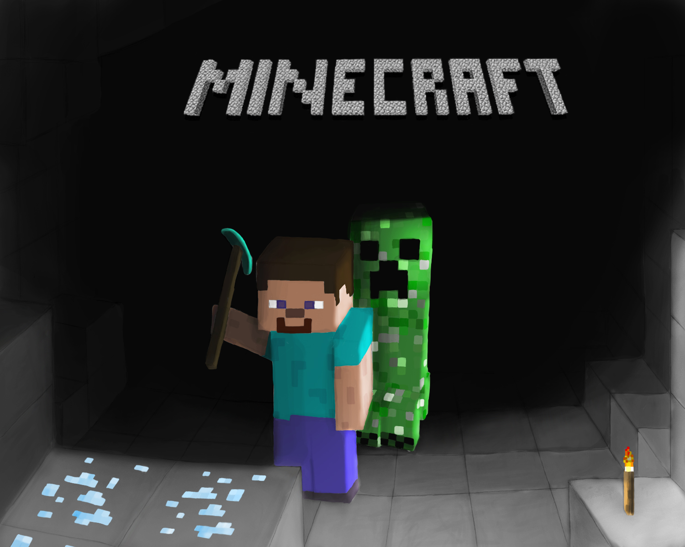
Minecraft
By sarah hobaish

Slide 2
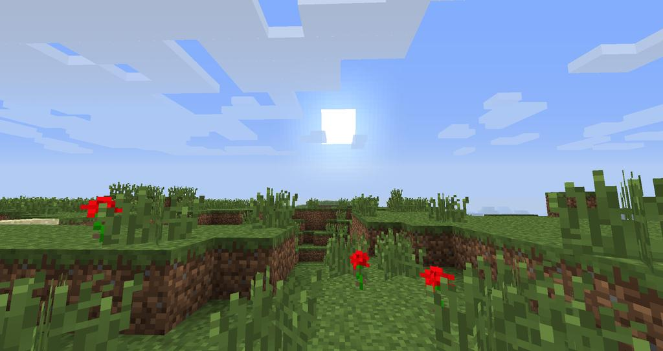
Its your first day
Its your first day on minecraft! So much to do and so much to see!
You settle on these options, but you cant decide! Which one fits you?
Choose your desired option, settle in on a house, stolen or built!!!!!!!!!
STEAL A HOUSE!!!!!!!!!! or Build a house!

Slide 3
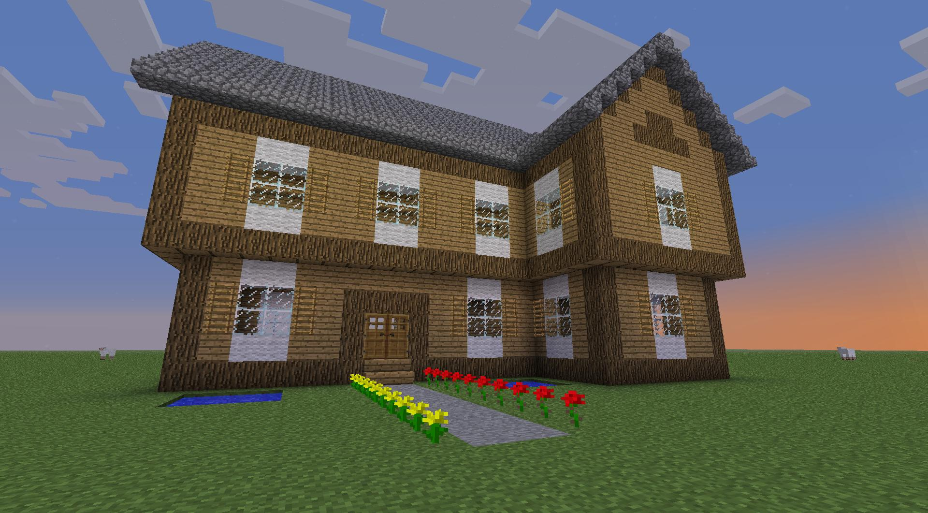
Build a house!
You decide to build a house. You work all day and the sun went down by the time you are finished. Luckily you are protected from zombies but unluckily you realize you don’t have a bed. What do you do?
Wait for daytime
Get supplies

Slide 4
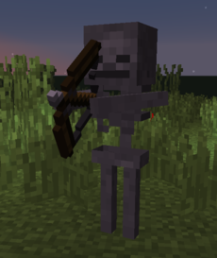
Get supplies
You are willing to do the dangerous, you storm out of your house and try to get supplies for the bed. You die from a skeleton instead. You respawn but you don’t have a house anymore

Slide 5
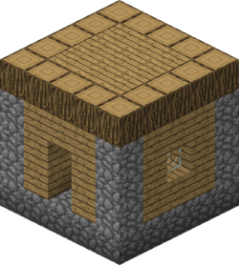
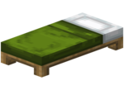
Then it happens…
You stole a house since building one went wrong. It is really small and only has a bed in it that is colored green. You die a bunch of times YOU LOSE!!!!

Slide 6
Wait for daytime
You wait for the day then get supplies and you go back in your house.
YOU WIN!!!!!

Slide 7
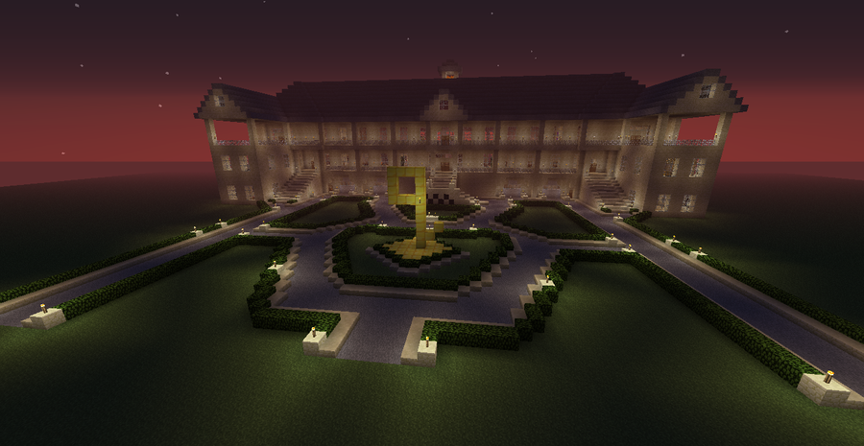
Steal a house!!!!!!
You stole a house! It turned out to be a huge mansion with a lot of furniture and food and you live happily ever after the end
YOU WIN!!!!!!!!!!!

