Slide 1
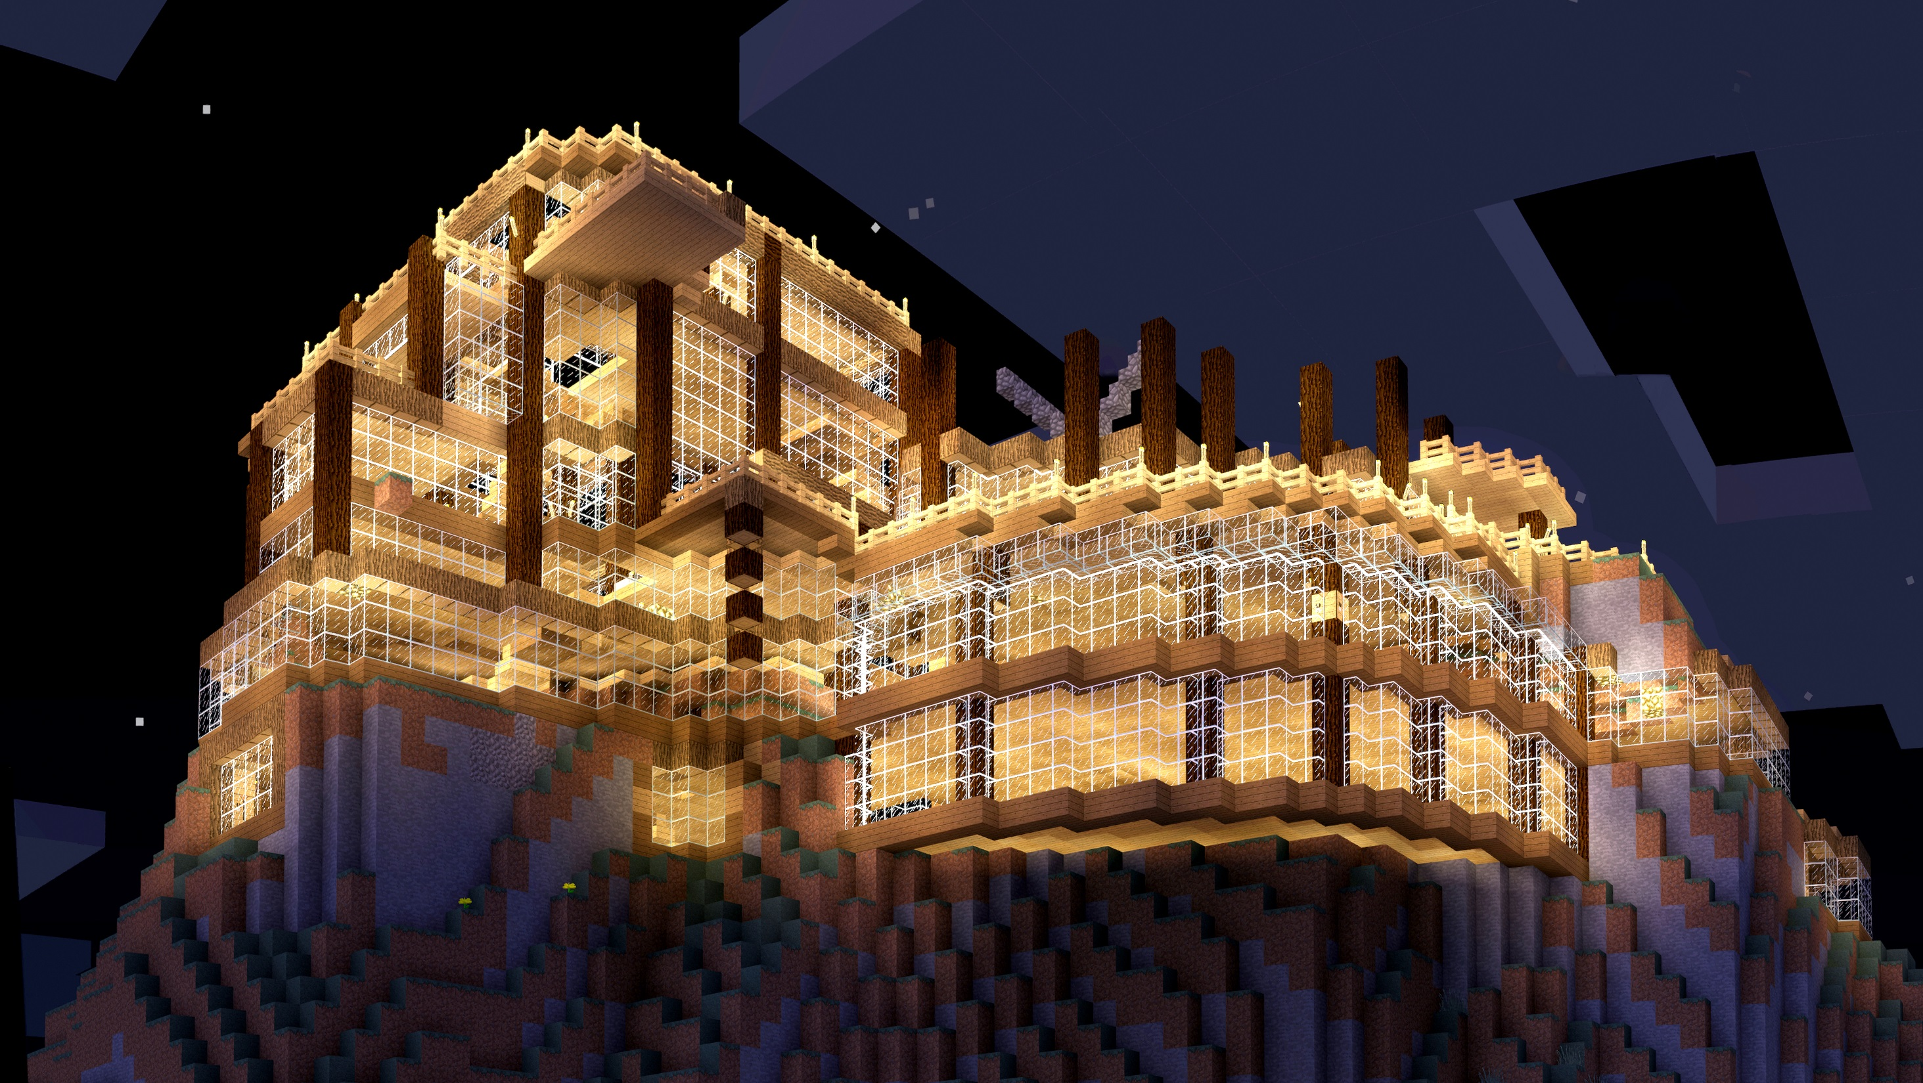
Minecraft houses.

Slide 2
House 1

Slide 3
House 2

Slide 4
House 3

Slide 5
House 4

Slide 6
House 5

Slide 7
House 6

Slide 8
House 7

Slide 9
house 8

Slide 10
Batmans house

Slide 11
Batmas cave

Slide 12
Avengrs tawer

Slide 13
Avengrs tawer

