Slide 1
ADVENTURE STORY
By:FINN.W!!!!!!!!!!!!!

Slide 2
Once in a world faaar away…in a city called finnopilis!!!!!!!!!!!!!!!!!!!!!!!!!!!!!!!!!!!!!!!!!!!
A dark figure swooshes over a building…
ITS MUTANT ROBOT!,THE MOST FEARED ROBOT OF ALL TIME

Slide 3
Do you run and hide do you fight the robot

Slide 4
You die!!!
You fight the robot!!
But he easily punches you and you and you
die
Game
Over!!!

Slide 5
You run and hide in a slimey cave
It’s the mouth of a
Giant ant!!!
Do you: run
Do you: fight

Slide 6
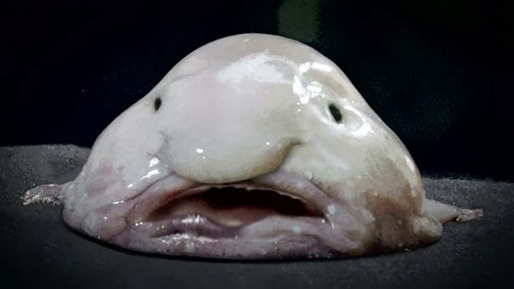
You run! Bad choice!!! You run to a monster
He eats you to bad! game
Over!!!

Slide 7
You win!!!
You fight the ant!
You defeat the ant!!!

