Slide 1
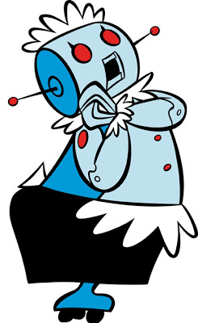
the crazy bot

Slide 2
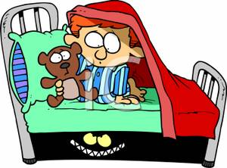
1.You go outside and you see the bot but the bot dosen’t
2.You stay inside protect yourself

Slide 3
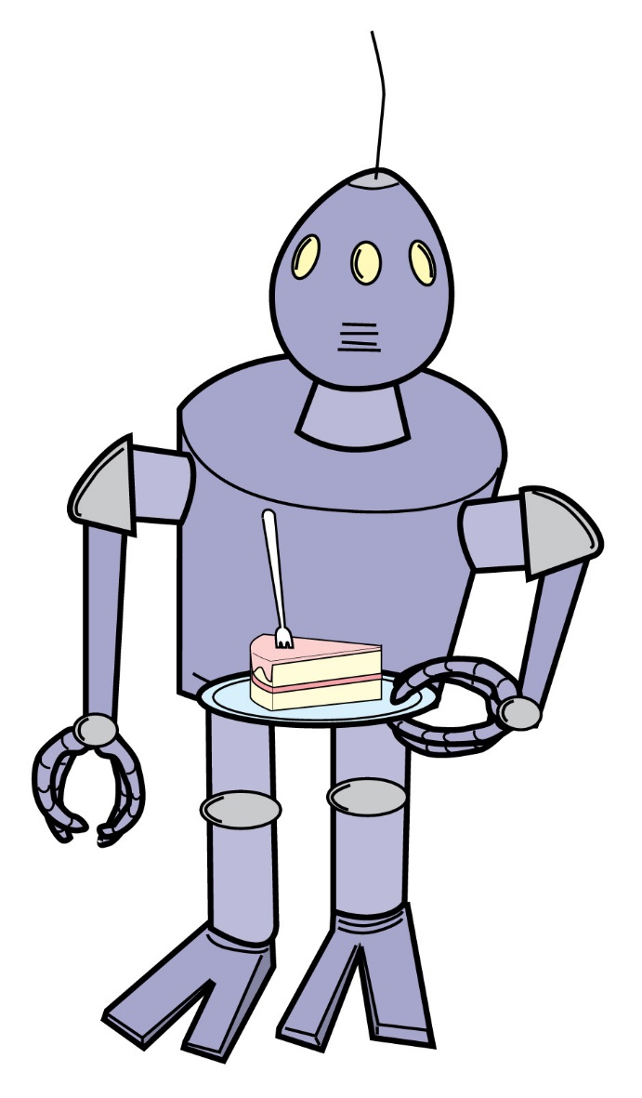
The bot turns around and sees you and attacks and
You die

Slide 4
You get a gun and try to attack

Slide 5
game over restart

Slide 6
You win you go outside and hit him and he dies you win

Slide 7
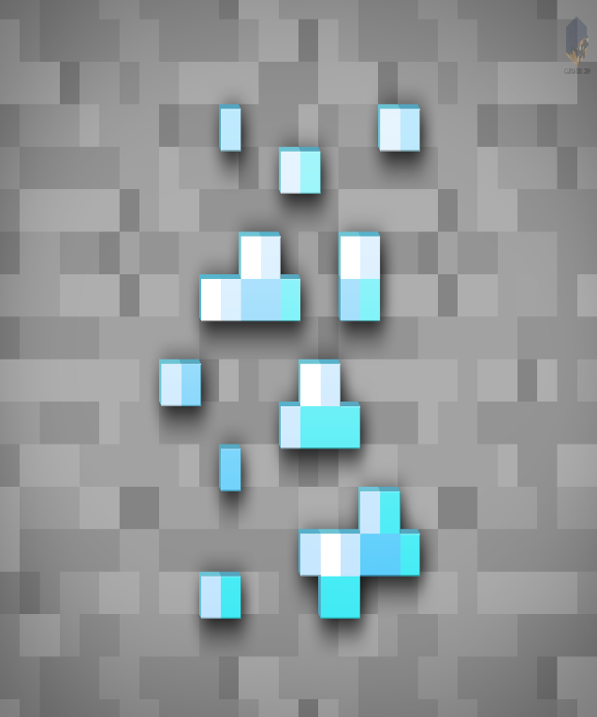
You win yeah

Slide 8
Restart you died

