Slide 1
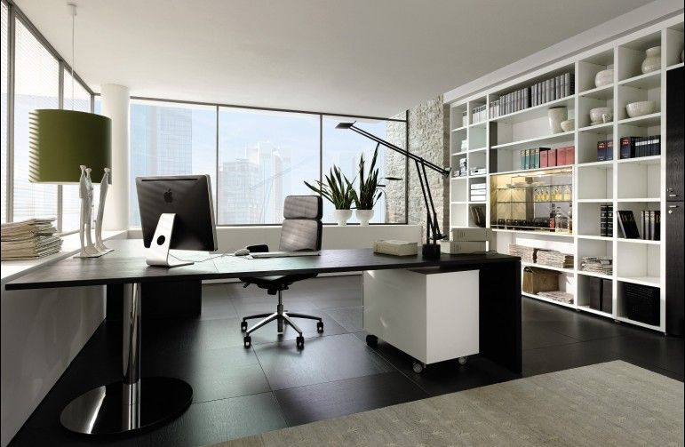
Work day
By: Olivia

Slide 2
Once upon a time…
You wake up to your alarm and you have 30 mins until work.
Choice one: take a shower
Choice two: get dressed
Choice three: go back to bed

Slide 3
Path 1
You take a shower and you find that you are late you get to work late for the 3rd time this week.

Slide 4
Path 2
You get dressed and you leave home and your car broke down …
Choice 1: Run to work
Choice 2: you call a taxi

Slide 5
Path 3
You go back to bed and get fired

Slide 6
Path 1
You run to work
You win

Slide 7
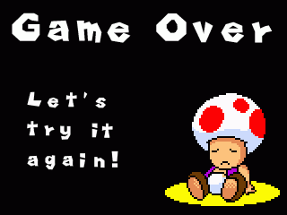
Path 2
You call a taxi and it turns out it was a kidnapper and you die

