Slide 1
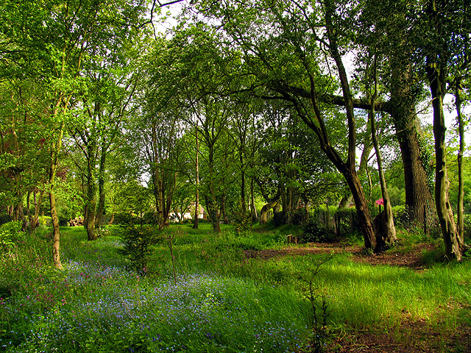
The Woodland Adventure
By: Owen Maxwell

Slide 2
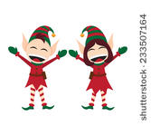
In a heavily wooded forest…
You are traveling with your Elvin friends in the forest of eternalia when you suddenly get separated. Your friends want to go back but one wants to stay. Do you
Go back
Keep going
Or stay there

Slide 3
Go back
You go back and you find your friends do you
Stay with them
Go on your own

Slide 4
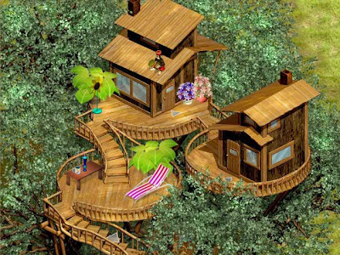
Keep going
You keep going on the path and find an abandoned tree house do you
Go in
Stay out

Slide 5
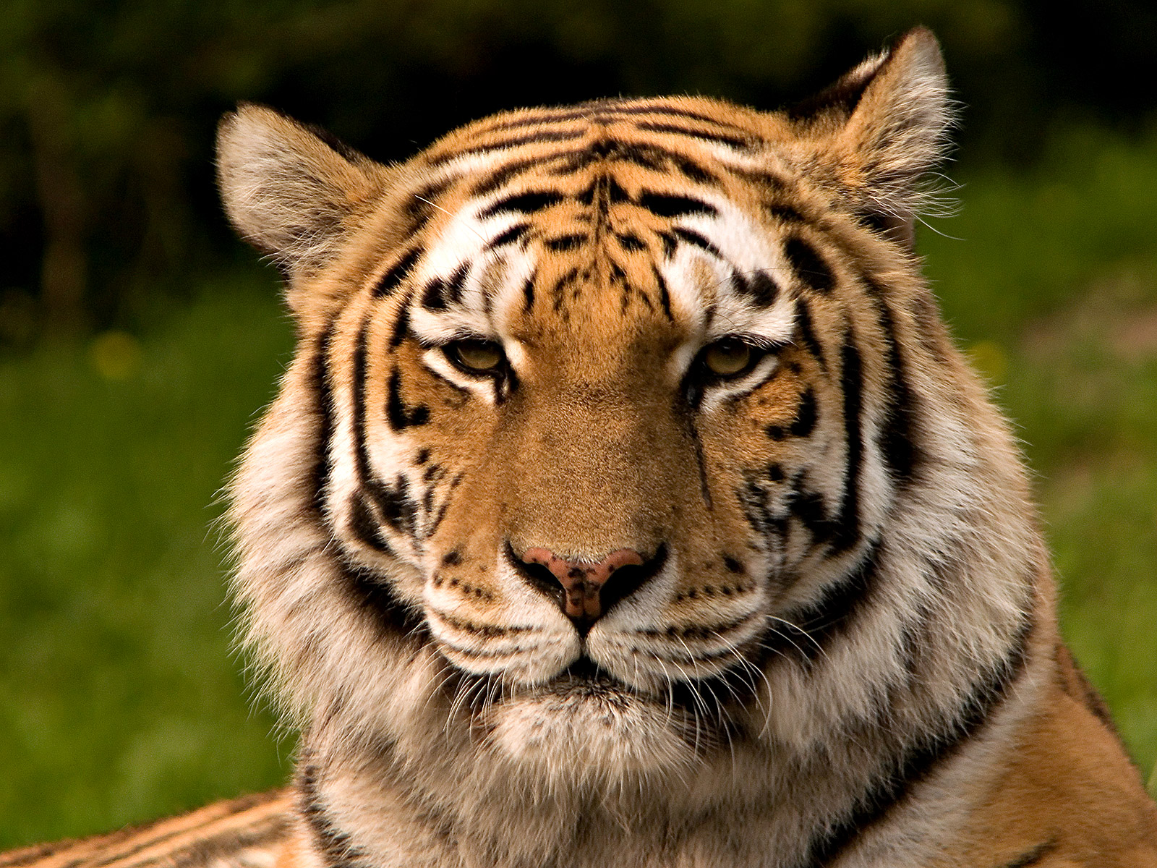
Stay there
You see something approaching you…
It’s a giant tiger
You get eaten
Game over

Slide 6
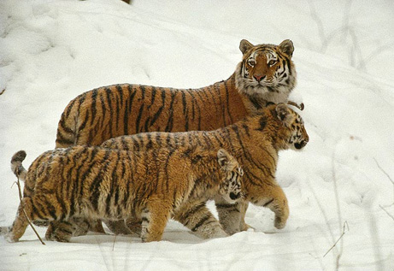
Stay with them
You all get eaten by a giant tiger pack
Game over

Slide 7
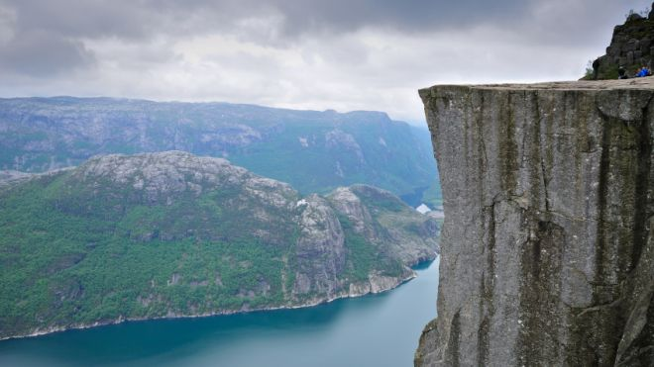
Go on your own
You go on your own and walk of a cliff
You lose

Slide 8
Go in
You go in and find a scroll
You get teleported to home
You win

Slide 9
Stay out
You keep walking and find a river
You decide to sleep there
The next day you get back out do you
Catch a taxi
Go back to the tree house

Slide 10
Catch a taxi
The taxi driver punches you in the back of the head
You lose

Slide 11
Go to the tree house
You live in the tree house for the rest of your life
You win

